Slide 1
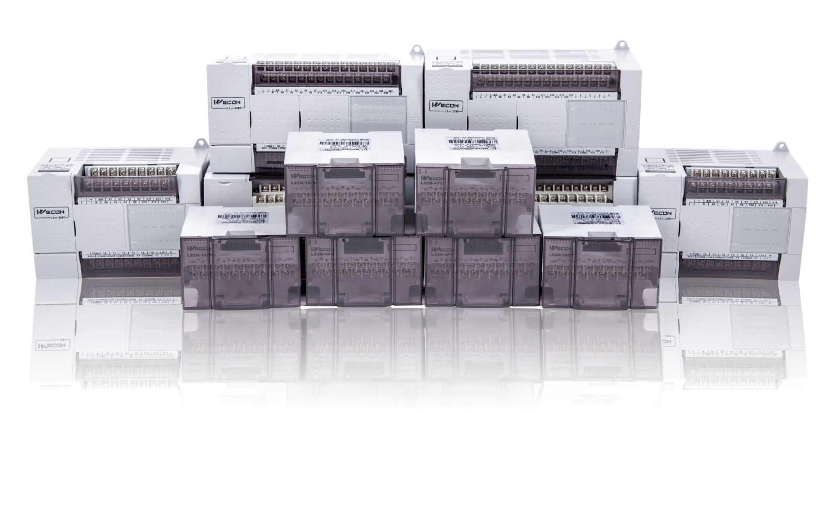

WECON PLC
http://www.we-con.com.cn/en/
Notes:
WECON PLC introductions.

Slide 2
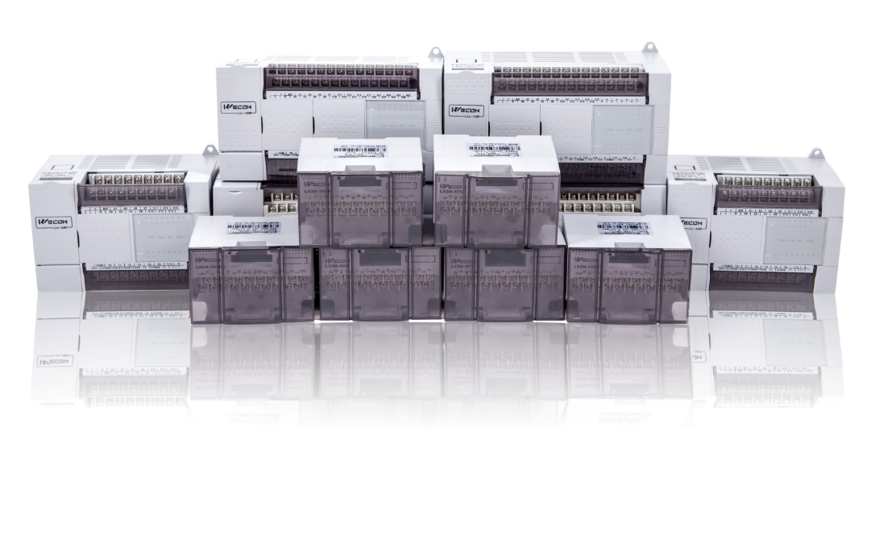
Contents
01
PLC Unit
02
Expansion Module
03
BD Board
04
Software Features
05
Application Case
Notes:
Today we will introduce the information of PLC CPU, expansion modules and BD modules, also software features and applications are introduced at the same time.

Slide 3
01
PLC Unit
Notes:
Firstly, is about the PLC CPU

Slide 4
4 sub-series
01
02
03
04
LX3V
LX3VP
LX3VE
LX3VM
Basic PLC model, which contains the general functions of the PLC.
High speed type PLC, it contains all function of LX3V, but provide high speed output function.
Motion control PLC, it contains all function of LX3VP, but provides motion control function.
It contains all the function of LX3VE, and it provides circular interpolation function.
Notes:
For PLC CPU, it divided into 4 sub-series, the names of the four sub-series are LX3V, LX3VP, LX3VE, LX3VM. There is a functional difference between each series, which will be introduced in detail later.

Slide 5
PLC naming rule
Expansion high speed output
4H: 4 channels
2H: 2 channels
Instruction set
1: LX1S Series set
2: LX2N Series set
Serial name, such as LX3VP, LX3VE
PLC CPU
LX3V-2416 M T 4H-A 2
I/O: 24 input, 16 output
Output type:
T: Transistor
R: Relay
Power supply:
A: AC 85~265V
D: DC24V
Notes:
This is the naming rule of PLC, use LX3V-2416MT4H-A2 as example. LX3V means series name, 24 means digital inputs, 16 means digital outputs, M means CPU, T means output type is transistor, another type is relay, use R as mark. 4H means 4 channels high speed outputs. A means PLC requires AC power supply, it also supports DC power supply, and marked as D. 2 means compatible with LX2N PLC. 1 means compatible with LX1S PLC.

Slide 6
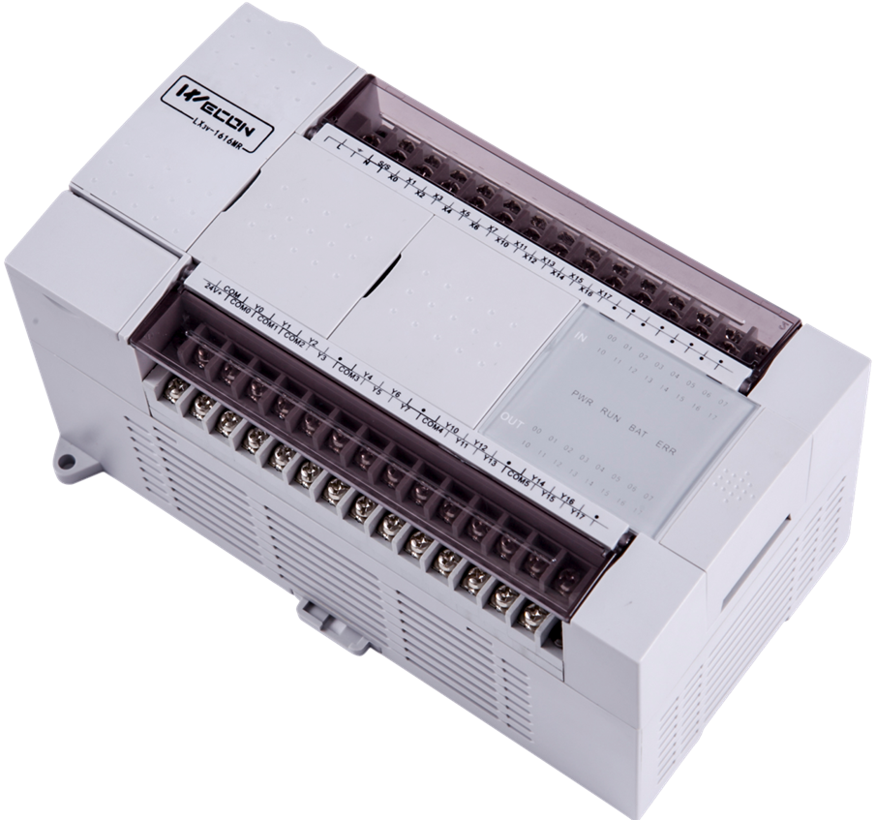
LX3V features
Unique kernel encryption
Unique PLC chip-level encryption, eliminate all possible cracks
Multiple password to prevent the program from being maliciously cracks
High speed input
2*200K+4*10K
2 channels AB phase pulse supported and frequency multiplier function
High speed output
2*200K+2*10K
Pulse output for Acc./Dec. and positioning
Multi-port
It supports up to 6 serial ports(with 2 485 BD boards)
Micro USB port for programming
PID function
PID (self-tuning and manual tuning)
Fast output response, high stability, smooth curve
Notes:
Let's see LX3V PLC feature. This is basic model, so it supports basic functions, like high speed inputs and outputs, PID function, encryption and so on.

Slide 7
LX3VP features
More high speed outputs
There are four channels(up to 200khz for each channel) high speed output port.
Larger capacity
With 64K ladder program capacity. (for LX3V, it is 16k)
N:N protocol
Up to 8 plc can communicate with each other.
1ms timer
T50~T191: 1ms non-accumulated timer to meet more requirements on timer function. (m8020 need to be on)
Notes:
LX3VP includes all the functions of LX3V, and on this basis, it has a larger storage space, more 1ms timers and the N: N protocol is standard.

Slide 8
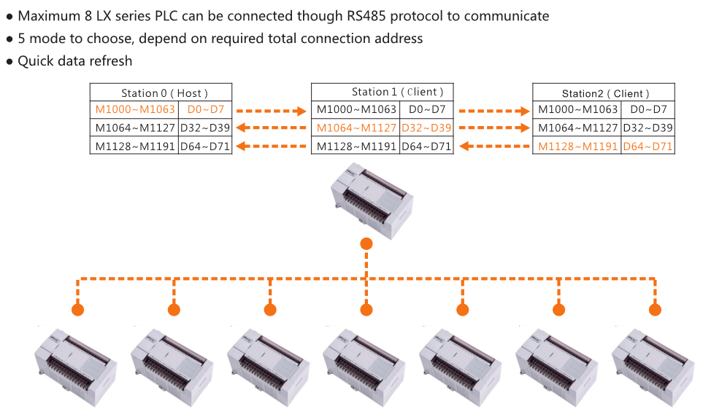
N:N network function
Notes:
This is the introduction of N:N protocol, this function combines multiple PLCs into a working network to realize the synchronization of various PLC data and functions. Maximum 8 PLCs are supported in a network.

Slide 9
LX3VE features
More high speed outputs
With four high speed output ports(up to 200khz for each port).
Larger capacity
With 32K ladder program capacity.
Motion control
S-type acceleration and deceleration;
The time for acceleration and deceleration are independent;
E-CAM
E-CAM function is supported for motion control
Notes:
LX3VE is motion controller, it includes all the functions of LX3V, and on this basis, it has a larger storage space, S type acceleration and deceleration for motion control and electronic cam function is standard.

Slide 10
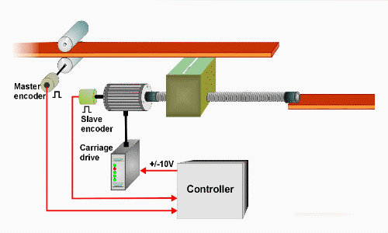
E-cam：Flying cut
The reciprocating action of flying cut.
Notes:
This animation shows flying cut, it is one of the classic applications of electronic cam;

Slide 11
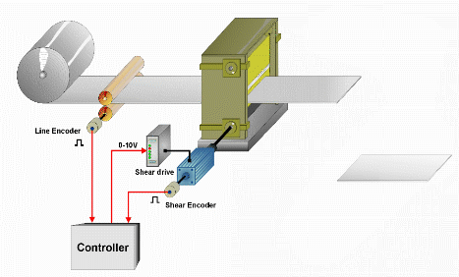
E-cam：Rotary cut
The circular motion of rotary cut.
Notes:
This animation shows rotary cut, it is one of the classic applications of electronic cam;

Slide 12
LX3VM features
Interpolation
Circular and linear interpolation for motion control.
Larger capacity
With 32K ladder program capacity.
Motion control
S-type acceleration and deceleration;
The time for acceleration and deceleration is independent;
E-CAM
E-CAM function is supported for motion control
Notes:
LX3VM is also motion controller, in includes all the functions of LX3VE, and on this basis, circular and linear interpolation are standard.

Slide 13
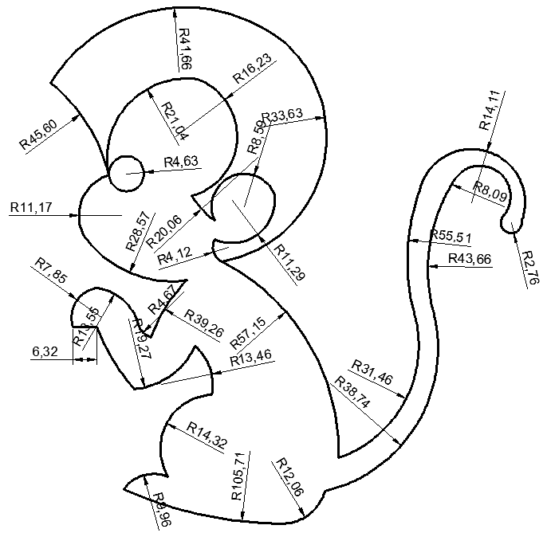
Circular interpolation
The demo video of circular interpolation.
Video
Notes:
This video shows circular and linear interpolation in LX3VM PLC.

Slide 14
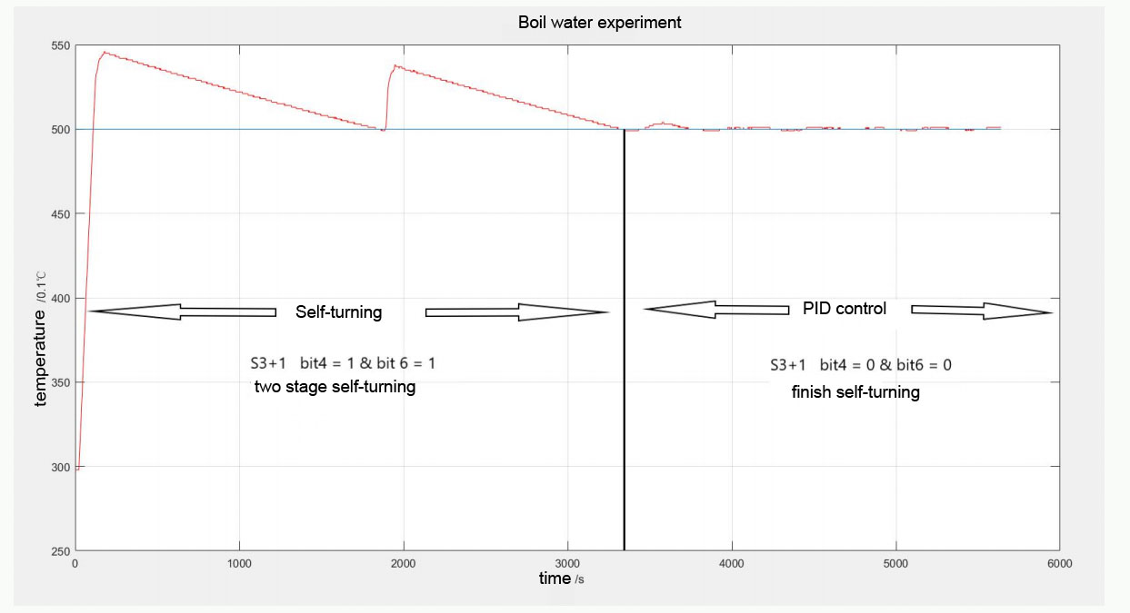
CC3V features
Better PID calculation than LX3V
Add CCPID instruction and 16*PWM output,Other features are same with LX3V
Fast output response, high stability, smooth curve
Notes:
CC3V is a temperature controller. It is a new product of WECON. It has a more accurate PID algorithm for controlling the temperature of liquids.also support 16 channels PWM output

Slide 15
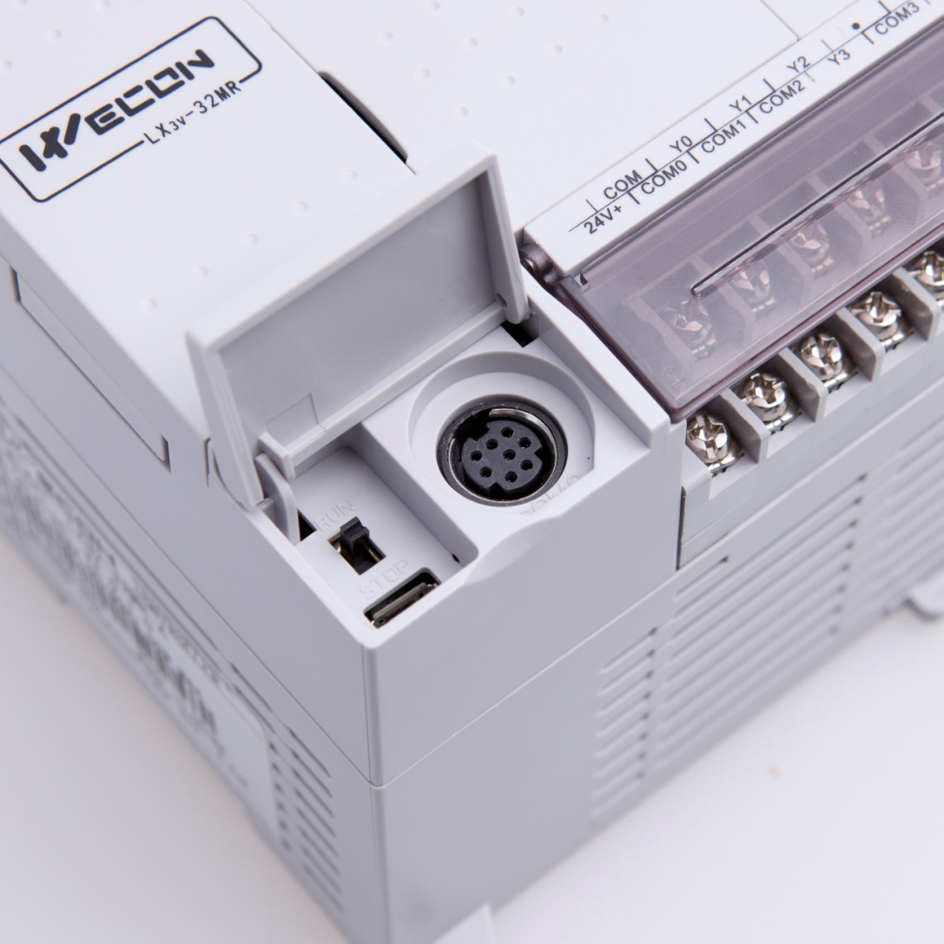
PLC interface
RS422 for communication
Download program
Upload program
Monitor PLC
Download program
Upload program
Monitor PLC
Notes:
This screen shows PLC interface, the round port is RS422 port for communication, also it could used for programming. USB port is for programming.

Slide 16
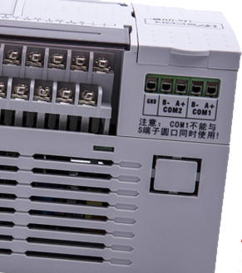
PLC interface
RS485(com1) for communication
Download program
Upload program
Monitor PLC
Wecon protocol
RS458(com2) for communication
MODBUS RTU/ASCII protocol
Wecon protocol
User-defined protocol
Notes:
The COM1 port and the round port are the same port, so it can be used for communication and programming, but during communication, it supports RS485. It should be noted that COM1 and round port cannot be used at the same time. COM2 port is RS485 for communication only. It could support MODBUS and user-defined protocol.

Slide 17
02
PLC expansion module
Notes:
All the introduction for PLC CPU is finished, next is about PLC expansion modules.

Slide 18
Digital expansion module
LX3V-8EX
LX3V-8EYR
LX3V-8EYT
LX3V-16EX
LX3V-16EYR
LX3V-16EYT
Notes:
Those are digital inputs and outputs expansion modules. 8 or 16 channels.

Slide 19
Analog expansion module
LX3V-1WT
LX3V-2WT
LX3V-4AD
LX3V-4DA
LX3V-4PT
LX3V-4TC
LX3V-4LTC
LX3V-4PG
Notes:
These are analog expansion modules, with analog input and output, weighing, temperature reading

Slide 20
Expansion module naming rule
Serial name
Function code
LX3V-4 AD
The number of channels
Notes:
Same as PLC CPU, there is a naming rule for expansion modules, use LX3V-4AD as example. LX3V means series name, 4 means number of channels, AD is function code.

Slide 21
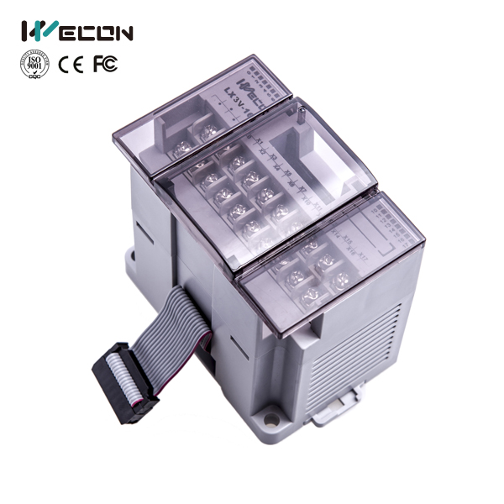
Weighing modules
Acquisition resolution: 24 bits
Reset: rearrange all configurations to default
01
04
Weight calibration
02
05
Stability check
Display gross or net weight tare is adjustable
03
06
Auto-zero
Notes:
This picture shows the parameters of weighing module, with high resolution, calibration, gross and net functions.

Slide 22
Analog input & output modules
Analog signal types
LX3V-4AD
-10V to 10V;
+4mA to +20mA;
0mA to 20mA;
LX3V-4DA
It has four input channels. The input channels receive analog signals and convert them into digital value. The maximum resolution is 16 bits.
It has four output channels. The output channels take a digital value and output an equivalent analog signal. The maximum resolution is 12bits.
Notes:
Those two are analog modules, 4AD is analog input, 4DA is analog output, both of them support current and voltage analog signal.

Slide 23
Temperature modules
01
02
03
LX3V-4PT
LX3V-4TC
LX3V-4LTC
The LX3V-4PT analog block amplifies the signal from four platinum temperature sensors (PT 100, 3 wire,100 Ω) and converts the data into 12 bit value stored in the Main Processing Unit (MPU). Both Centigrade (°C) and Fahrenheit (°F) can be read. Reading resolution is 0.2°C to 0.3°C / 0.36°F to 0.54°F.
The LX3V-4TC analog block amplifies the signal from four thermocouple sensors and converts the data into 16 bit value stored in the main unit. Both Centigrade (°C) and Fahrenheit (°F) can be read. Reading resolution is 0.4°C/0.72°F of Type K and 0.3°C/0.54°F of Type J.
It has four temperature input ports and four transistor output ports (open collector output), it reads data from thermocouple, and then outputs value with PID control.
Notes:
For temperature reading, WECON expansion modules could support PT100 and thermocouple, and for LX3V-4LTC, it is temperature controlling with PID function.

Slide 24
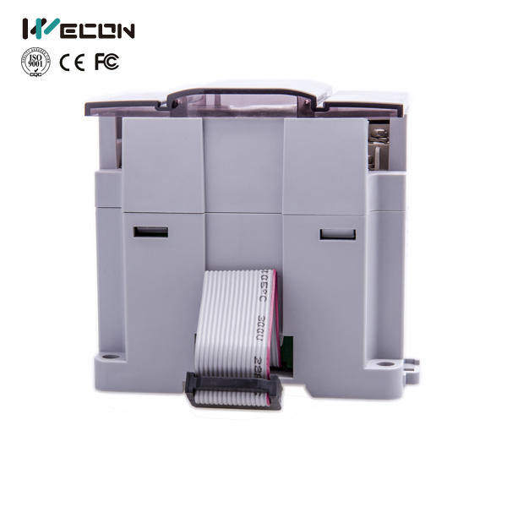
Pulse generator module
01
The LX3V-4PG has four pulse output channels. Each channel can control positioning of an axis independently.
02
It works by sending specified quantity of
pulses (200 kHz maximum) to Server controller or step motors.
03
There are two versions for LX3V-4PG, one is LX3V-4PGA (Advanced), and the other is LX3V-4PGB (Basic).
04
S-type acceleration and deceleration, interrupt single speed positioning and two-speed positioning are available in advanced version.
年
度
工
作
概
述
年
度
工
作
概
述
年
度
工
作
概
述
年
度
工
作
概
述
年
度
工
作
概
述
Notes:
LX3V-4PG is pulse generator, which provides 4 high speed outputs, which can meet more high-speed pulse outputs requirements, and support S-type acceleration and deceleration, ensuring the stability of motion control.

Slide 25
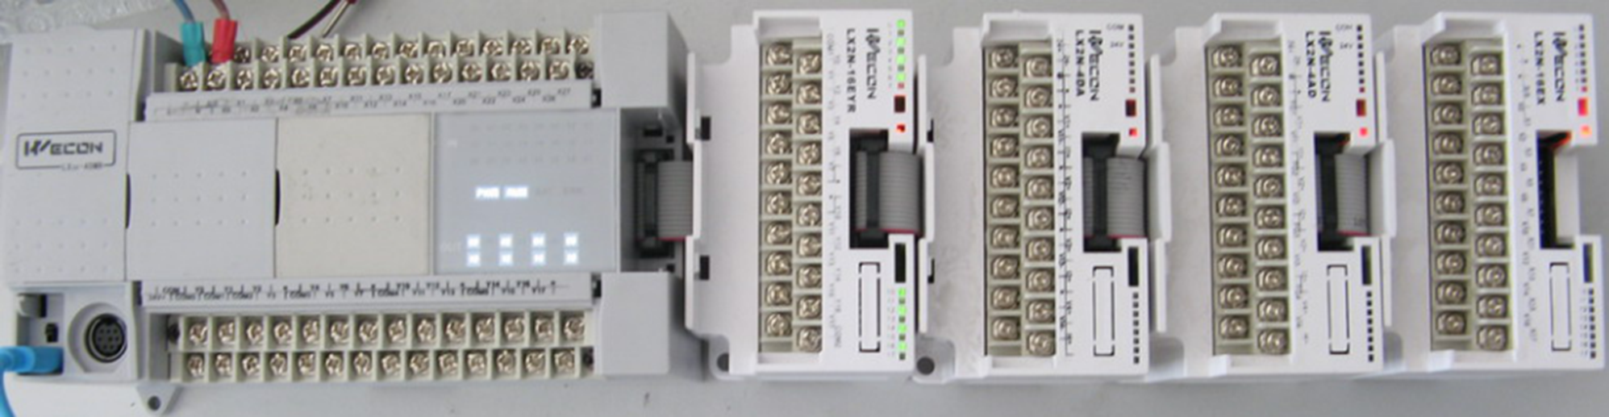
Module Installation diagram
Notes:
Maximum number of modules is 16 in one PLC CPU, the picture shows how modules connect to PLC.

Slide 26
03
BD board
Notes:
Beside expansion modules, we also have BD module, in addition to the expansion module, we also provide the BD module, which has a smaller size and a more convenient programming method.

Slide 27
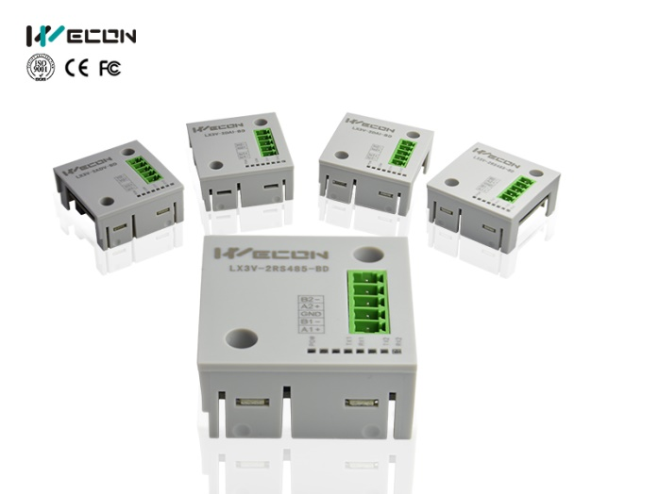
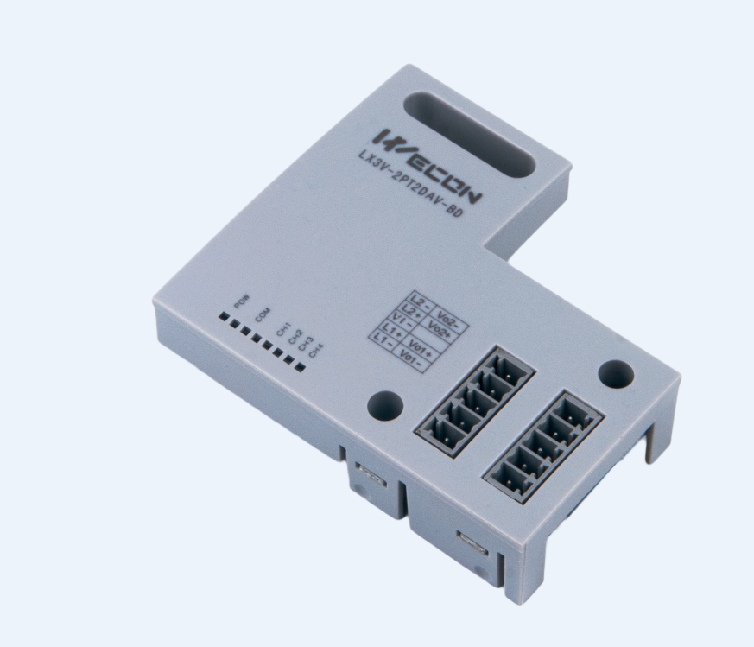
BD board list
Small size BD board
LX3V-2RS485-BD
LX3V-2TC-BD
LX3V-ETH-BD
LX3V-2AD2DA-BD
LX3V-2PT-BD
LX3V-CAN-BD
LX3V-2DAV-BD
LX3V-2DAI-BD
LX3V-2ADV2DAV-BD
More is coming
LX3V-2ADV-BD
LX3V-2PT2DA-BD
LX3V-2ADI-BD
LX3V-2TC2DA-BD
Big size bd board
Notes:
This is BD module list, it contains analog inputs and outputs, temperature reading, and communication modules.

Slide 28
BD board naming rule
Serial name
Function code
Function code
LX3V-2 AD 2 DA-BD
Channel number
Channel number
Module type
Notes:
Using LX3V-2AD2DA-BD as example to introduce BD module naming rule. LX3V is series name, 2 means numbers of channel. AD and DA means function code, BD means BD module.

Slide 29
Input-output hybrid BD board
LX3V-2AD2DA-BD
LX3V-2ADV2DAV-BD
LX3V-2PT2DA-BD
LX3V-2TC2DA-BD
It has 2 analog input channels and 2 analog output channels, it only supports 4~20mA analog signal.
It has 2 analog input channels and 2 analog output channels, it only supports -10V~10V analog signal.
It has 2 thermal resistance input channels and 2 analog output channels. The output supports 4~20mA analog signal.
It has 2 thermocouple input channels and 2 analog output channels. The output supports 4~20mA analog signal.
The above boards have both input and output channels.
Notes:
For BD module, there are 4 channels and 2 channels . This screen introduce the 4 channels BD modules.

Slide 30
Communication BD boards
Introduction
LX3V-2RS485-BD
There are three kinds of BD board for communication.
1.
LX3V-2RS485-BD, it provides 2 RS485 communication ports.
2.
LX3V-ETH-BD, it provides 1 Ethernet communication port.
LX3V-ETH-BD
LX3V-CAN-BD
3.
LX3V-CAN-BD, it provides 1 CAN communication port.
Notes:
Different from expansion modules, BD module provides communication modules, for RS485, Ethernet and CANBUS communication.

Slide 31
2-channel BD boards
2 thermocouple input channels. K type and J type thermocouples are supported.
2 analog input channels. -10V~10V signal is supported.
LX3V-2TC-BD
LX3V-2ADV-BD
LX3V-2PT-BD
2 thermocouple input channels. PT100 is supported.
LX3V-2DAI-BD
2 analog output channels. 4~20mA signal is supported.
LX3V-2ADI-BD
2 analog input channels. 4~20mA signal is supported.
LX3V-2DAV-BD
2 analog output channels. -10V~10V signal is supported.
Notes:
It lists 2 channels BD modules, including analog input, temperature reading.

Slide 32
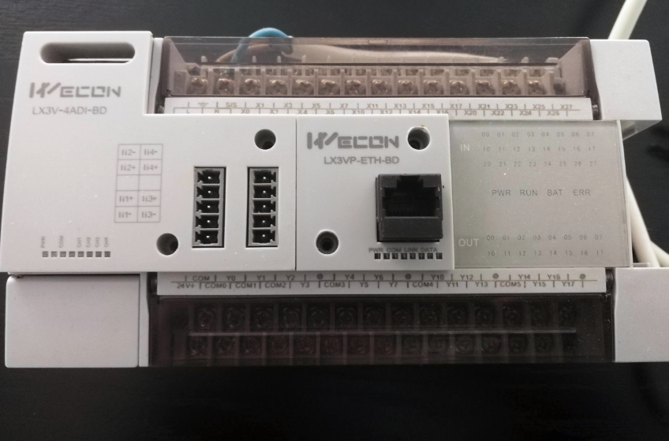
BD board installation diagram
Notes:
This picture shows BD module is installed in PLC CPU, the right one is 1 Ethernet channels BD, the left one is 4 channels BD.

Slide 33
04
Software Features
Notes:
Next let's check PLC software features.

Slide 34
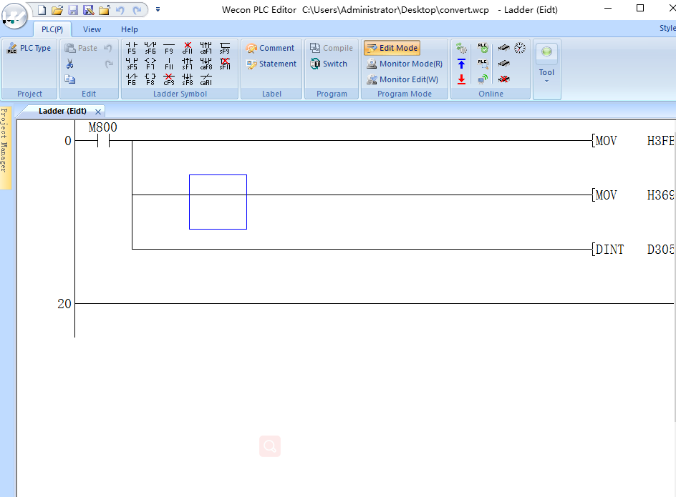
Software features
Unique encryption tool
Different function with different password:program password,download password,
upload password,clock pawword,
Udisk download
It support to download PLC project with Udisk
Generate download file
User could download this file into PLC directly,but can not open this file,avoid to leak PLC project
Auto save setting
It supports to save program automatically.(option)
FB and FC function(Developping in LX5V series)
Program is more convinient ,easier to understand,improve efficiency,
Notes:
Firstly is about encryption tool, it can protect the interests of programmers. USB flash disk download, which brings more convenience to programming. And it could save project automatically. And in the future, we will released FB and FC programming way.

Slide 35
05
Application Case
Notes:
Finish the introduction of PLC, let’s learn some applications

Slide 36



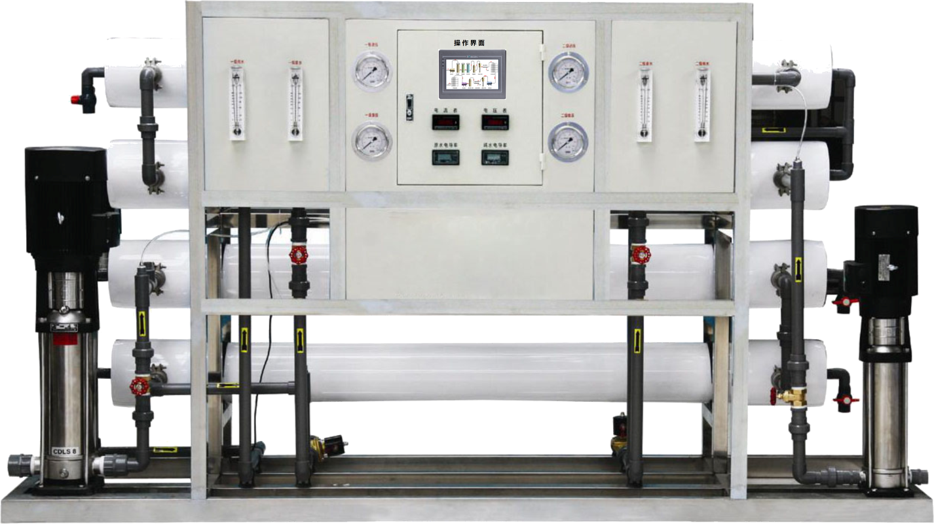
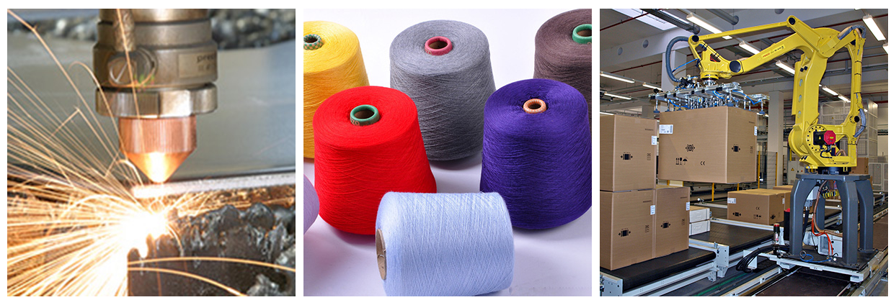

Case of LX3V series PLC
Sewage Treatment
Packaging Machinery
Printing Machinery
Water Treatment
Rubber Machinery
Solar Control
Machinery
Industry
Energy
Processing
Textile Machinery
Petrochemical Engineering
Woodworking Machinery
Boiler treatment
Non-standard machinery
Charging pile
Healthcare
Thermal power control
Other
areas
Security control
Metallurgical industry
Transportation
Culture & entertainment
Notes:
As a universal controller, WECON PLC has been applied in various industries and fields. For example, machinery manufacturing, energy processing, and so on. Let me introduce some application in detailed.

Slide 37
Face Mask Machine
The mask machine includes a plane mask body manufacturing machine, a plane mask inner ear strap automatic fusion machine, and a mask outer ear strap fusion machine.
Introduction
WECON HMI: PI3070i
WECON PLC: 1* LX3V1412MT-A, 1* LX3V-3624MT4H, 1*LX3V3624MR2H, 1*LX3V-16EYT.
This solution contains high-speed interrupt stop
Solution
1. PI3000i series HMI, using intelligent frequency modulation mechanism, taking into account the screen refresh frequency and operation response speed, greatly improving the screen switching and refresh speed, and improving work efficiency
2. Fully automatic output, the mask body machine has a mechanism of automatically ear strap obtain, reducing labor costs and errors;
3. The ear strap machine does not need to wait for work, adaptive interactive processing system, and comprehensively increase production capacity;
4. Preset quantitative integrated output, neatly folded, eliminating scattered, sanitary and reliable.
Advantages
Notes:
This is face mask machine, the mask machine includes a plane mask body manufacturing machine, a plane mask inner ear strap automatic fusion machine, and a mask outer ear strap fusion machine.
It uses WECON HMI and PLC.

Slide 38
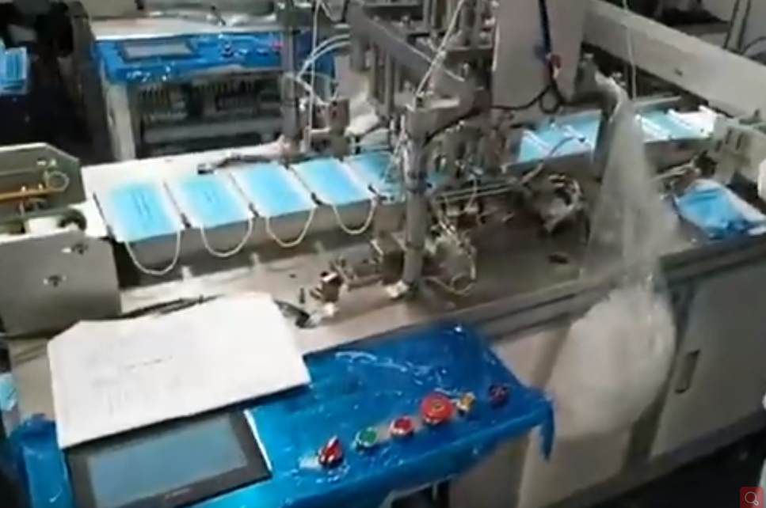
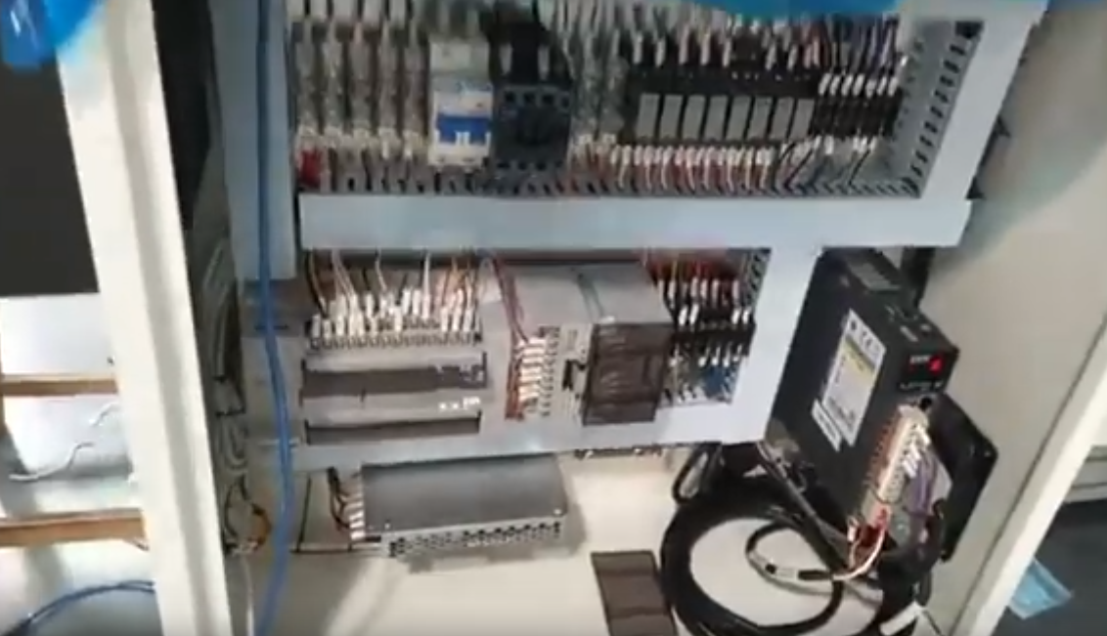
Mask packing machine
Notes:
Those are the picture of face mask machine.

Slide 39
Mask packing machine
This machine is mainly used for the packaging of finished masks. According to different feeding methods, this system can be applied to different feeding modes.
Video link: https://www.youtube.com/watch?v=bbYXc68SRtA
Introduction
WECON HMI: PI3102i,
WECON PLC: LX3VT-1616MT4H, dedicated controller for pillow charter
WECON Servo: three sets of servos.
This system has unique S-shaped flying shear, virtual axis, high-speed interruption and other functions.
Solution
1. HMI PI3102i, 1024 * 600 HD resolution, supports Ethernet communication, greatly improving the visual and operating experience.
2. By collecting the blanking signal of the mask packaging machine and working it online with the face mask machine, a mask packaging production line can be formed, which can greatly reduce the staff who manually place the packaging (at present, most control systems on the market can only implement a single machine function).
Advantages
Notes:
This is mask packing machine, this machine is mainly used for the packaging of finished masks. According to different feeding methods, this system can be applied to different feeding modes.

Slide 40
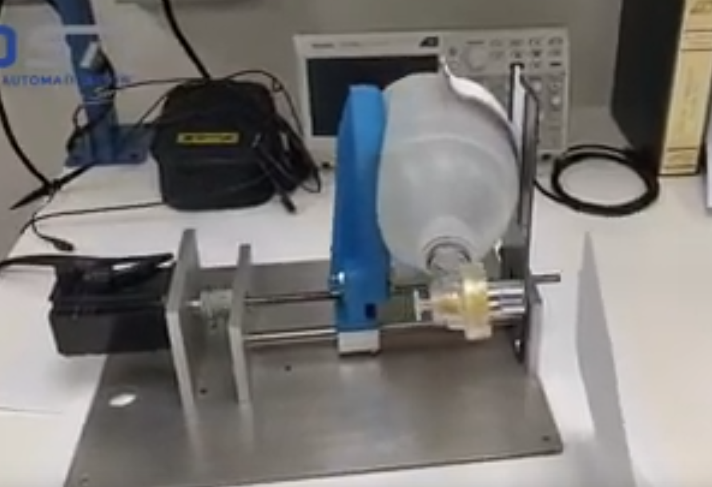
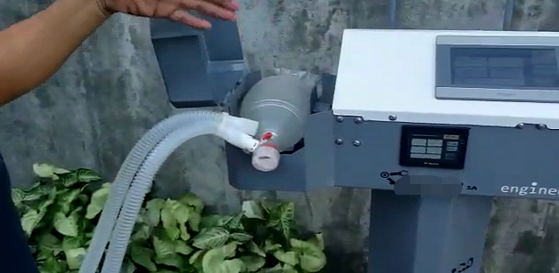
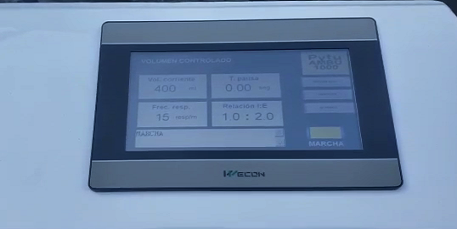
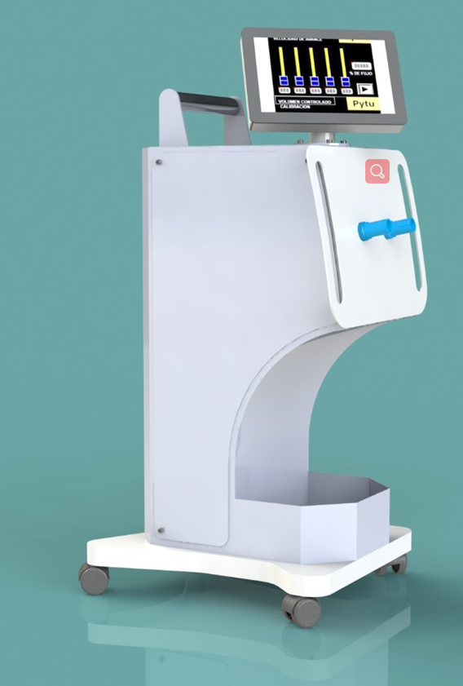
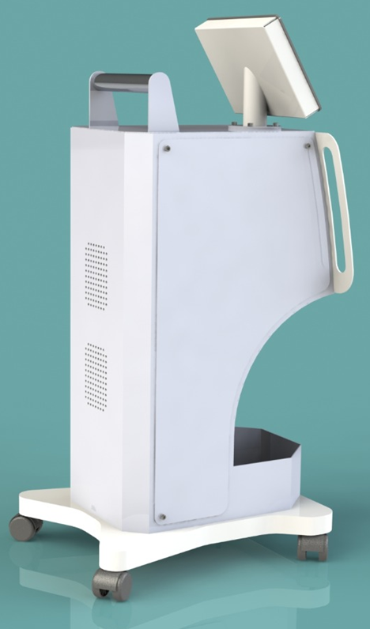
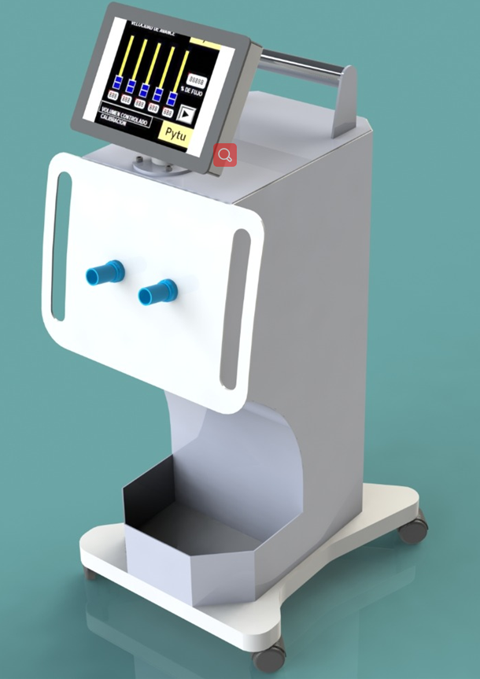
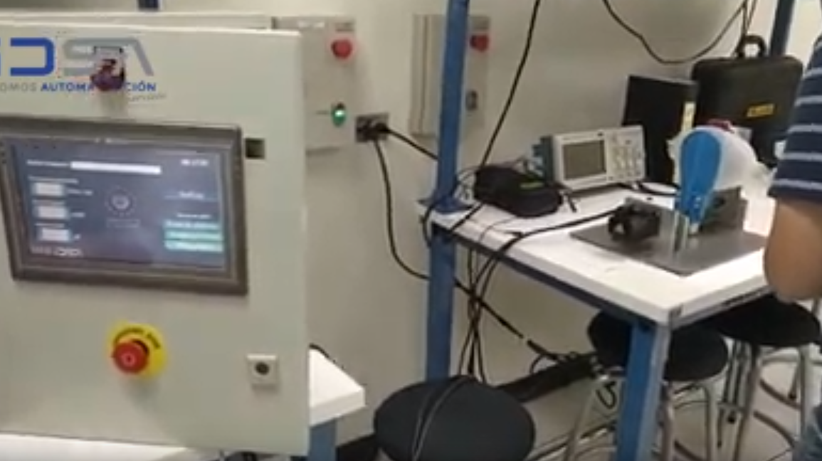
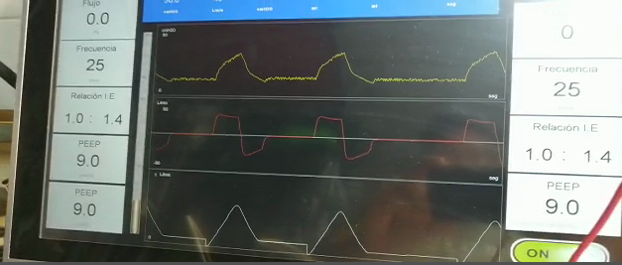
Ventilator machine
Notes:
Those are the pictures of Ventilator machine.

Slide 41
Ventilator machine
The system using WECON HMI and PLC consists of two air supplies for oxygen and fresh air, and can come from a tank or compressor pushing by pump. Both sources are regulated by two input valves to control mixture composition, which comes from an air tank where the mixture is kept at certain pressure limits. For this system has an input and output valves connected to lungs simulator to control pressure in lungs and the respiratory frequency to maintain patient safety.Video link: https://www.youtube.com/watch?v=KLvRk8ZPAoo
https://www.youtube.com/watch?v=OHyLbf6PvEk&feature=youtu.be
Introduction
HMI PI3070i
PLC LX3V-1212MT-A
Analogue input module LX3V-4AD
Analogue output module LX3V-4DA
Solution
Accurate measurement
Set number of breathes per minutes
Humidity and temperature control
Auto start/stop control
Alarm notification with SMS
Advantages
Notes:
The system using WECON HMI and PLC consists of two air supplies for oxygen and fresh air, and can come from a tank or compressor pushing by pump. Both sources are regulated by two input valves to control mixture composition, which comes from an air tank where the mixture is kept at certain pressure limits. For this system has an input and output valves connected to lungs simulator to control pressure in lungs and the respiratory frequency to maintain patient safety

Slide 42
Thank you
Notes:
Thanks for your watching and listening.

