Slide 1
福州富昌维控电子科技有限公司
QUARTERLY WORK SUMMARY REPORT
EARLY ACCESS VERSION PISTUDIO
New Function
In order to review the work of this quarter better and carry out the work of next quarter, the work at the end of this quarter is hereby summarized and reported.
Overseas Sales | Hunter
HMIHMI

Slide 2
CONTENTS
PART 01
PART 02
PART 03
PART 04
New Software Layout
Device Management Tool
V3.0 HMI Background
New Protocol Driver
Please supplement the title with a further description here. the description should be short and to the point
Please supplement the title with a further description here. the description should be short and to the point
Please supplement the title with a further description here. the description should be short and to the point
Please supplement the title with a further description here. the description should be short and to the point

Slide 3
01
PART
01
New Software Layout
Please supplement the title with a further description here. the description should be short and to the point
FOLLWING

Slide 4
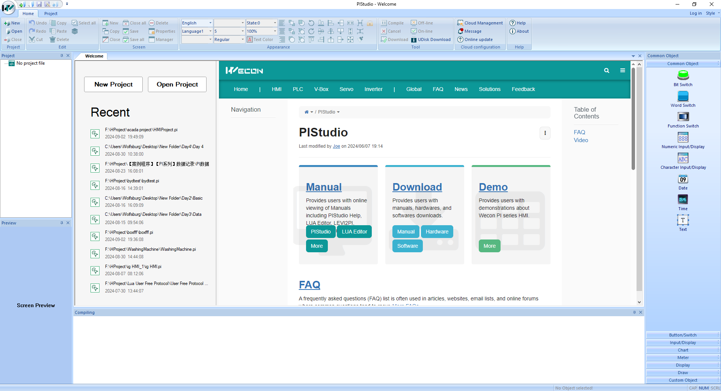
Part Ⅰ
New Layout
Welcome Page
Wecon support center page will be displayed on the home page of PIStudio, the left side is recently opened.

Slide 5
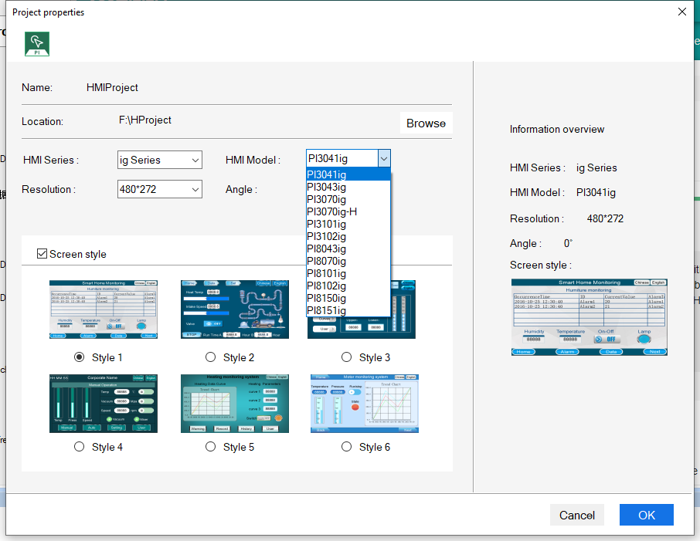
Part Ⅰ
New Layout
New Project
When user create the new project, it does not require to select the protocol on the first step, only model selection.

Slide 6
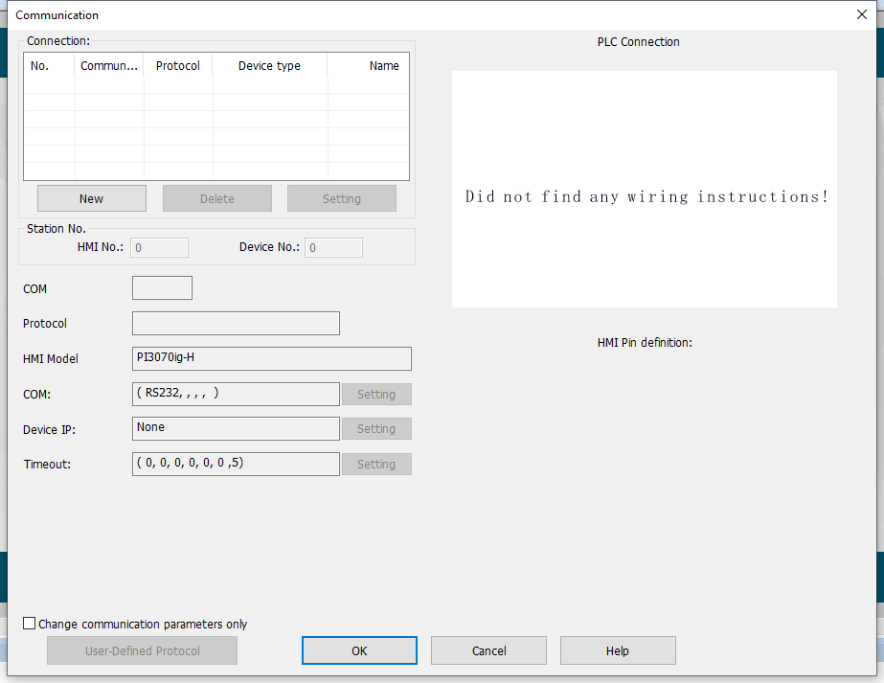
Part Ⅰ
New Layout
New Project
After we done the model selection, the communication settings would automatically pop up.

Slide 7
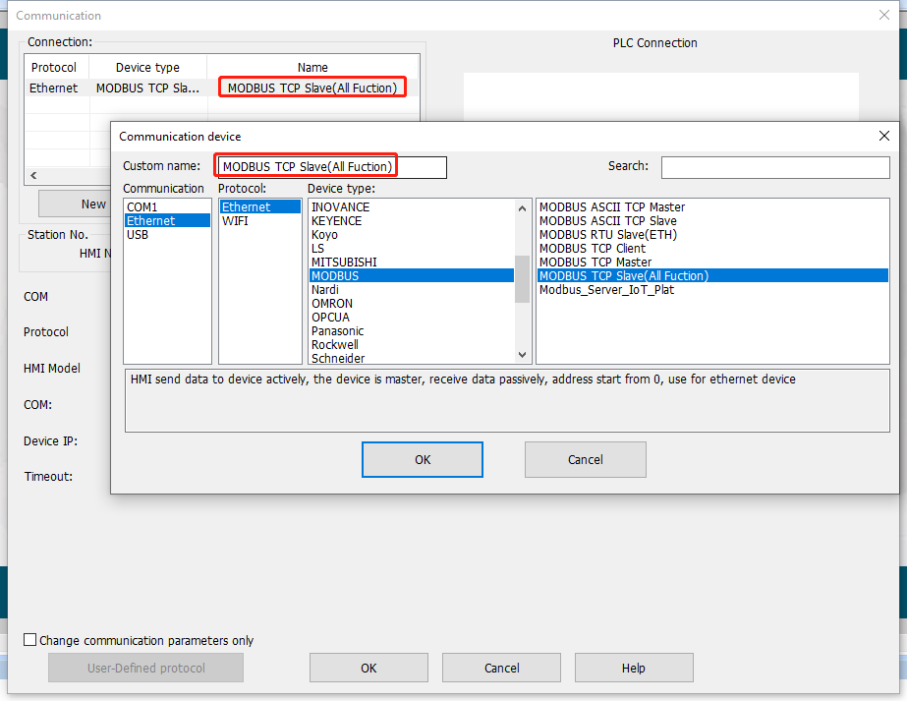
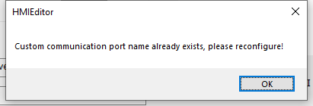
Part Ⅰ
New Layout
One Tip
When user want to add the multiple protocol with same name in the communication settings, the PIStudio would not allow to do that. Please remember to rename their custom name.

Slide 8
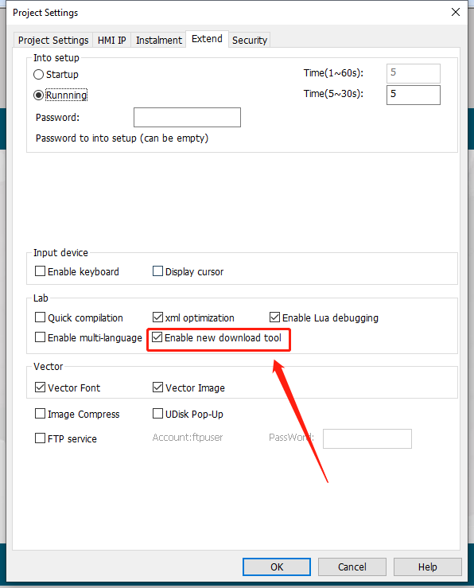
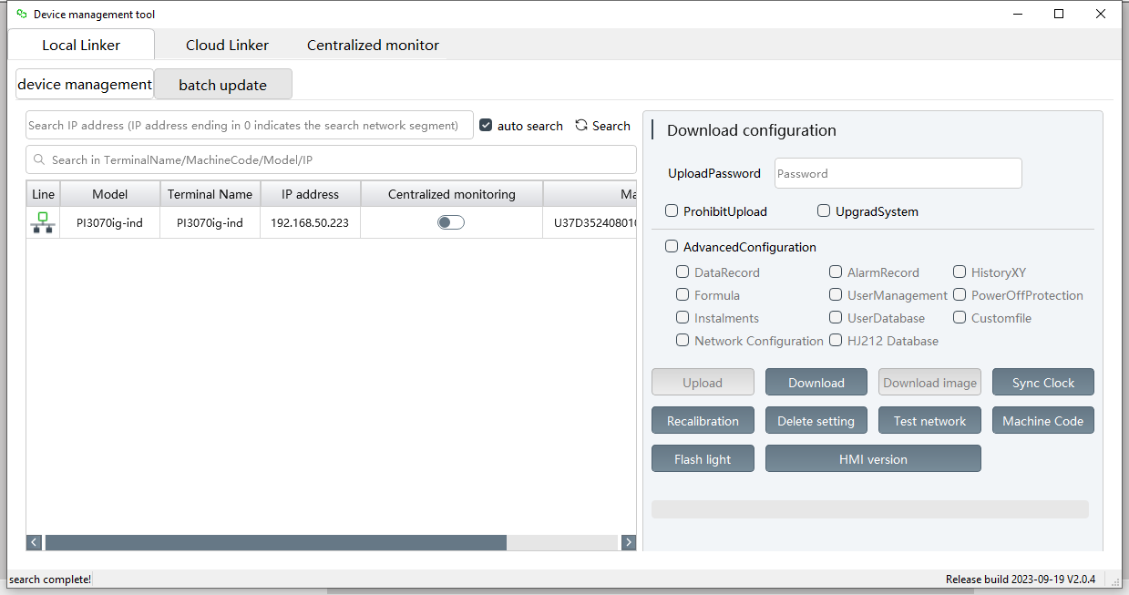
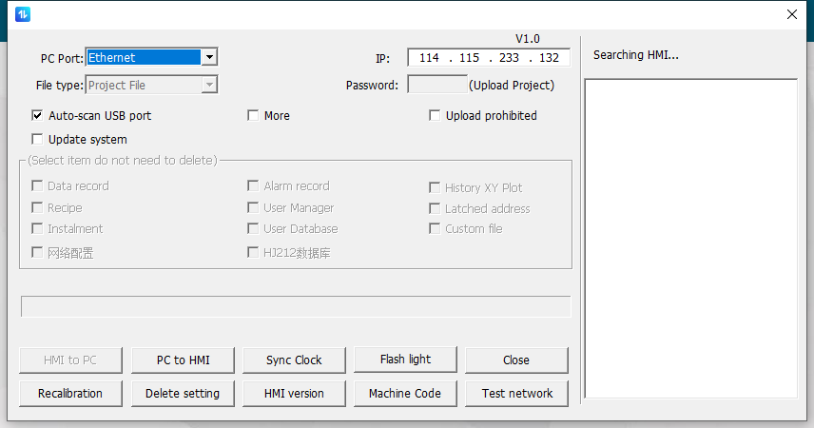
Part Ⅰ
New Layout
Enable New Tool
If the user want to use the old type tool, there is one option to roll the tool back to the old interface tool;

Slide 9
Part Ⅰ
New Layout
Cloud Configuration
There are some new function buttons showing on the software toolbar:
Cloud Management: Device management tool, mainly for centralized monitoring and new download tool
Message: Jump into Wecon News website
Online update: Detect whether there is the new update for PIStudio software

Slide 10
02
PART
02
Device Manage-ment Tool
Please supplement the title with a further description here. the description should be short and to the point
FOLLWING

Slide 11
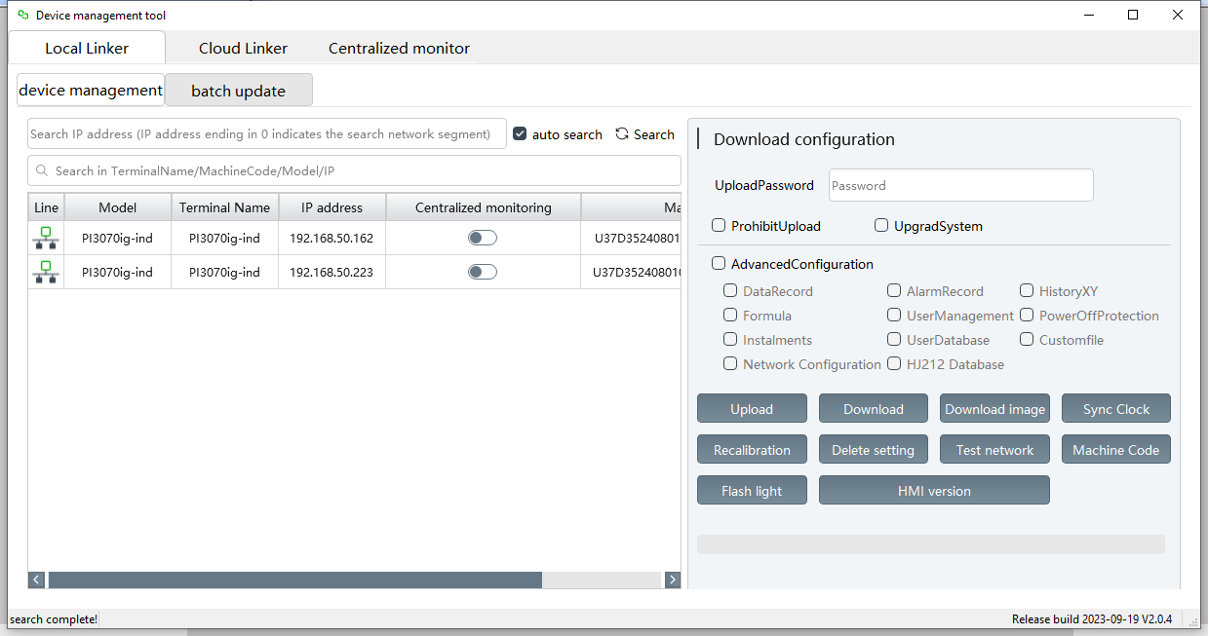
Part Ⅰ
Management Tool
Local Connection
(Download/Upload)

Slide 12
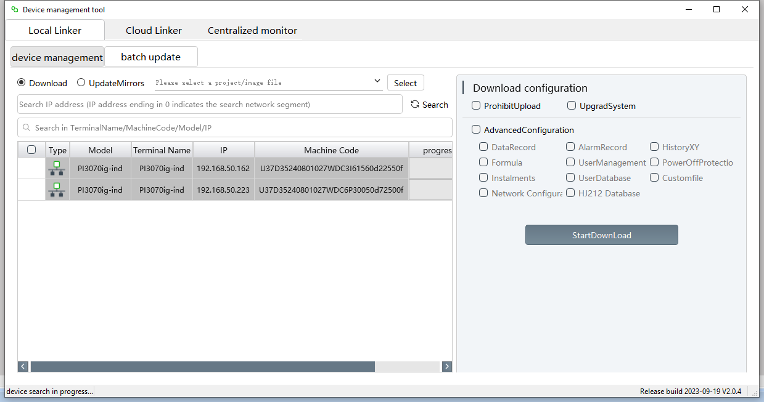
Part Ⅰ
Management Tool
Local Connection
(Batch Update)

Slide 13
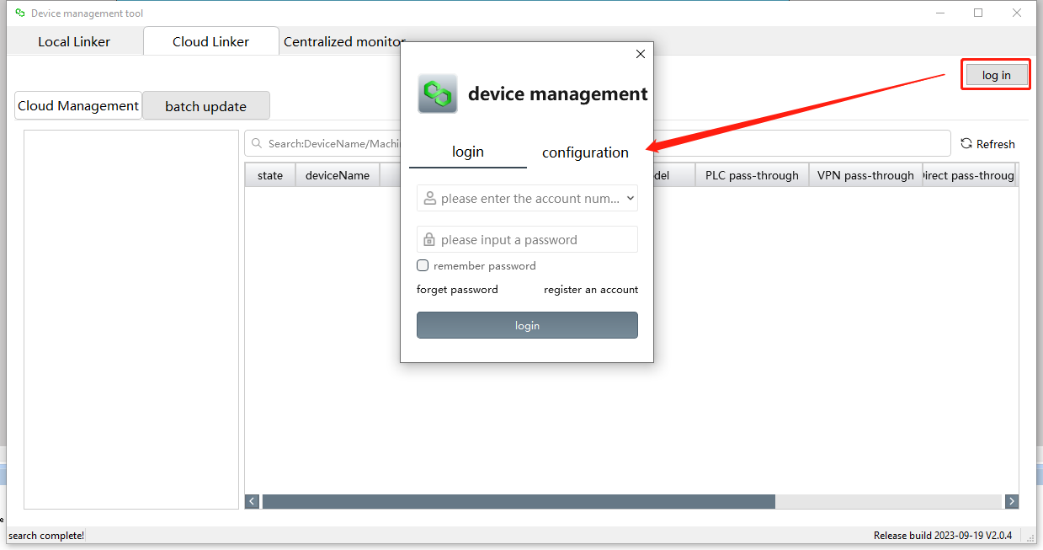
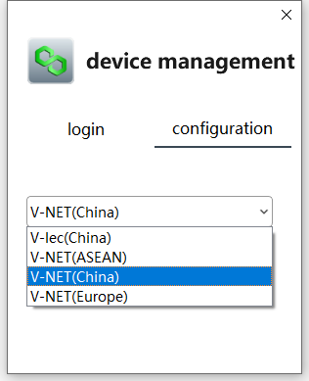
Part Ⅰ
Management Tool
Cloud Connection
(Account Login)

Slide 14
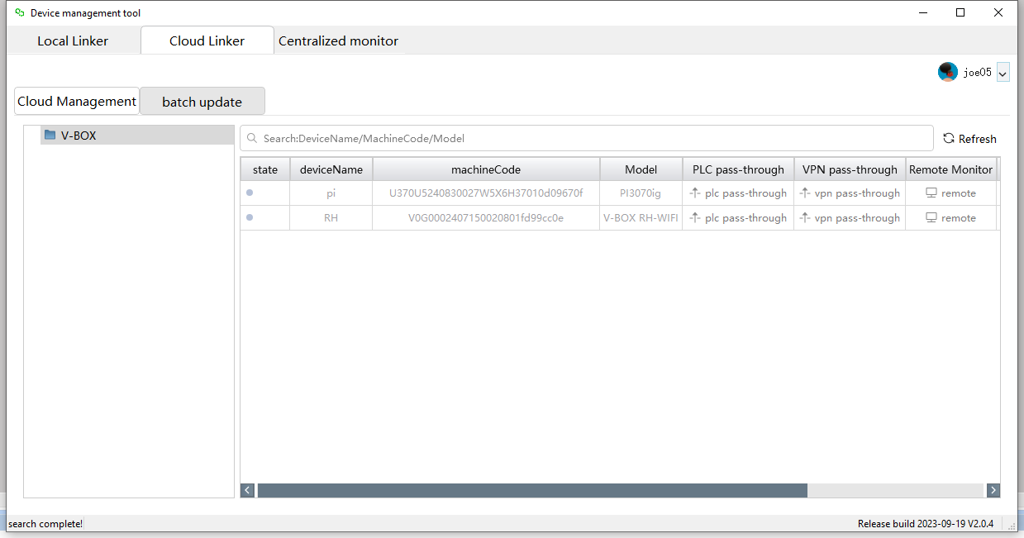
Part Ⅰ
Management Tool
Cloud Connection
(Cloud Management)

Slide 15
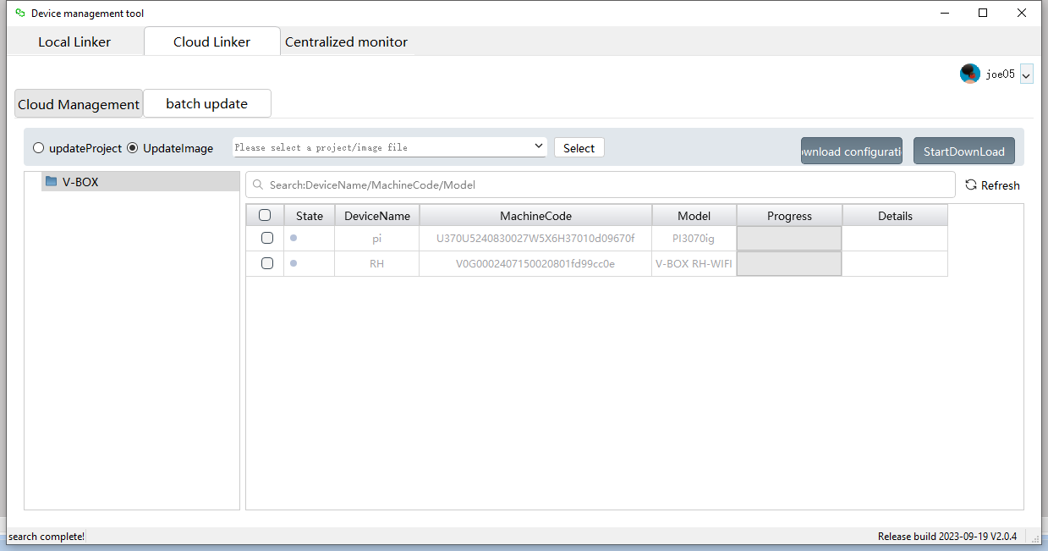
Part Ⅰ
Management Tool
Cloud Connection
(Batch Update)

Slide 16
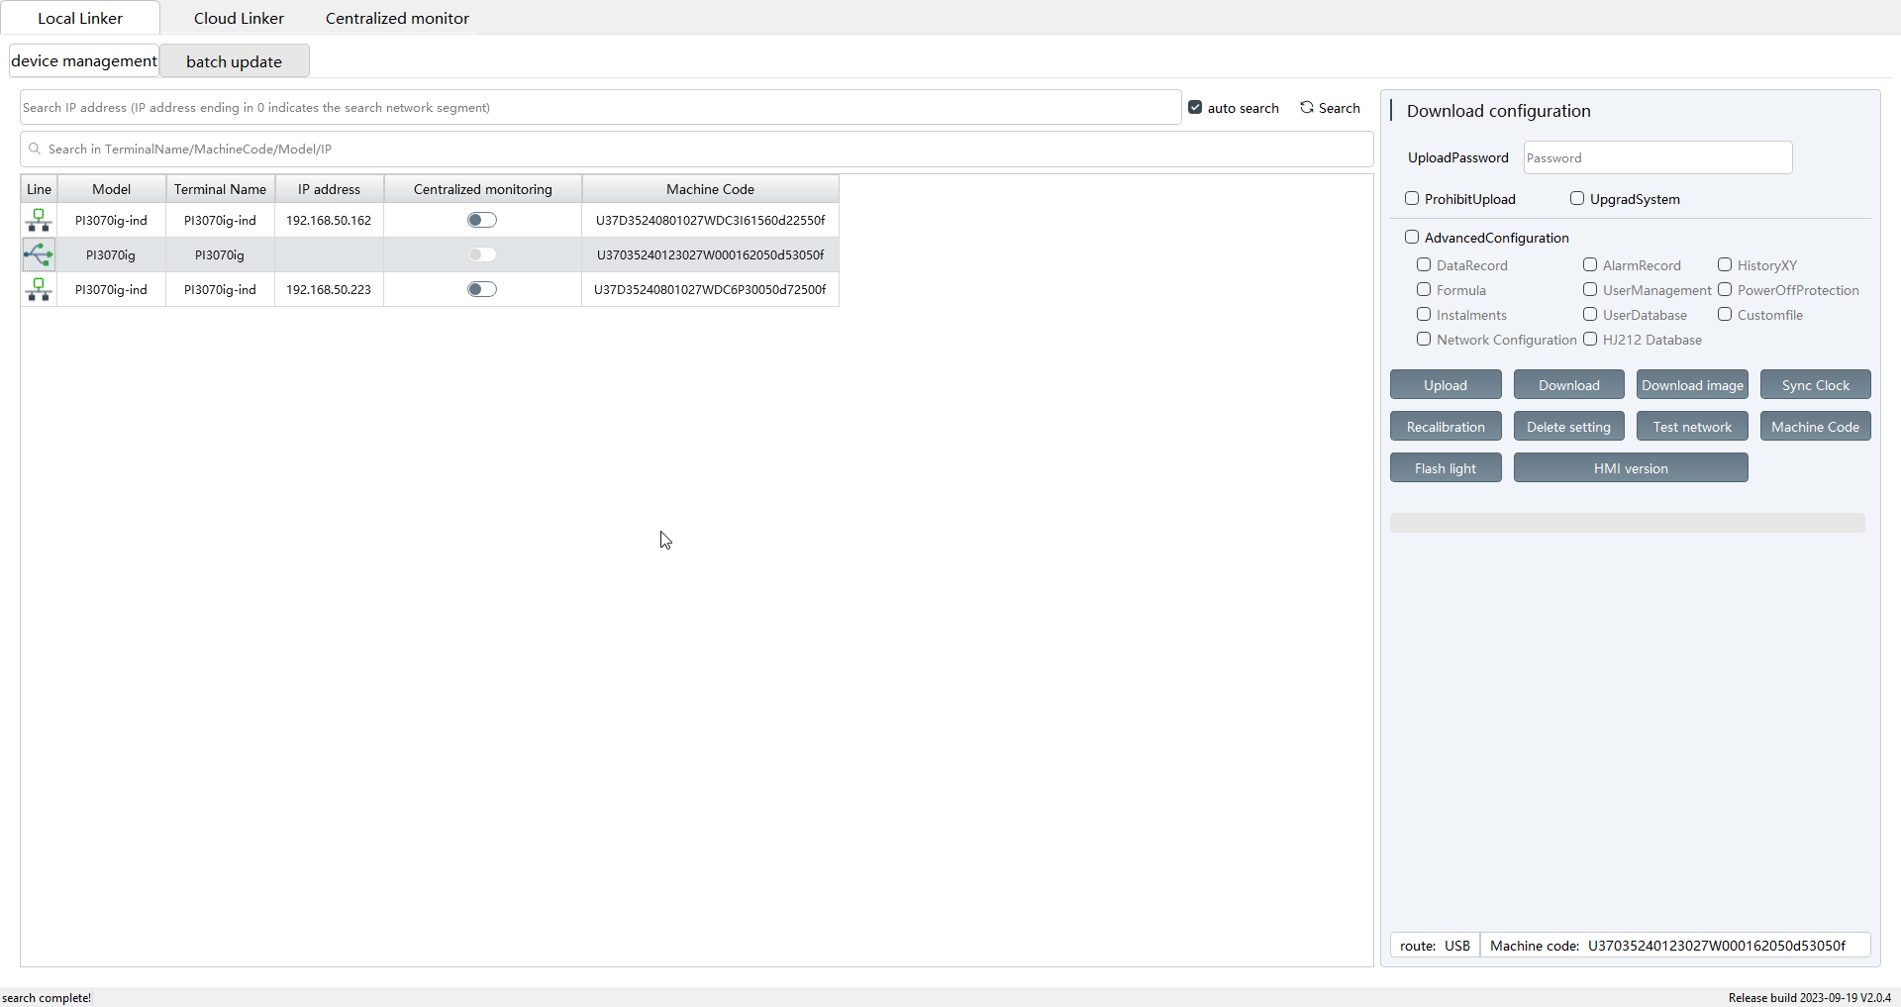
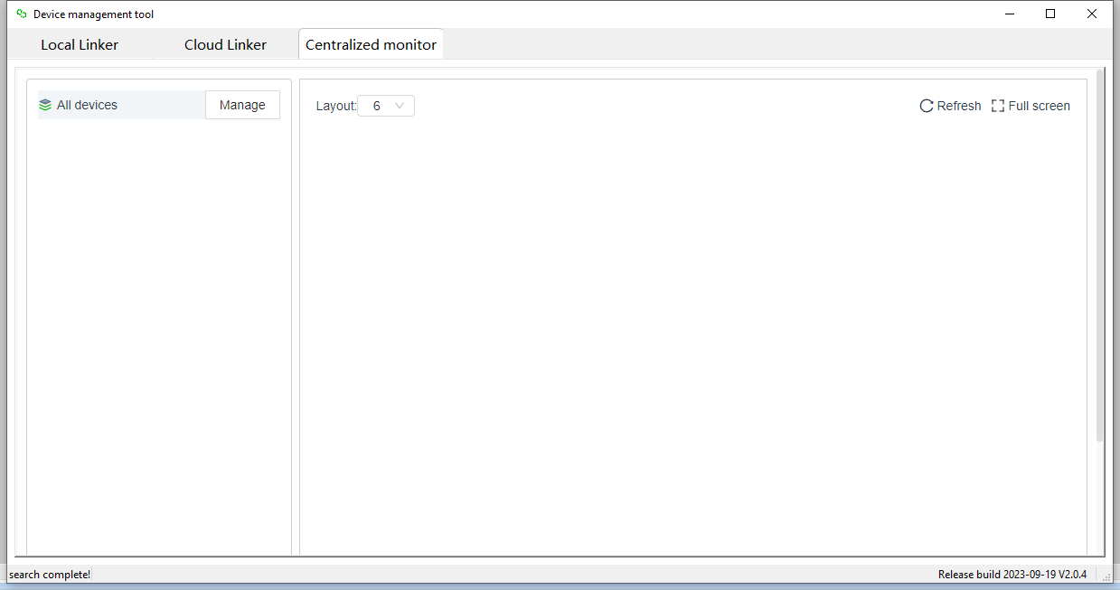
Part Ⅰ
Management Tool
Centralized Monitor
All devices with [Centralized Monitoring] enabled will be displayed on this monitor interface.

Slide 17
03
PART
03
V3.0 HMI Background
Please supplement the title with a further description here. the description should be short and to the point
FOLLWING

Slide 18
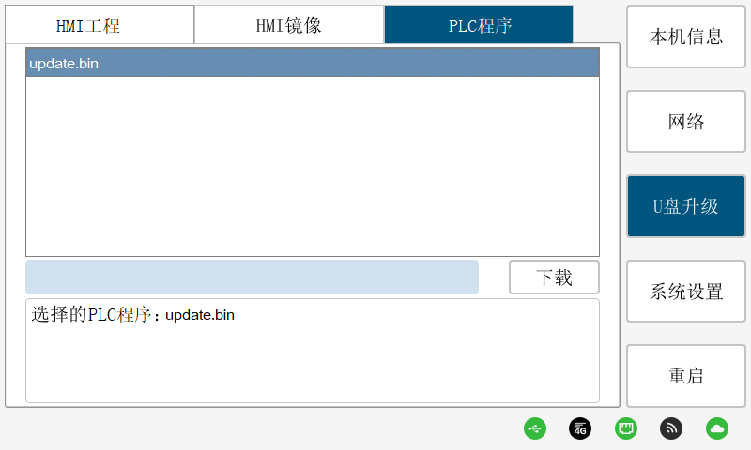
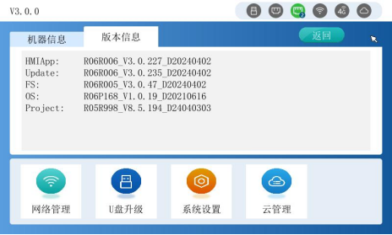
Part Ⅲ
HMI V3.0
New Appearance
HMI V3.0 has the function of front-end and back-end isolation, that is, if user enter the backstage interface, it doesn’t impact the running of HMI project, the communication and script still normally execute.
HMI V2.0
HMI V3.0

Slide 19
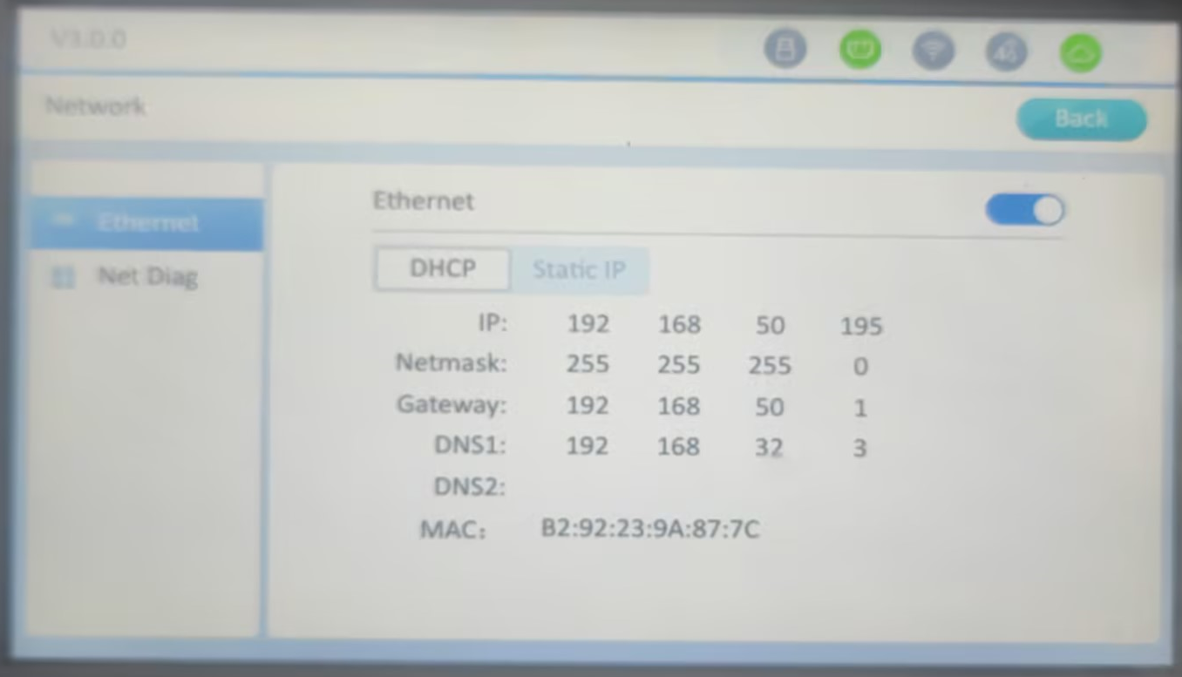
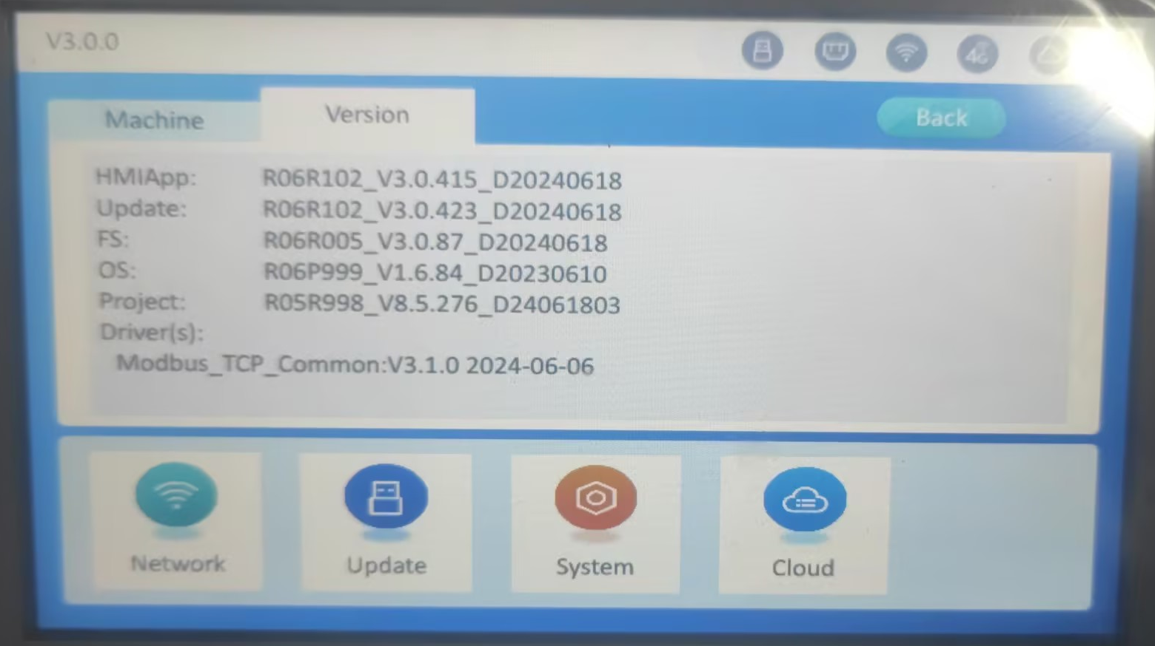
Part Ⅲ
HMI V3.0
New Appearance
The general function is basically same to the HMI V2.0, but the interface style is very different from the HMI V2.0:

Slide 20
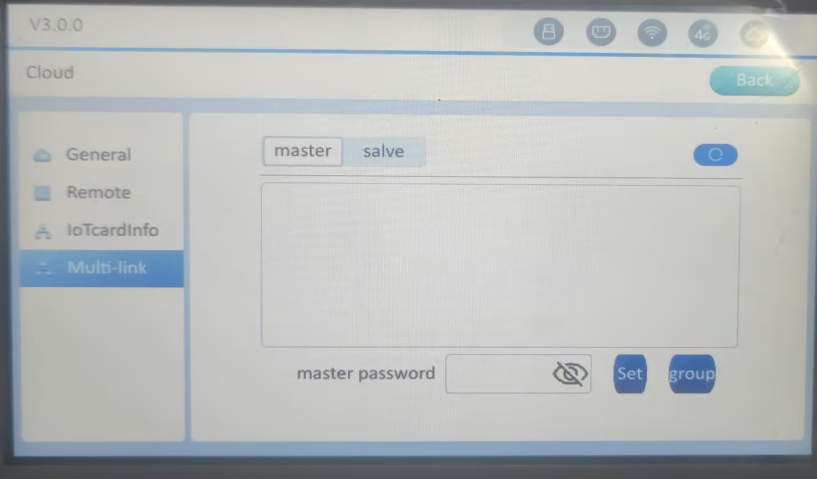
Part Ⅲ
HMI V3.0
Multi-Link
The brand new Multi-Link replaces the old Multi-Link function, no longer need to programming for the Slave HMIs, for more saving time.

Slide 21
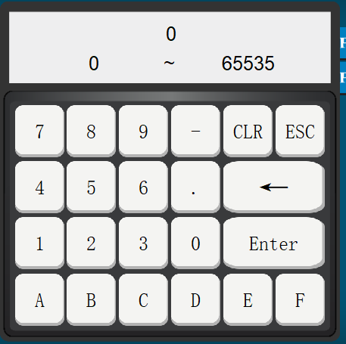
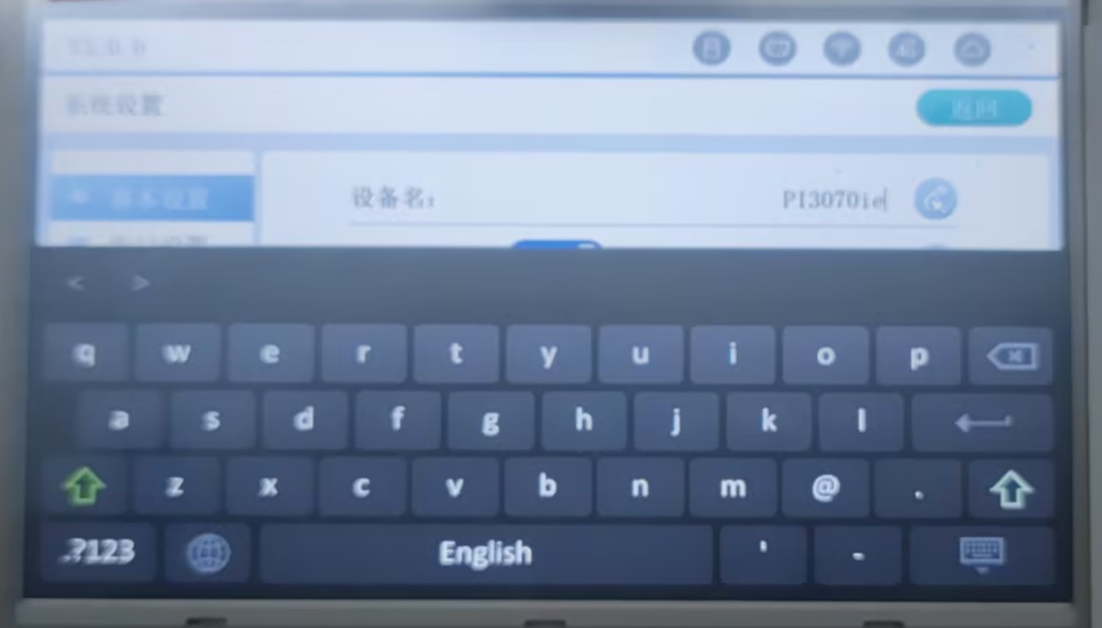
Part Ⅲ
HMI V3.0
System Keyboard& Customized Keyboard
System Keyboard
Customized Keyboard

Slide 22
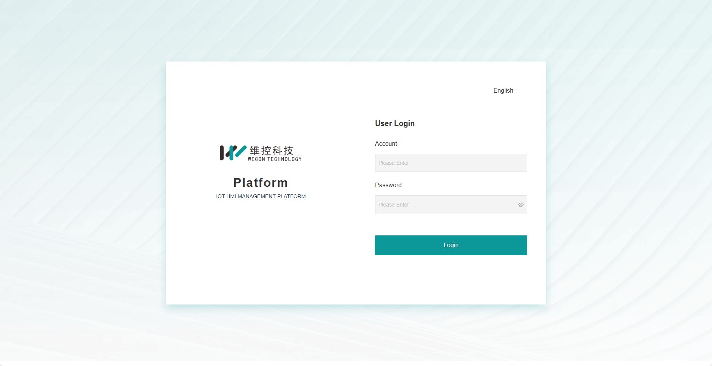
Part Ⅲ
HMI V3.0
Remote Background
Input the HMI IP:9091 in the browser address bar for accessing the remote background.
Note: Input the HMI IP only in the browser address bar for accessing the LAN monitoring

Slide 23
04
PART
04
New Protocol Driver
Please supplement the title with a further description here. the description should be short and to the point
FOLLWING

Slide 24
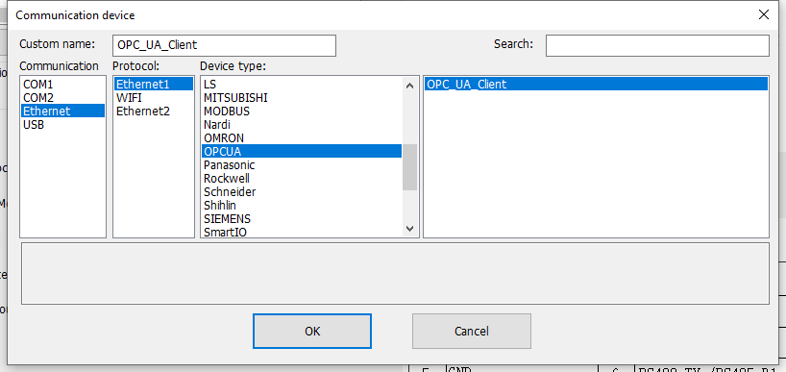
Part Ⅳ
Protocol
FreeTag Protocol
1. OPC UA Client
2. Siemens S7-1200/1500 Ethernet FreeTag
3. BECKHOFF TwinCAT PLC Ethernet

Slide 25
福州富昌维控电子科技有限公司
QUARTERLY WORK SUMMARY REPORT
CODESYS SoftMotion Control
THANKS
In order to review the work of this quarter better and carry out the work of next quarter, the work at the end of this quarter is hereby summarized and reported.
Overseas Sales | Hunter
SERVO

