Slide 1
Lua Script: CSV File Read&Write
Presented by Hunter
福州富昌维控电子科技有限公司
FUZHOU FU CHANG WECON ELECTRONICS TECHNOLOGY CO.,LTD

Slide 2
Catalog
1
What is CSV
2
How to recognize the CSV separator
3
Demonstration

Slide 3
What is CSV

Slide 4
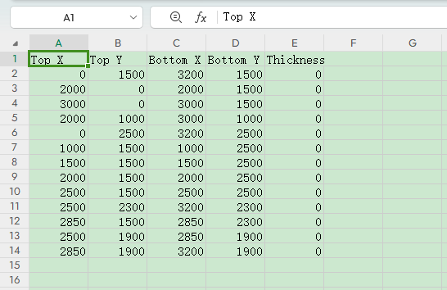
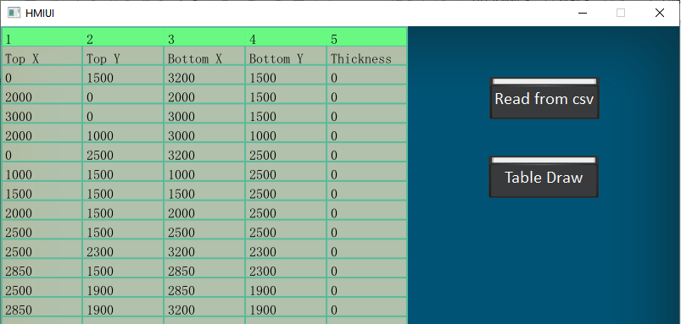
CSV
The Comma-separated values (CSV) is a text file format that uses commas to separate values. A CSV file stores tabular data (numbers and text) in plain text.
Application scenario: Common data exchange format between different platform, different OS, different software.

Slide 5
How to recognize the CSV separator

Slide 6
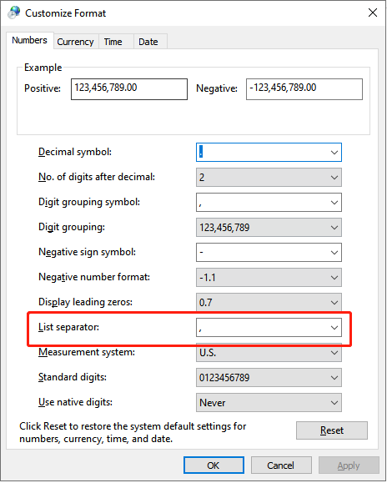
Separator
In Windows OS, we could check it inside the Control Panel/Region/Additional settings..., there is one option called List separator;
Or we can directly open a csv file by notepad(Suitable for all OS);

Slide 7
Demonstration

Slide 8
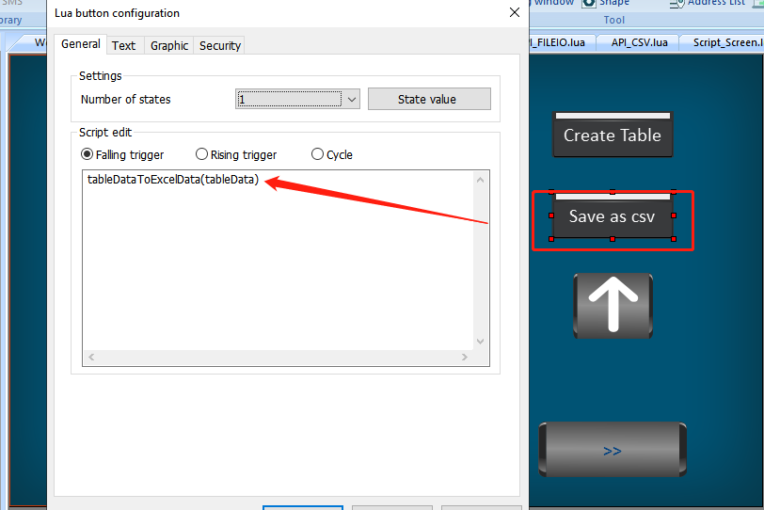
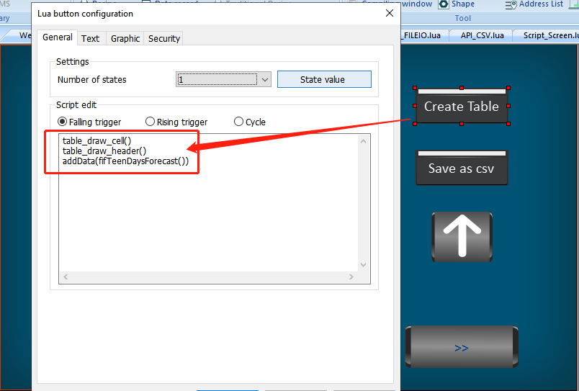
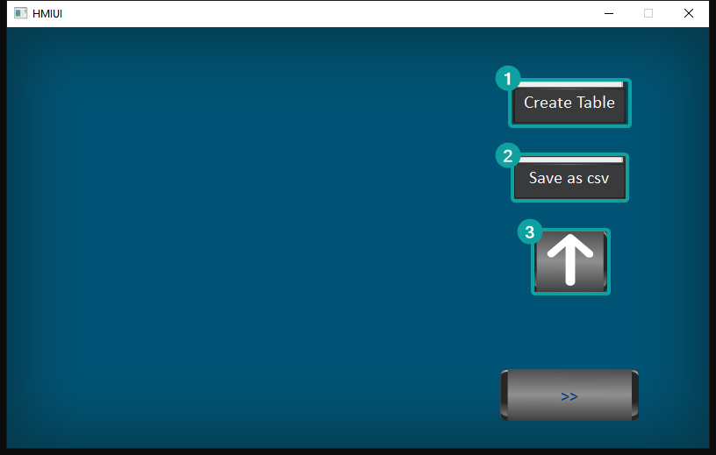
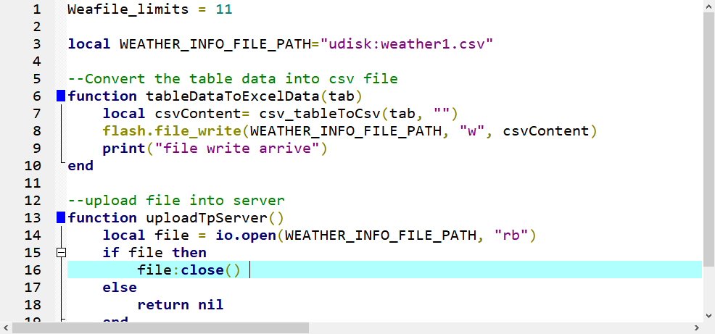
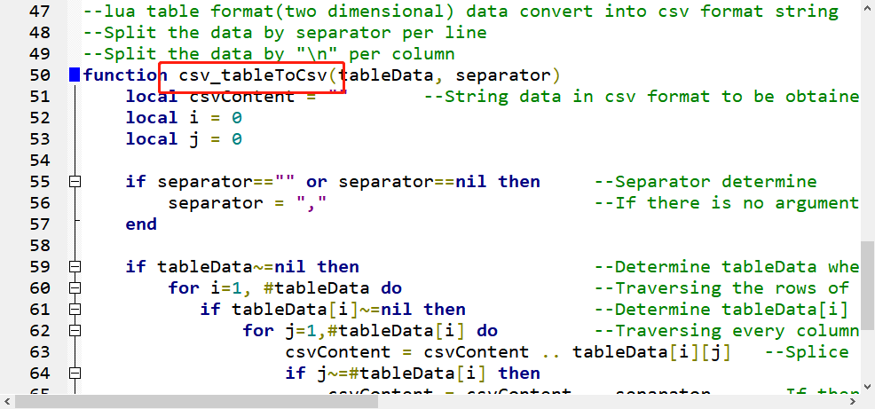
Demo
The project is combine with functions of FTP , custom table draw, csv data conversion;

Slide 9
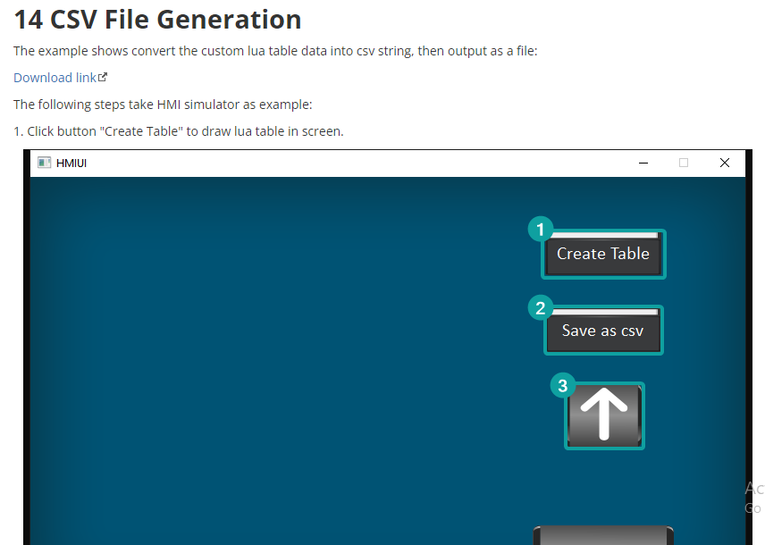
Instance
CSV file generate(Write)
https://docs.we-con.com.cn/bin/view/PIStudio/2%20Demo/Lua%20Script/#H14CSVFileGeneration

Slide 10
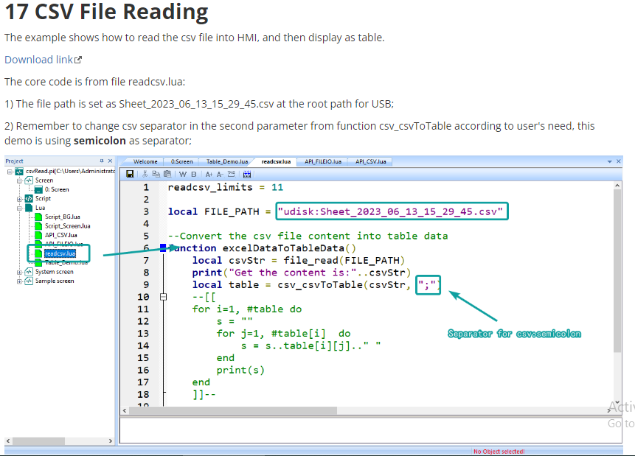
Instance
CSV file read
https://docs.we-con.com.cn/bin/view/PIStudio/2%20Demo/Lua%20Script/#H17CSVFileReading

Slide 11
THANK YOU!

