Slide 1
Lua Script: FTP Client
Presented by Hunter
福州富昌维控电子科技有限公司
FUZHOU FU CHANG WECON ELECTRONICS TECHNOLOGY CO.,LTD

Slide 2
Catalog
1
What is FTP
2
Build up FTP site on PC
3
Core code part of FTP Client

Slide 3
What is FTP

Slide 4
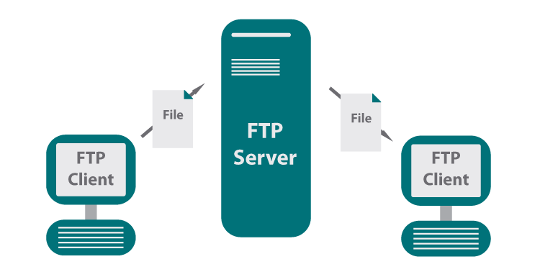
FTP
The File Transfer Protocol (FTP) is a standard communication proto-col used for the transfer of files from a server to a client on a network.
FTP is built on a Client-Server model architecture using separate control and data connections between the client and the server.
PC

Slide 5
Build up FTP site on PC

Slide 6
FTP site bulid up(IIS Manager)
1. Turn Windows features on or off
2. Check the options of FTP Server
3. Search and open Internet Information Services (IIS) Manager
4. Add FTP site
5. Verify the FTP site whether set up successfully
Reference website: https://www.windowscentral.com/how-set-and-manage-ftp-server-windows-10

Slide 7
Core code part of FTP Client

Slide 8
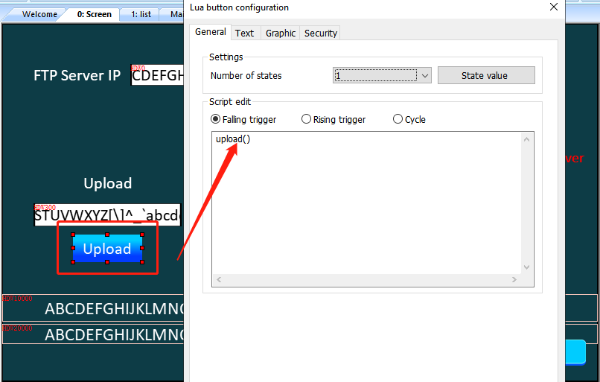
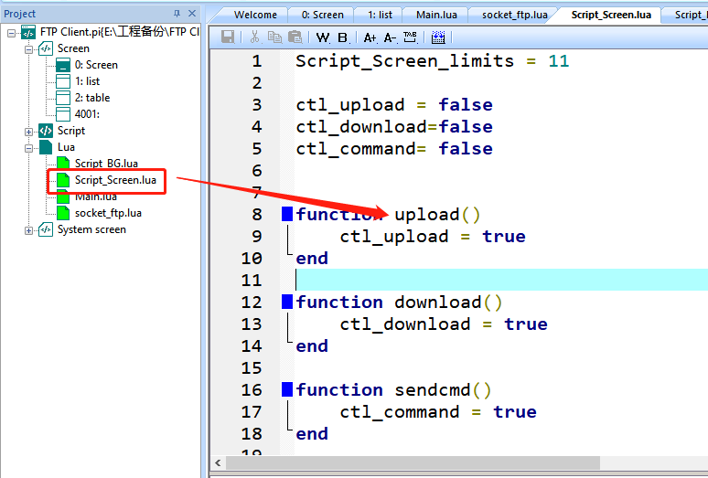
Core code of FTP Client
Lua button with upload() function;
Control rising edge of variable;

Slide 9
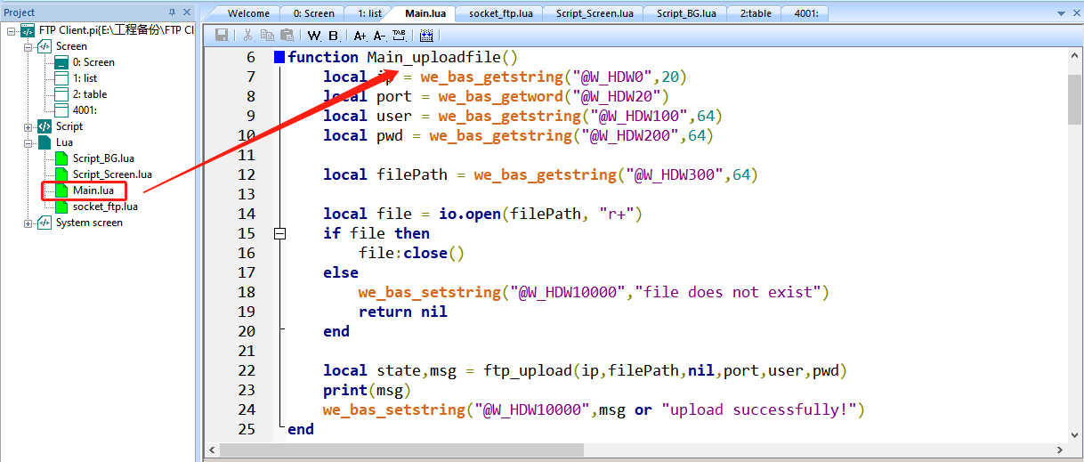
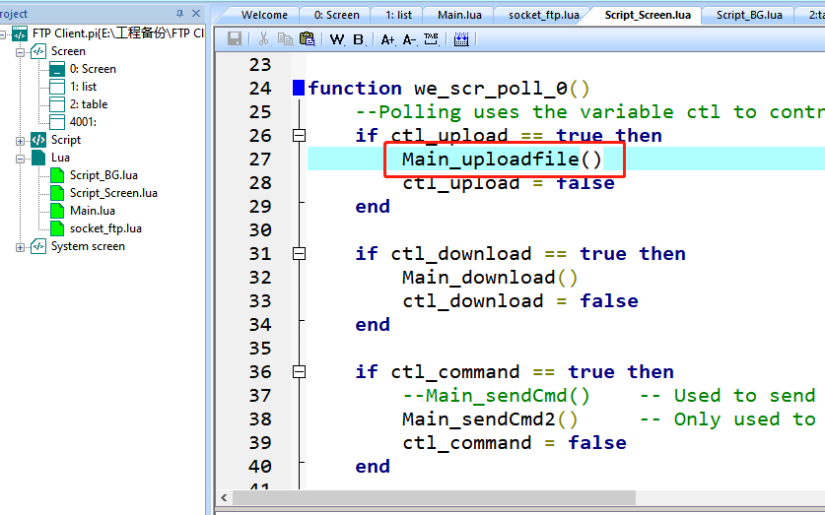
Core code of FTP Client
When rising edge, call the main function;
According to the server parameters to upload;

Slide 10
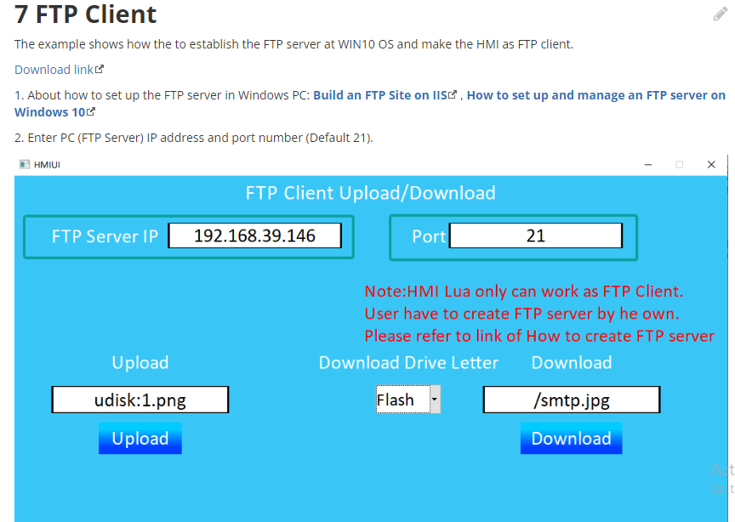
Instance
https://docs.we-con.com.cn/bin/view/PIStudio/2%20Demo/Lua%20Script/#H7FTPClient

Slide 11
THANK YOU!

