Slide 1
Lua Script: HTTP and JSON
Presented by Hunter
福州富昌维控电子科技有限公司
FUZHOU FU CHANG WECON ELECTRONICS TECHNOLOGY CO.,LTD

Slide 2
Catalog
1
What is HTTP
2
What is JSON
3
How to request HTTP

Slide 3
What is HTTP

Slide 4
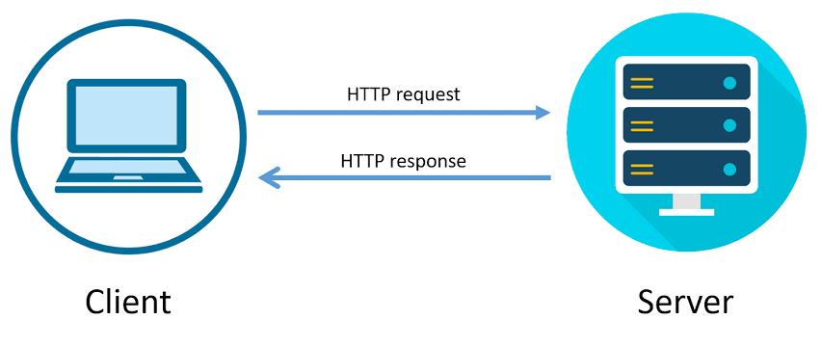
HTTP
HTTP is Hypertext Transfer Protocol

Slide 5
What is JSON

Slide 6
JSON
JSON is JavaScript Object Notation
Official website: https://www.json.org/json-en.html

Slide 7
How to Request HTTP

Slide 8
Preparation Work Before Request
First Step: Find the HTTP API document of server;
Second Step: Try to connect with server with a http request tool or others kind of online API explorer according to document instruction;
Third Step: Programming in the code;
Tool link: https://www.postman.com/

Slide 9
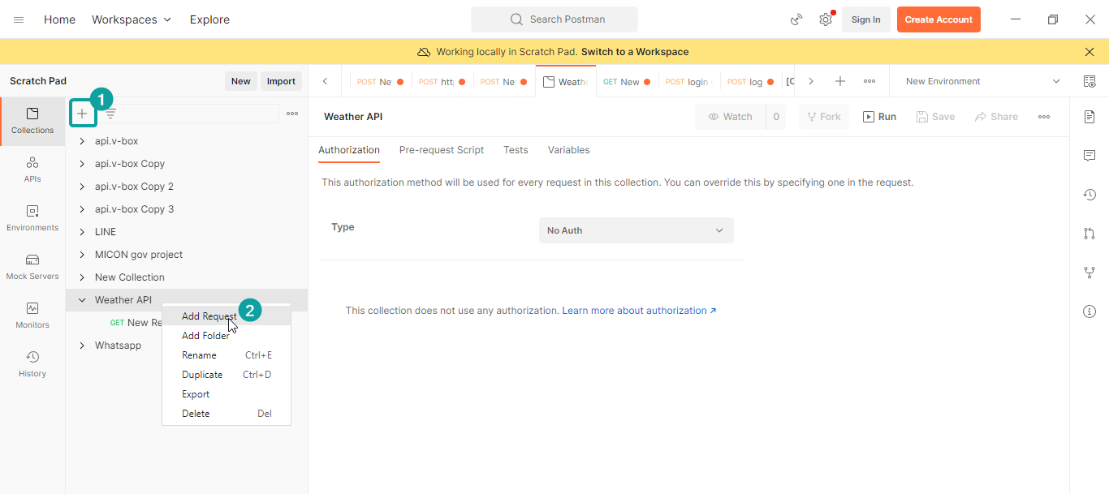
Preparation Work Before Request
Create new collection and new request

Slide 10
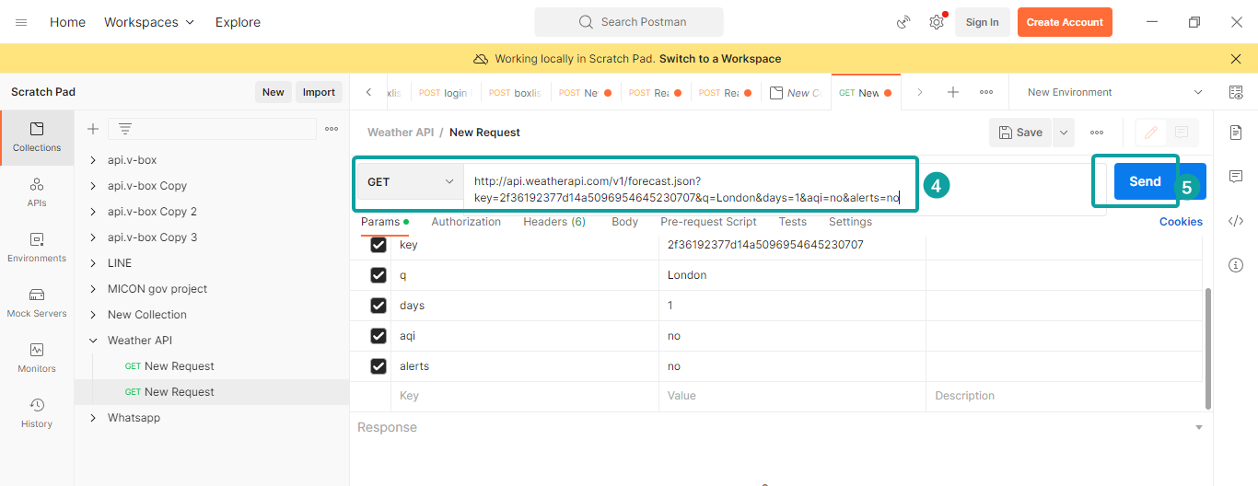
Preparation Work Before Request
Paste into URL bar and click Send

Slide 11
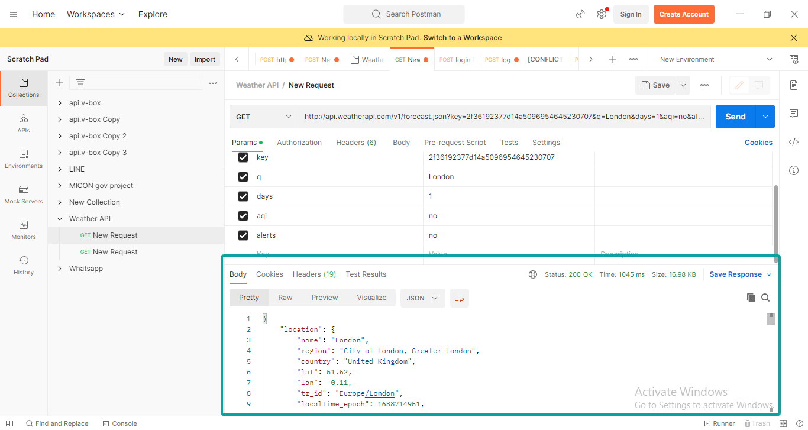
Preparation Work Before Request
Check the response result

Slide 12
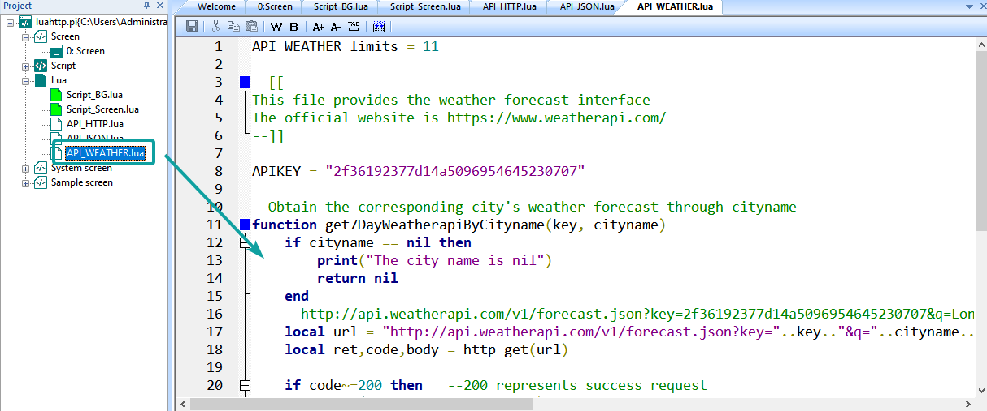
Instance
https://ftp.we-con.com.cn/Download/WIKI/PI%20HMI/Demo/Lua%20Script/luahttp.zip

Slide 13
THANK YOU!

