Slide 1
Lua Script: MQTT Client
Presented by Hunter
福州富昌维控电子科技有限公司
FUZHOU FU CHANG WECON ELECTRONICS TECHNOLOGY CO.,LTD

Slide 2
Catalog
1
What is MQTT
2
Preparation
3
How to Connect

Slide 3
What is MQTT

Slide 4
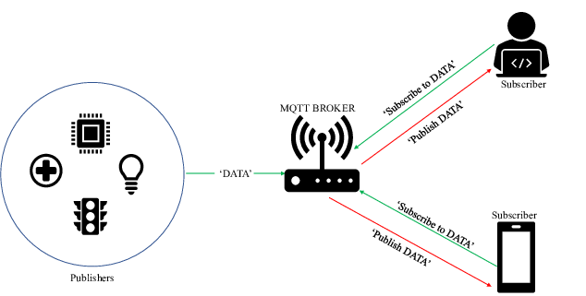
MQTT
MQTT is a transport protocol for network

Slide 5
Preparation

Slide 6
Preparation Work Before Connection
Setup a MQTT server(broker);
Try to connect with server with a MQTT Client tool successfully;
Tool link: http://mqttfx.jensd.de/index.php

Slide 7
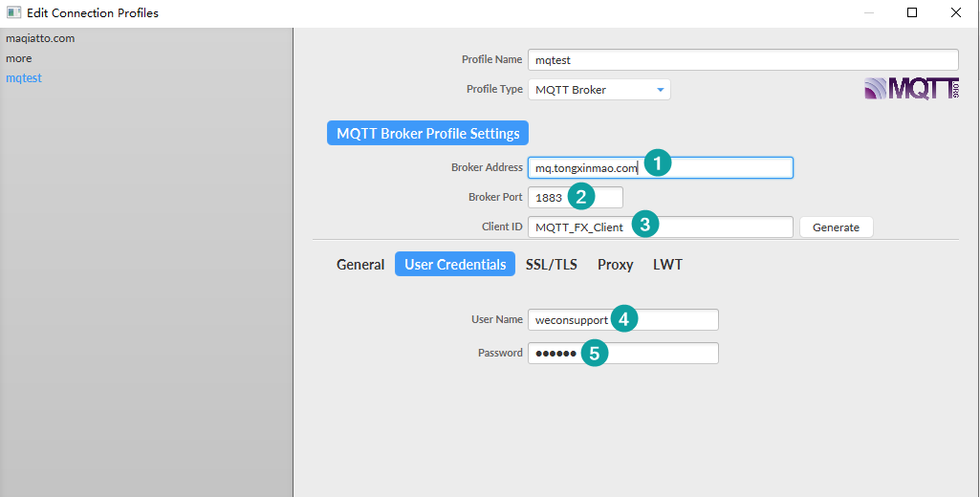
Preparation Work Before Connection
Modify Connection Configuration

Slide 8
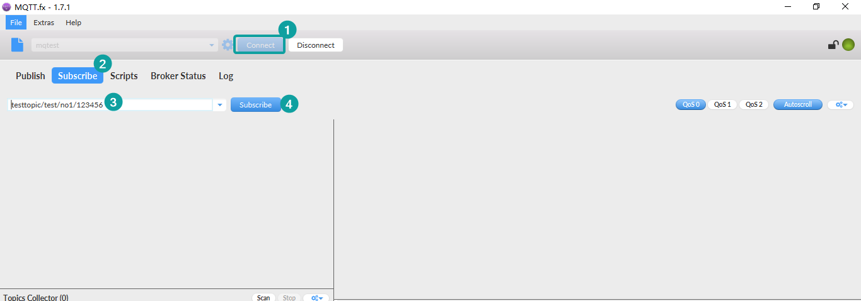
Preparation Work Before Connection
Subscribe Topic

Slide 9
Preparation Work Before Connection
Publish Topic

Slide 10
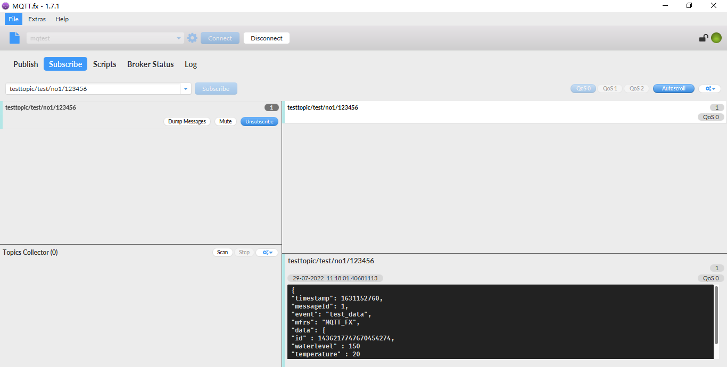
Preparation Work Before Connection
Test Message & Result
{
"timestamp": 1631152760,
"messageId": 1,
"event": "test_data",
"mfrs": "MQTT_FX",
"data": {
"id" : 1436217747670454274,
"waterlevel" : 150,
"temperature" : 20
}
}

Slide 11
How to Connect

Slide 12
Lua Script Programming
Initialize mqtt object
1
Connect to mqtt
2
Subscribe/Publish topic
3

Slide 13
V-Box Demo Script Snippet Code
Complete Code:
https://docs.we-con.com.cn/bin/view/V-BOX/V-Net/Training/2.Script/#H2.1V-Boxconnectwithtestserver28GeneralExample29
function MQTT.main()
--dosomething
print(os.date("%Y-%m-%d %H:%M %S", os.time()) .. " main start")
--determine the mqtt object whether exist
if g_mq then
--determine the mqtt object whether has been connected or not
if g_mq:isconnected() then
send_data()
else
if os.time() - LAST_TIME > 20 then
LAST_TIME = os.time()
--connect to mqtt
mqtt_connect()
end
end
else
--mqtt object does not exist so create new one
mqtt_init()
end
print(os.date("%Y-%m-%d %H:%M %S", os.time()) .. " main end")
end

Slide 14
HMI Demo Script Snippet Code
Complete Project:
https://docs.we-con.com.cn/bin/view/PIStudio/2%20Demo/Lua%20Script/#H2MQTTClient
-- mqtt execution
function mqtt_loop()
if obj then
if obj:isconnected() then
send_data()
else
mqtt_connect()
end
else
mqtt_init()
end
end

Slide 15
THANK YOU!

