Slide 1

Lua Script: MQTT & OpenCloud
Presented by Hunter
福州富昌维控电子科技有限公司
FUZHOU FU CHANG WECON ELECTRONICS TECHNOLOGY CO.,LTD

Slide 2
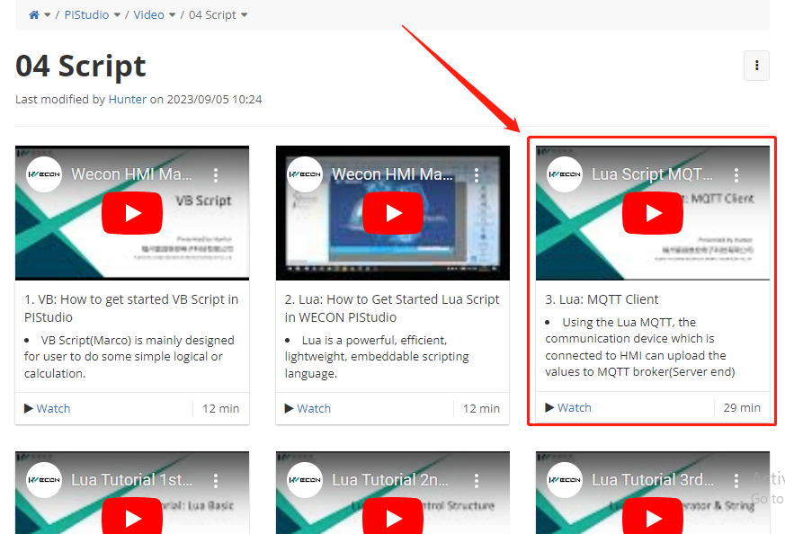
Previous Tips
Relevant Traning on Lua MQTT Client
https://docs.we-con.com.cn/bin/view/PIStudio/3%20Video/Script/

Slide 3
Catalog
1
What is OpenCloud
2
Huawei IOTDA Setup
3
Product Model Data Create
4
OpenCloud Function Demonstration

Slide 4
What is OpenCloud

Slide 5
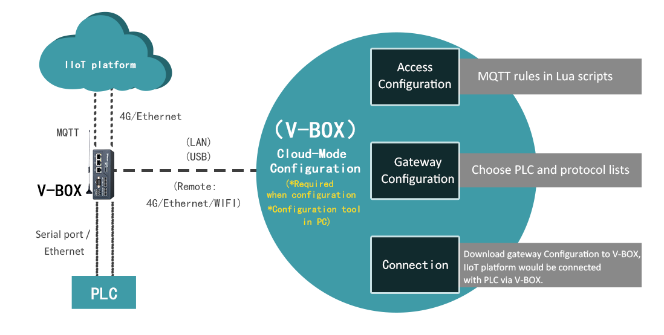
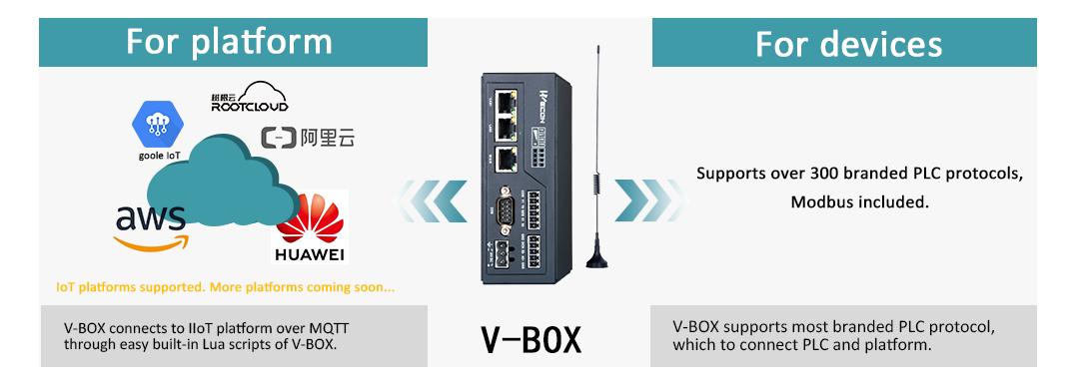
OpenCloud
OpenCloud is an "advanced version Lua MQTT"

Slide 6
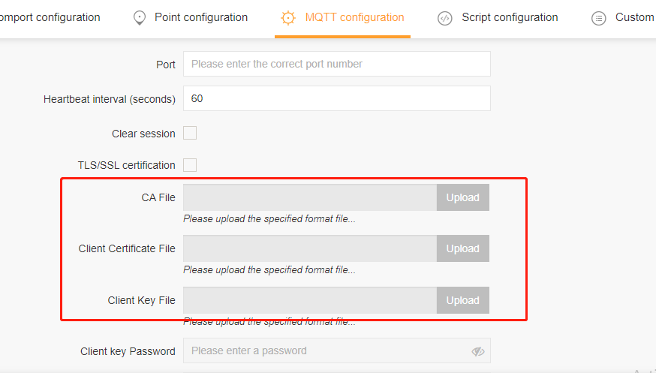
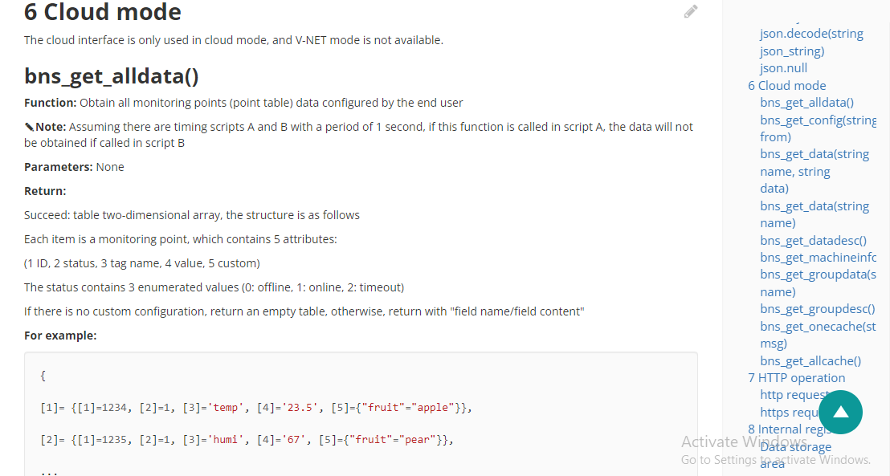
OpenCloud
For V-BOX:
We need to use the another OpenCloud platform rather than V-NET platform;
On this OpenCloud platform we will be able to upload certificate file;
OpenCloud designated functions;

Slide 7
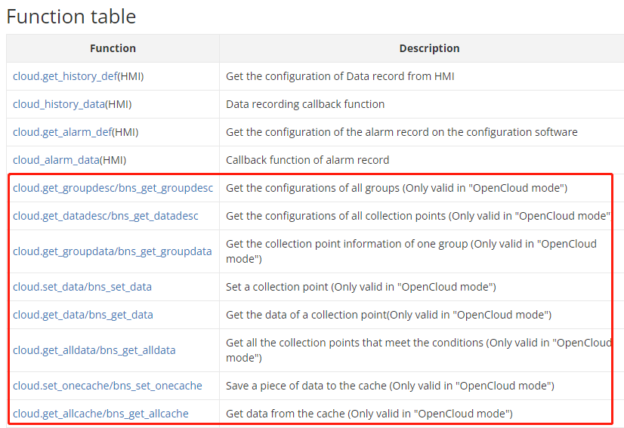
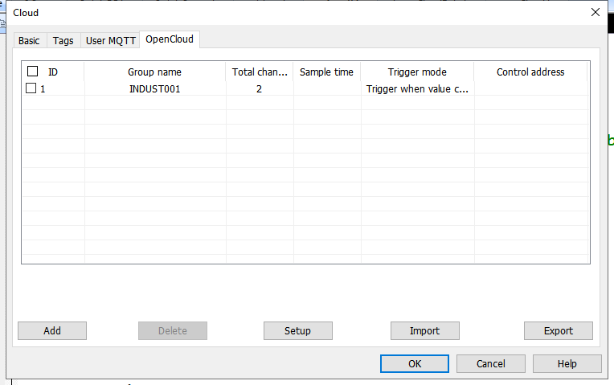
OpenCloud
For HMI:
OpenCloud configuration tab on PIStudio;
OpenCloud designated functions;

Slide 8
HUAWEI IoTDA Setup

Slide 9
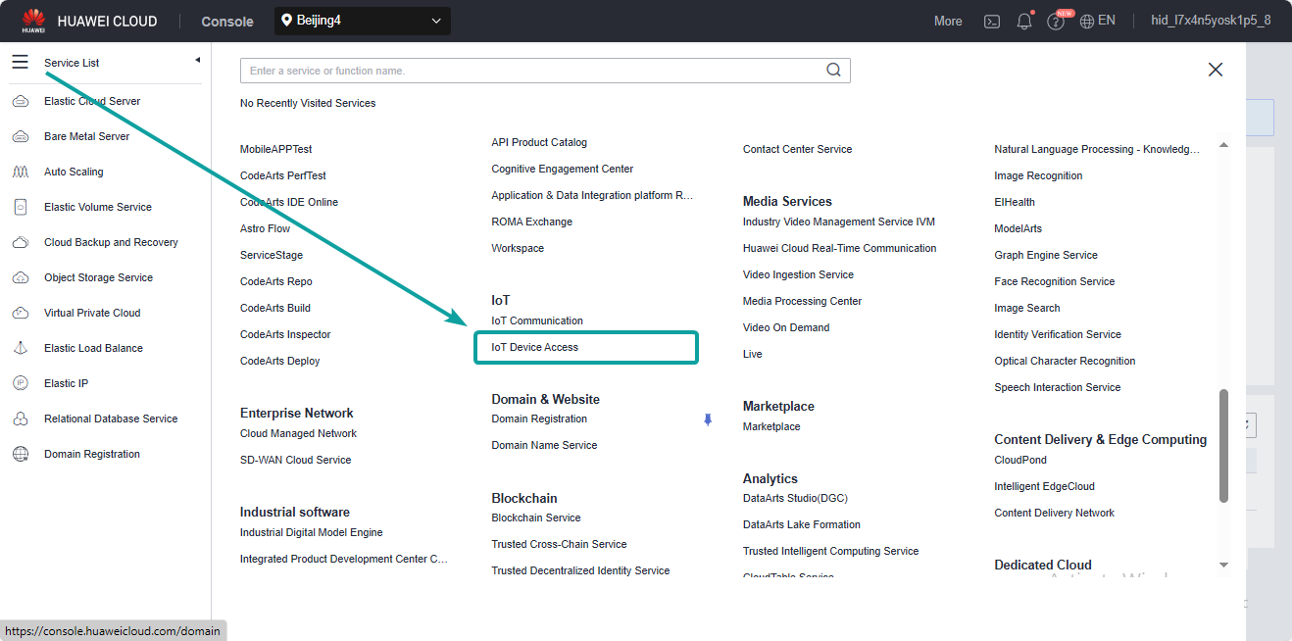
HUAWEI CLOUD
Find the option of IoT Device Access;

Slide 10
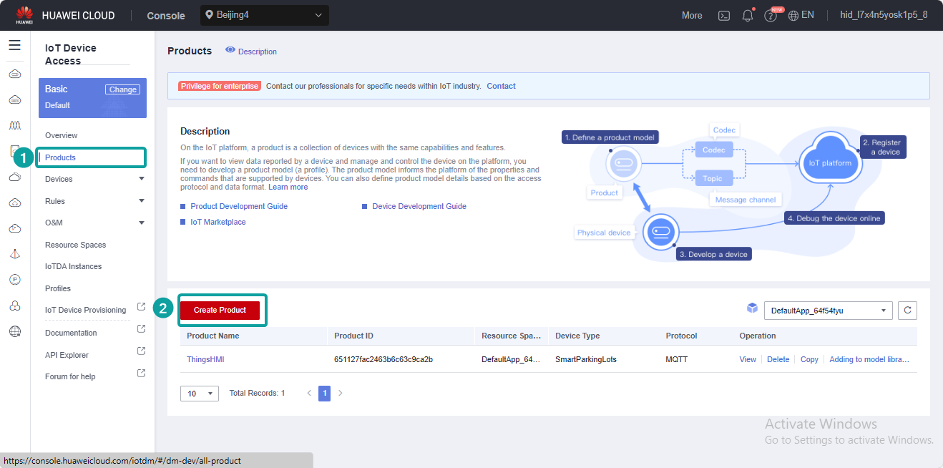
HUAWEI CLOUD
Create Product;

Slide 11
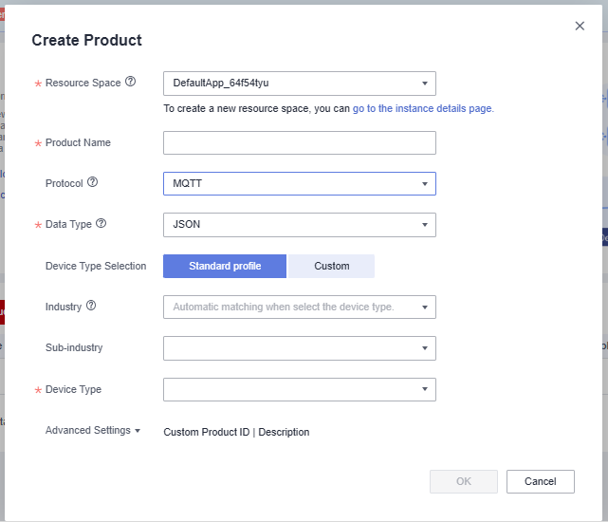
HUAWEI CLOUD
Protocol must be MQTT;
Data Type must be JSON;
And others field set as user's required;

Slide 12
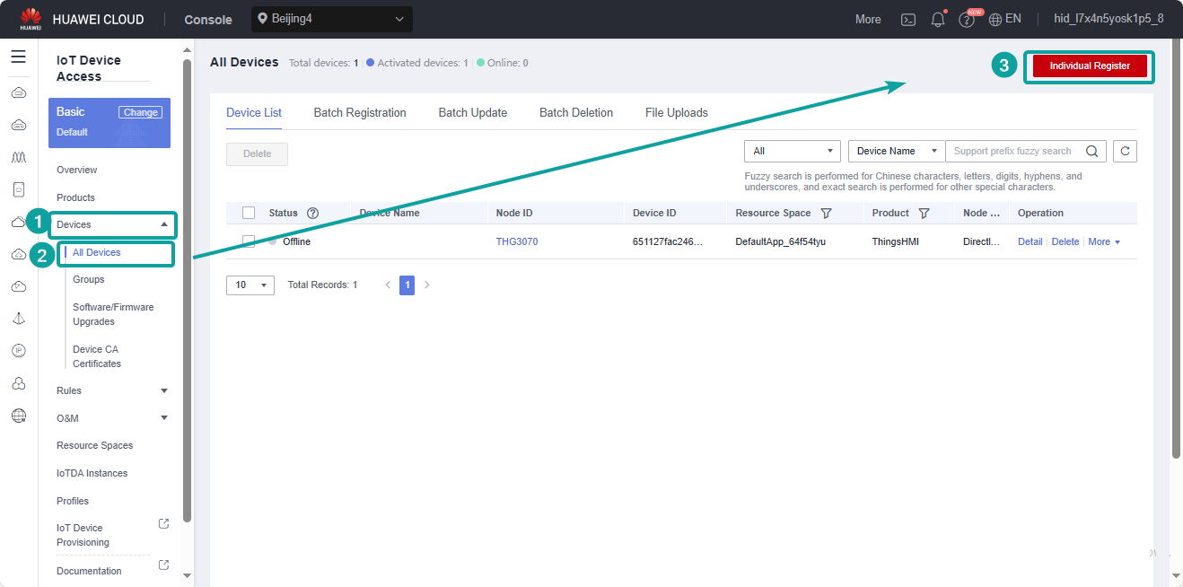
HUAWEI CLOUD
[Device]-[All Devices]-[Individual Register];

Slide 13
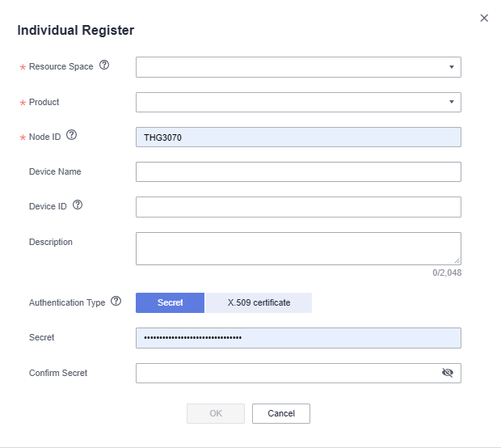
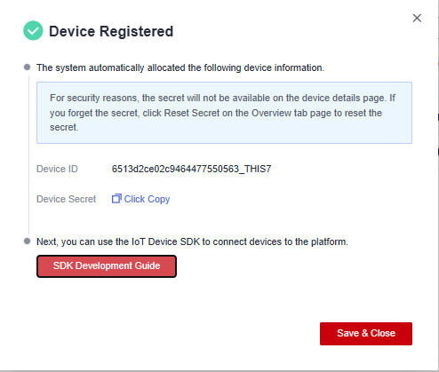
HUAWEI CLOUD
Register the Device;
After register is done, we would get the Device IP and DeviceSerect;

Slide 14
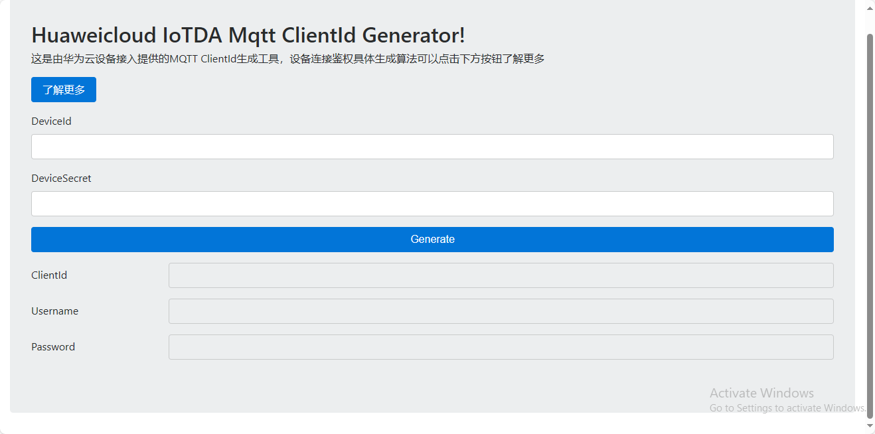
HUAWEI CLOUD
Using the online MQTT ClientId Generator to generate the MQTT parameter: Client ID, Username, Password:
https://iot-tool.obs-website.cn-north-4.myhuaweicloud.com/

Slide 15
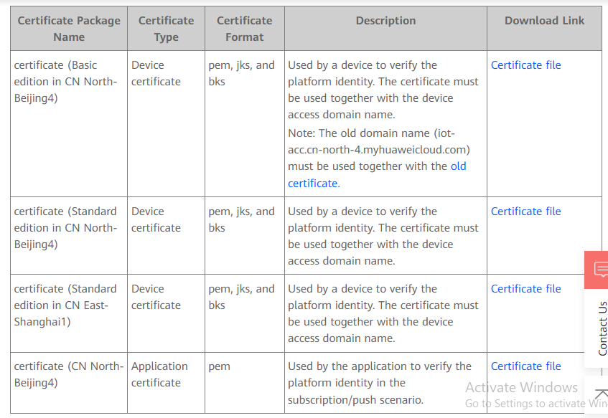
HUAWEI CLOUD
Check which server node and which edition we are using, and download the corresponding Device certificate file if using the secure MQTT port 8883(Optional);
https://support.huaweicloud.com/en-us/devg-iothub/iot_02_1004.html

Slide 16
Product Model Data Create

Slide 17
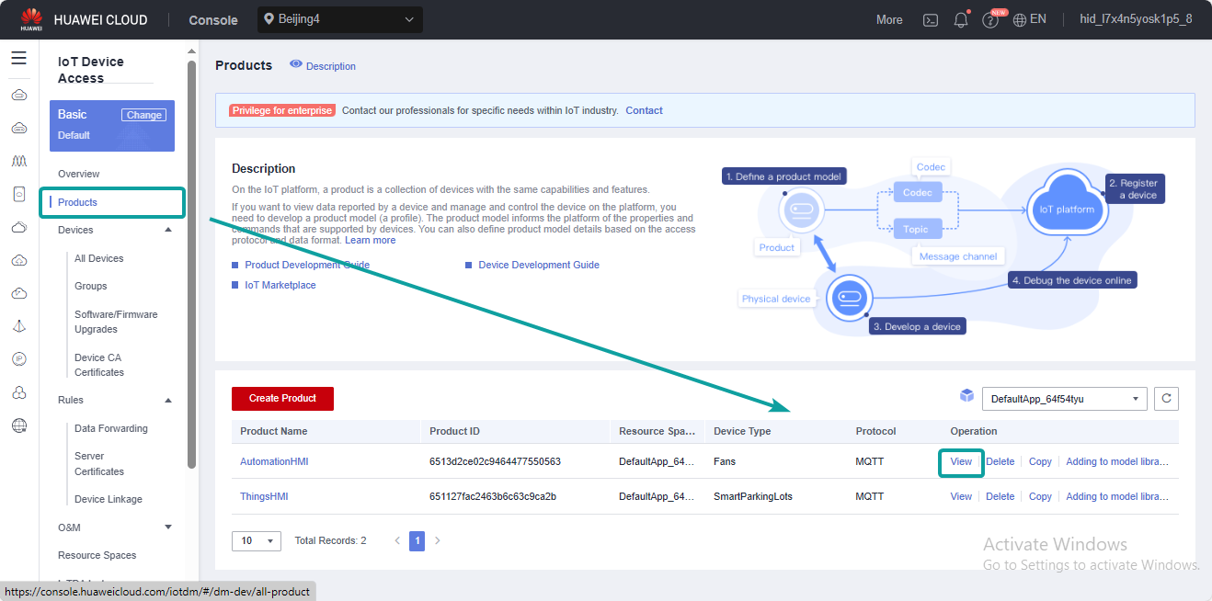
Device Data Report
[Product]-[View];

Slide 18
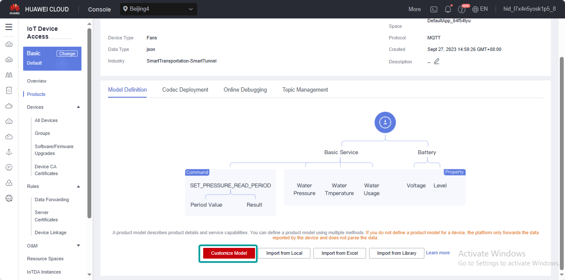
Device Data Report
[Customize Model];

Slide 19
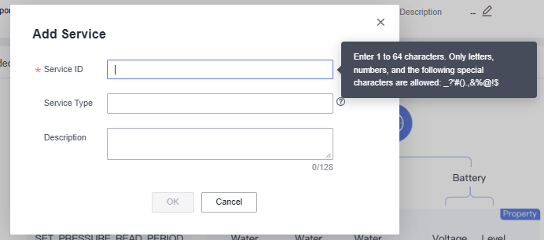
Device Data Report
Add the service;

Slide 20
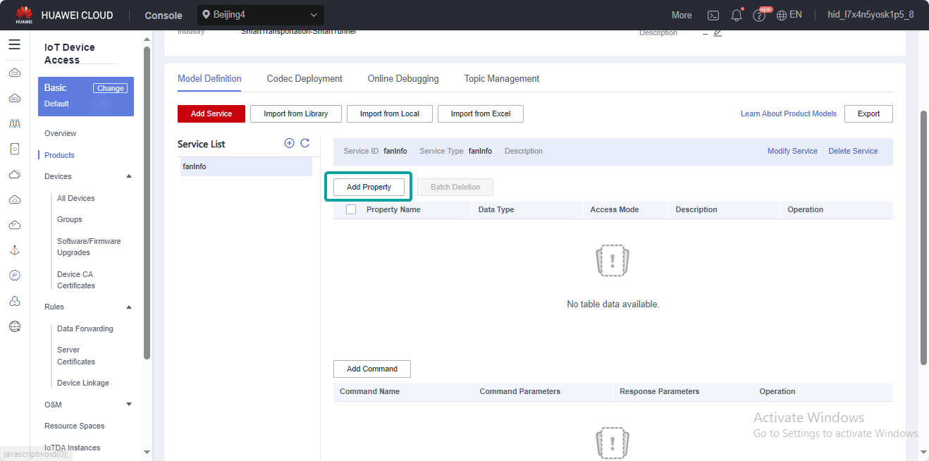
Device Data Report
Add the property as we need;

Slide 21
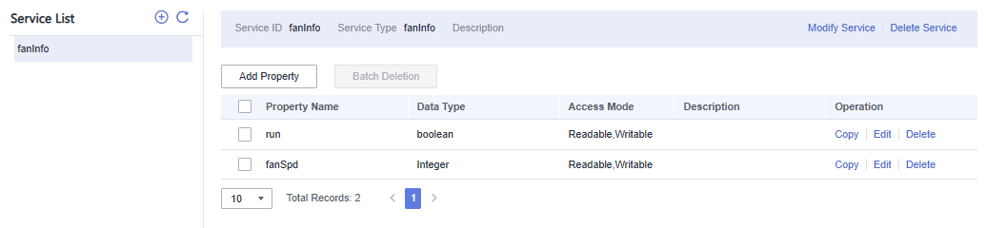




Device Data Report
According to the created data to construct the JSON format;
{"services":
[
{
"properties":
{
"fanSpd":50,
"run":"0"
},
"service_id":"fanInfo"
}
]
}

Slide 22
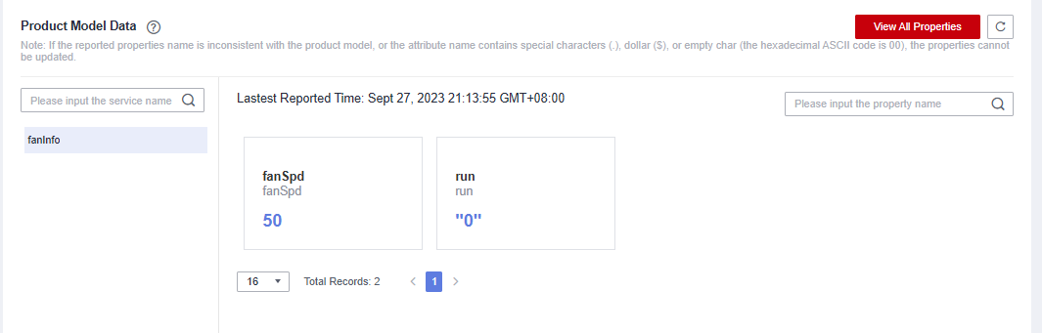
Device Data Report
Publish the JSON message by MQTT test tool, if it is showing the result on the Product Model Data, which means our construct data is OK;
The topic format should be $oc/devices/{device_id}/sys/properties/report

Slide 23
Device Data Report
Above all the content are refer from the HUAWEI CLOUD Help Center, please check the following link if there is still not clear:
https://support.huaweicloud.com/en-us/devg-iothub/iot_02_1004.html

Slide 24
OpenCloud Function Demonstration

Slide 25
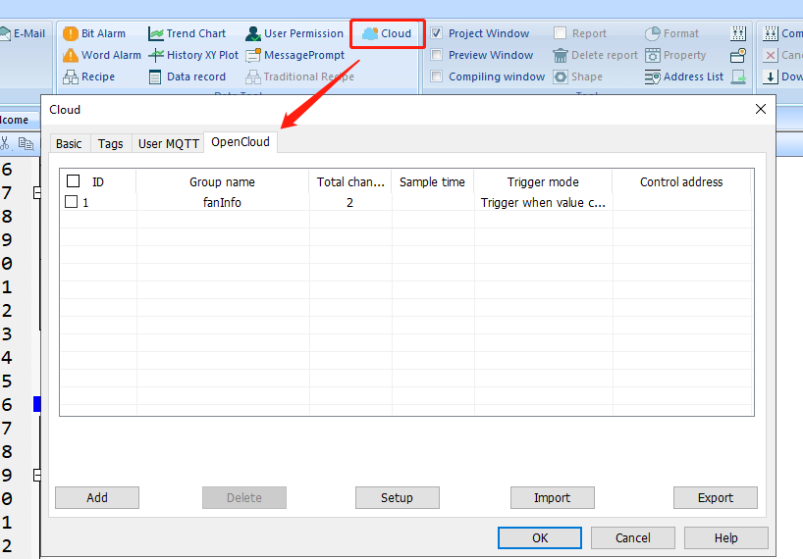
OpenCloud
[Cloud]-[OpenCloud]

Slide 26
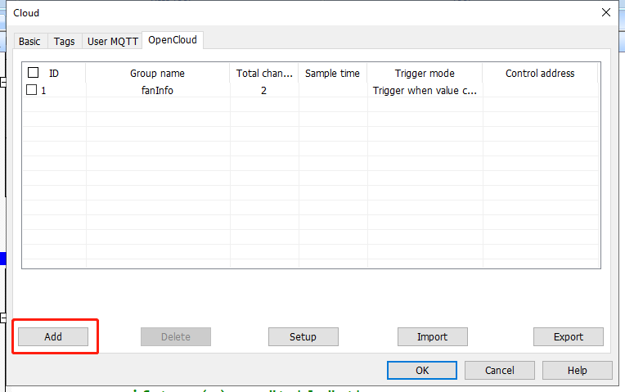
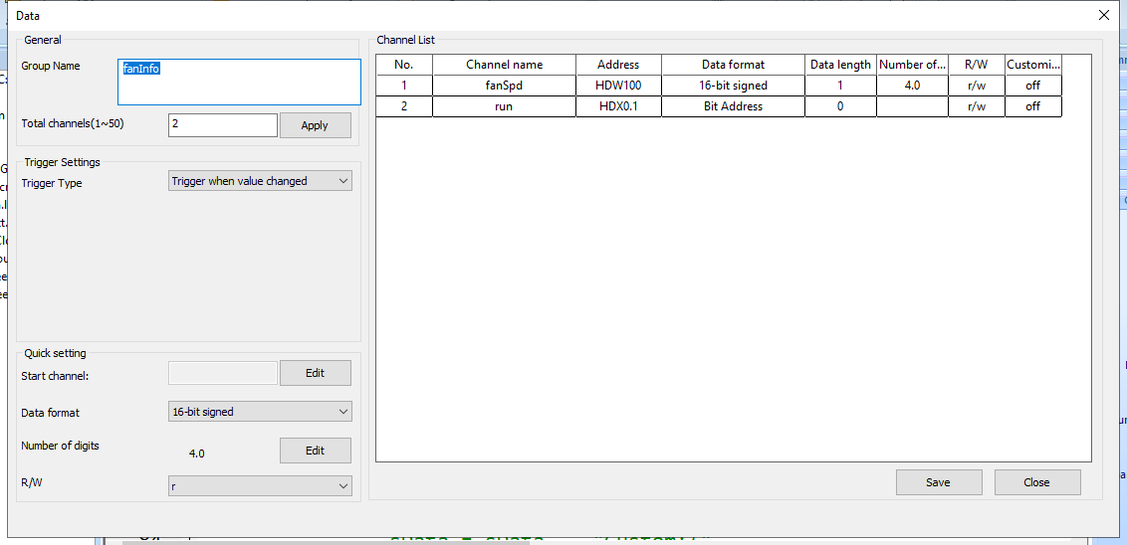
OpenCloud
Add the new group;
Add the channel we want to report(group name and channel name should be consistent with the service name on the platform);

Slide 27
OpenCloud
Using the corresponding function to get the group and data info and put into the message we want to publish;
local groupInfo = cloud.get_groupdesc()
local serviceName = groupInfo[1][2]
local fangroup = cloud.get_groupdata(serviceName)
local property1 = fangroup[1][3]
local property2 = fangroup[2][3]
local fan = {}
fan[1] = {
properties = {
fanSpd = cloud.get_data(property1),
run = cloud.get_data(property2)
},
service_id = serviceName
}
local pub_data = {
services = fan
}
mqtt_publish(PUBLISH_TOPIC, json.encode(pub_data))

Slide 28
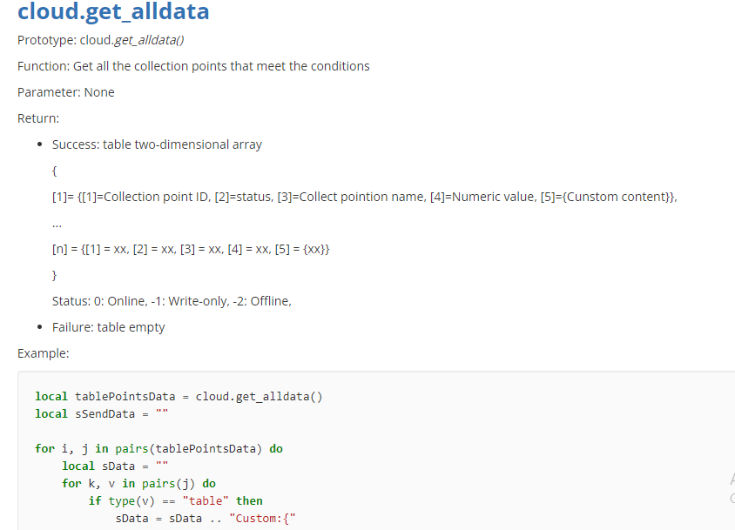
OpenCloud
We can utilize some opencloud functions according to the user scenario requirements;

Slide 29
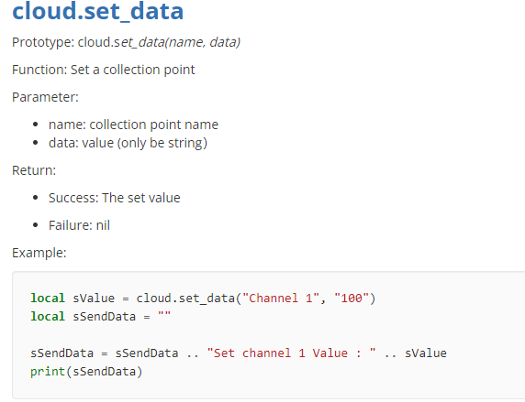
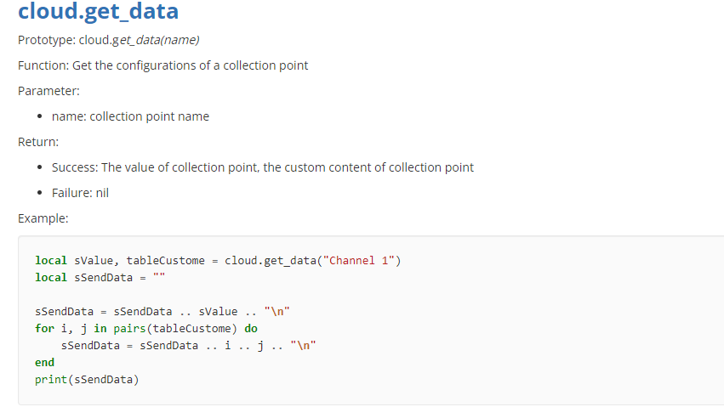
OpenCloud
We can utilize some opencloud functions according to the user scenario requirements;

Slide 30
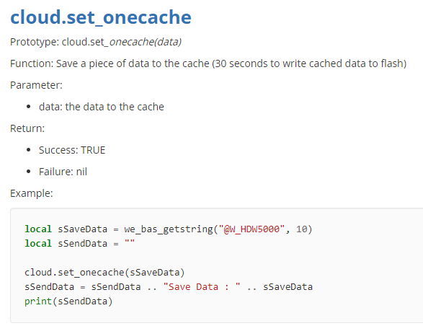
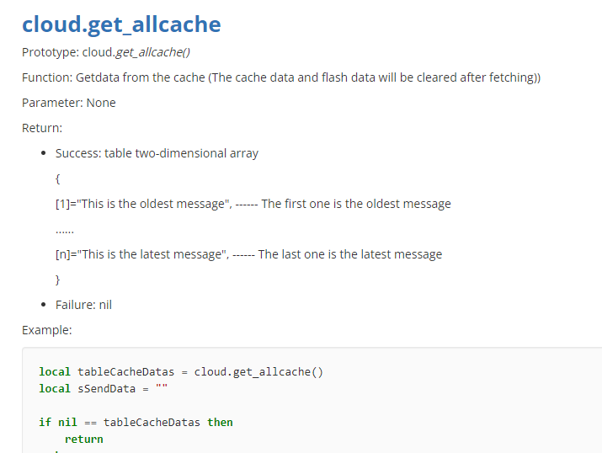
OpenCloud
We can utilize some opencloud functions according to the user scenario requirements;

Slide 31
THANK YOU!

