Slide 1
PIStudio Version9.0
Presented by Hunter
福建富昌维控电子科技股份有限公司
FUJIAN FUCAN WECON CO LTD

Slide 2
Catalog
A
PC Software
B
HMI Function
C
Protocol Driver
D
New Models

Slide 3
PC Software
New UI
Device Management Tool

Slide 4
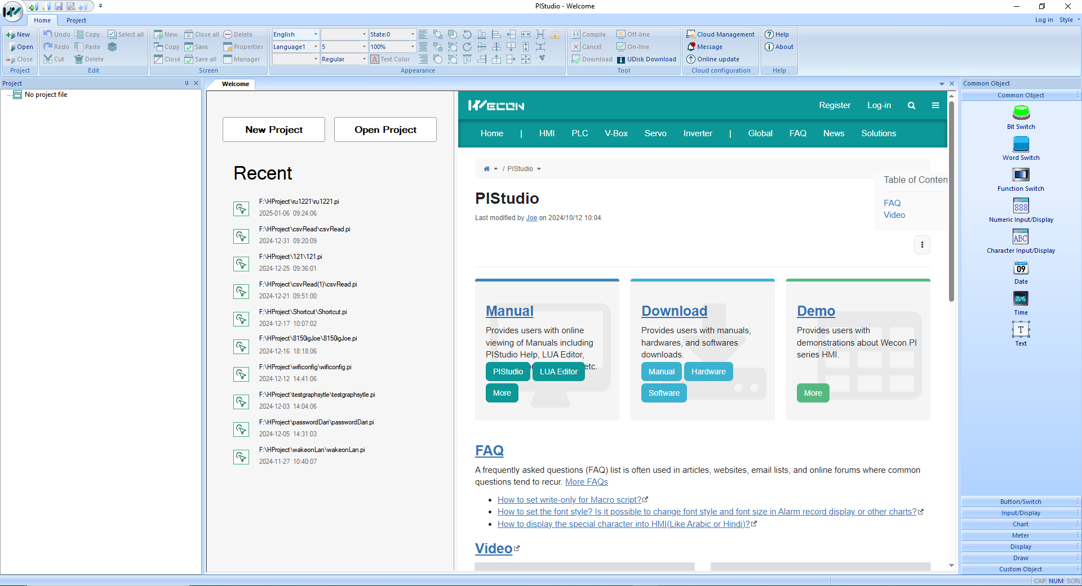
Configuration Software
Wecon support center now is embedded into PIStudio homepage.

Slide 5
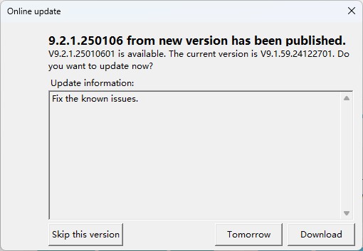
Online update
More easily to obtain the upgrade versions
Send upgrade package to the designated users

Slide 6
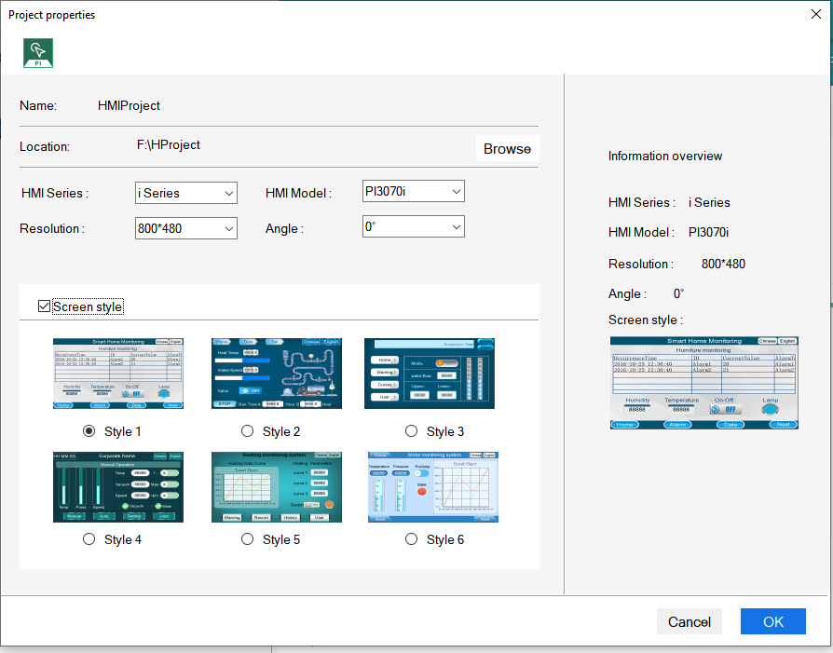
New Project
Project properties page

Slide 7
Screen Edit
Bigger configuration canvas
Draft Area
Screen Area
Draft Area
Draft Area
Screen Area
Draft Area
Now
Before

Slide 8
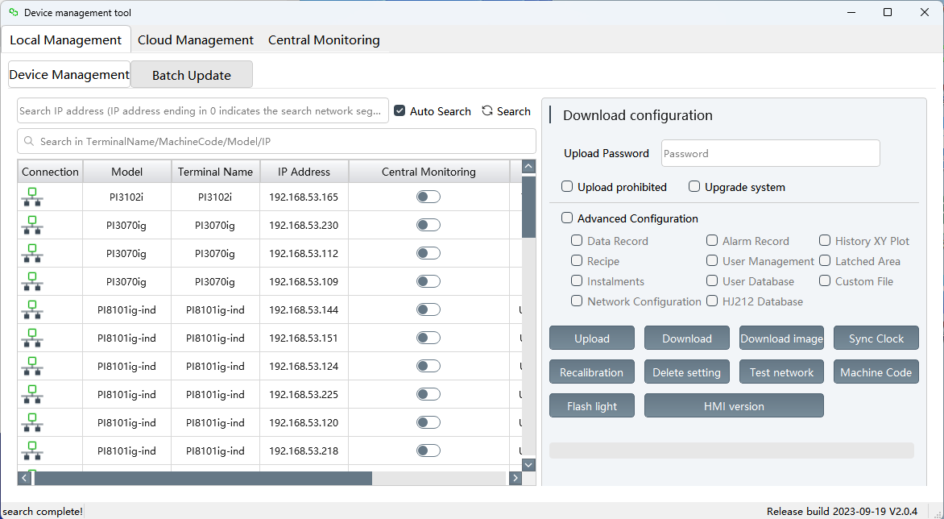
Device Management Tool
Local Management
Search HMI
Batch download

Slide 9
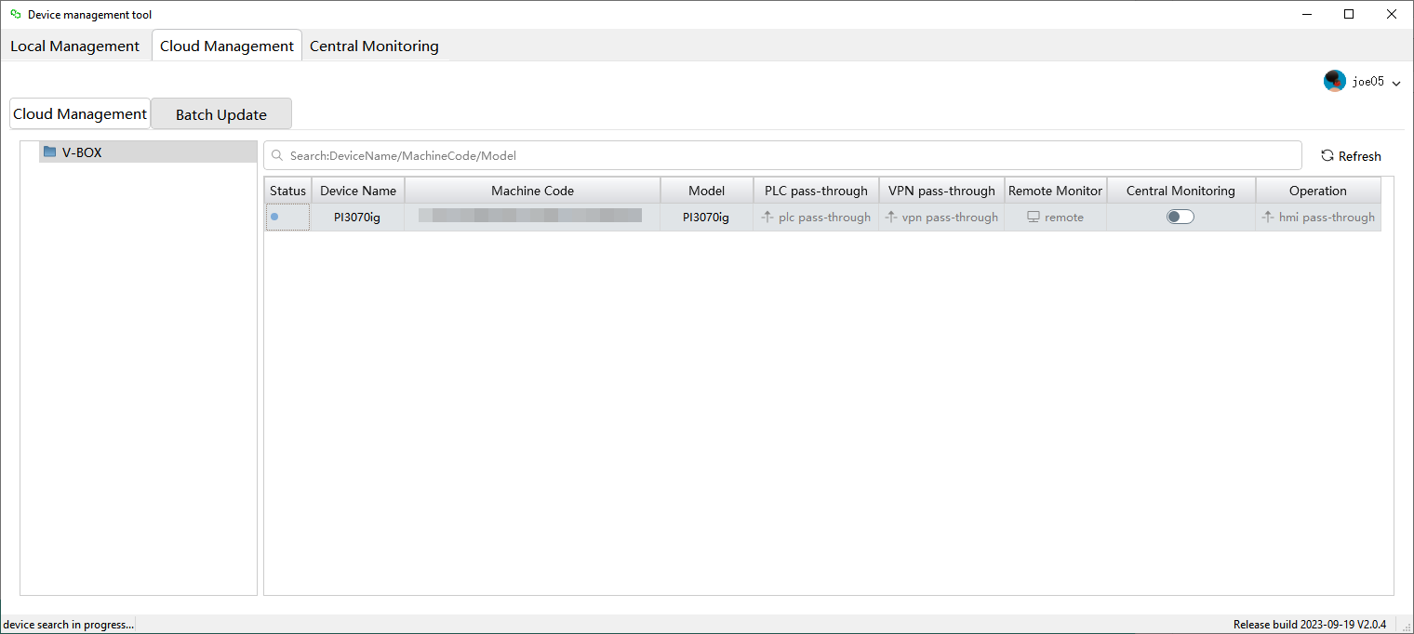
Device Management Tool
Cloud Management
Easily pass-through without opening the V-NET Client

Slide 10
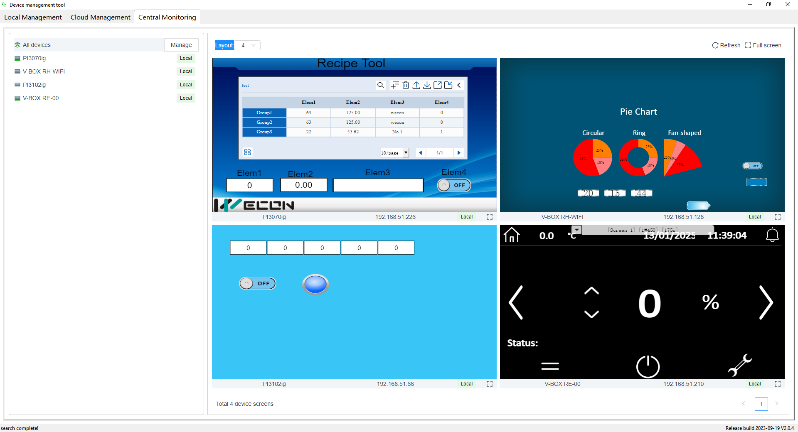
Device Management Tool
Central Monitoring
LAN device monitoring
Remote device monitoring

Slide 11
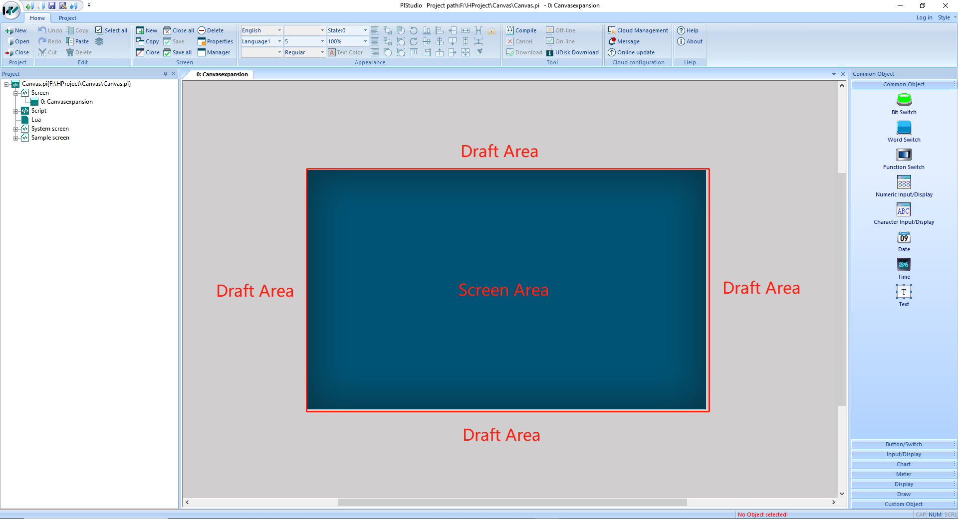
Summary
Quick Access
Online Update
UI Optimize
Canvas Expand
Single/Batch Download
Pass-through
Central Monitoring

Slide 12
HMI Function
New Object
New Function
New Backend UI

Slide 13
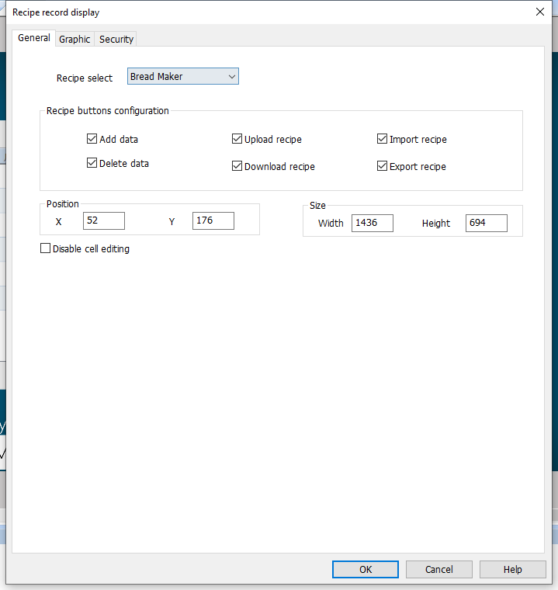
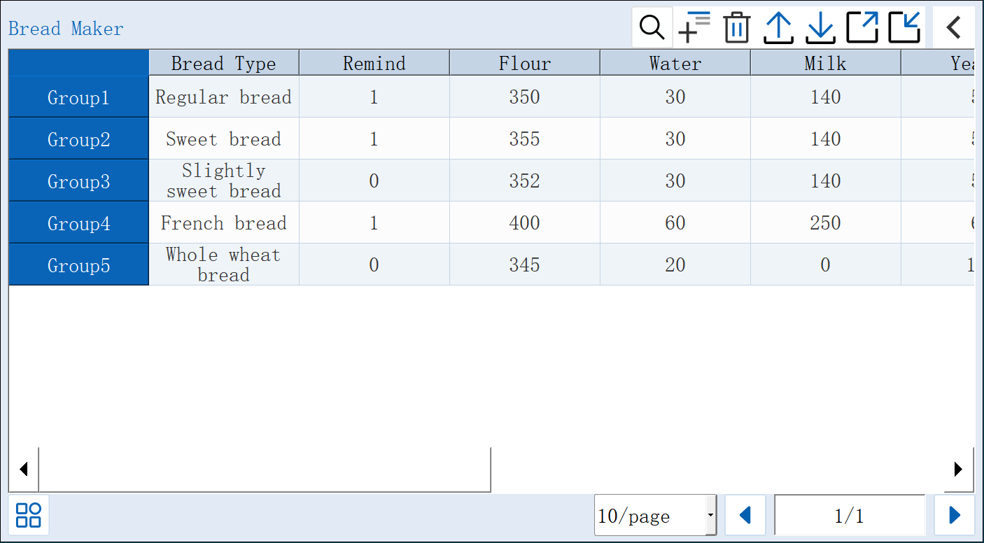
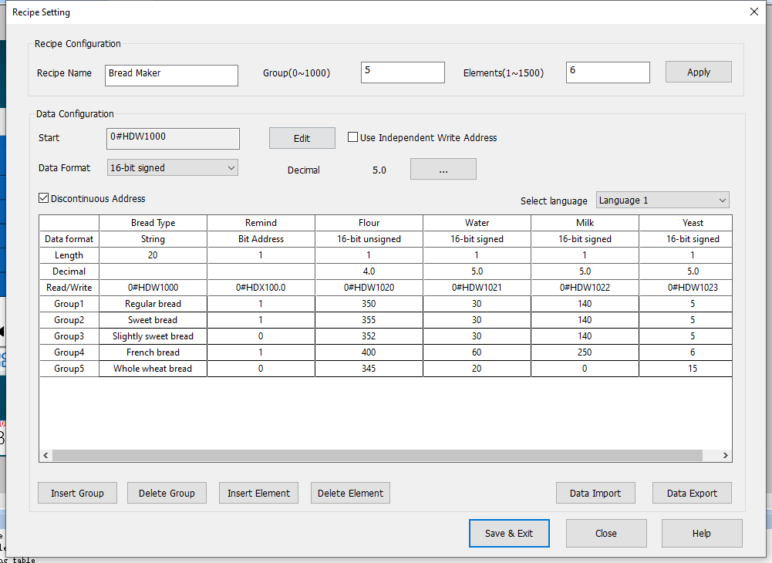
New Object
New
Recipe Record

Slide 14
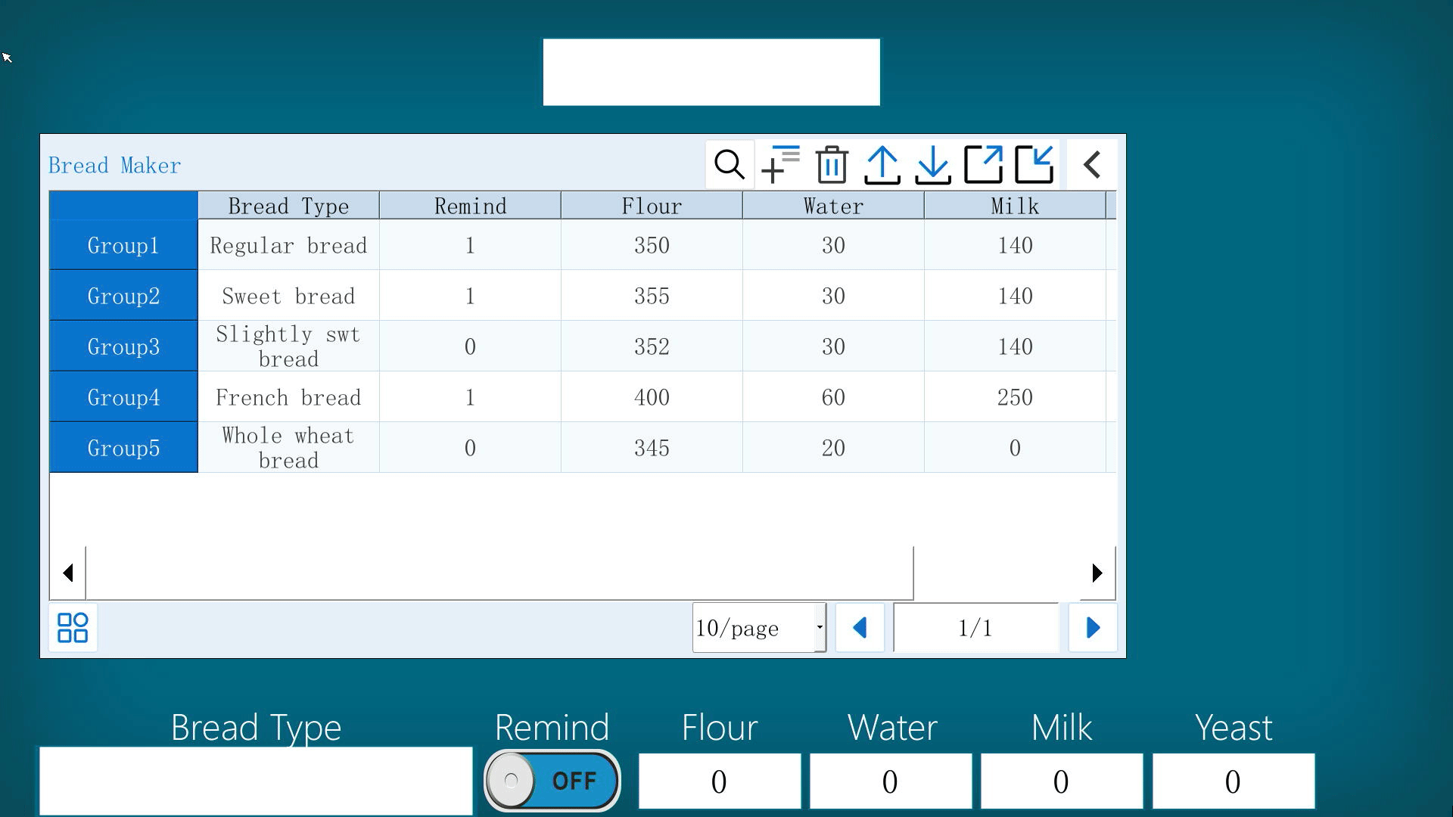
New Object
Recipe Download/Upload

Slide 15
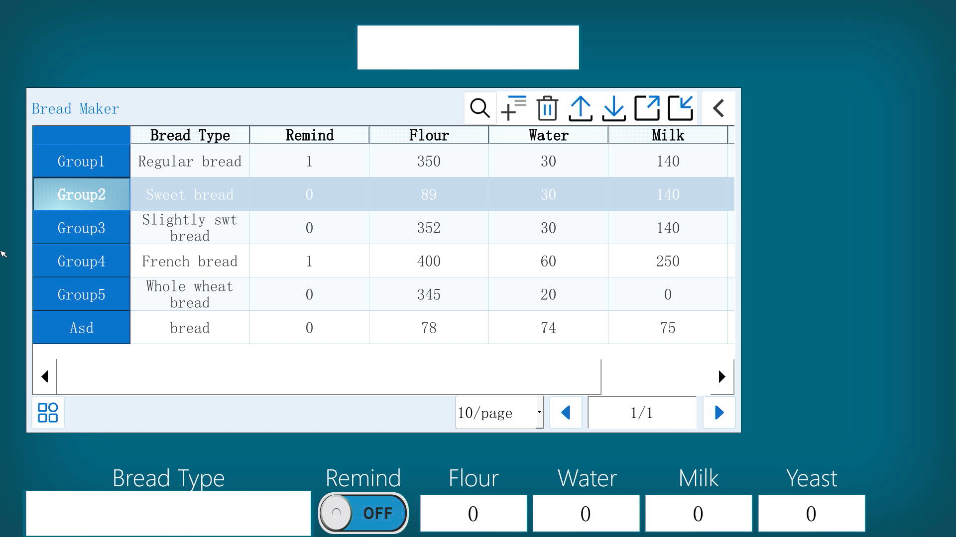
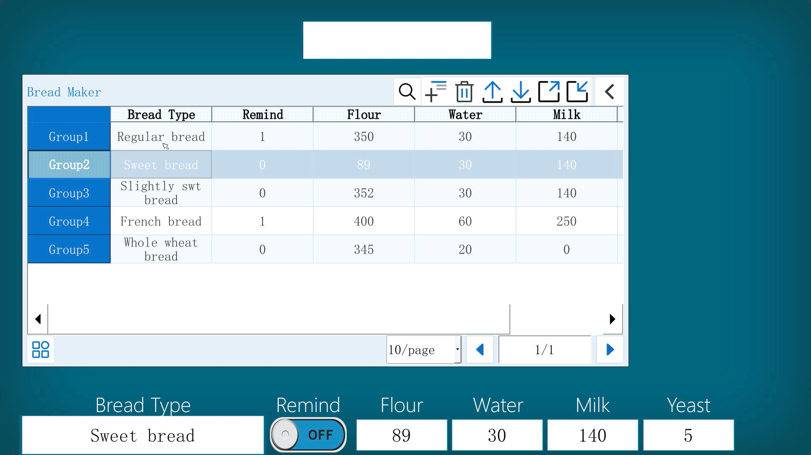
New Object
New, Query, Delete Recipe

Slide 16
New Object
Cell edit

Slide 17
New Object
Export csv, Import csv, Recipe file switch

Slide 18
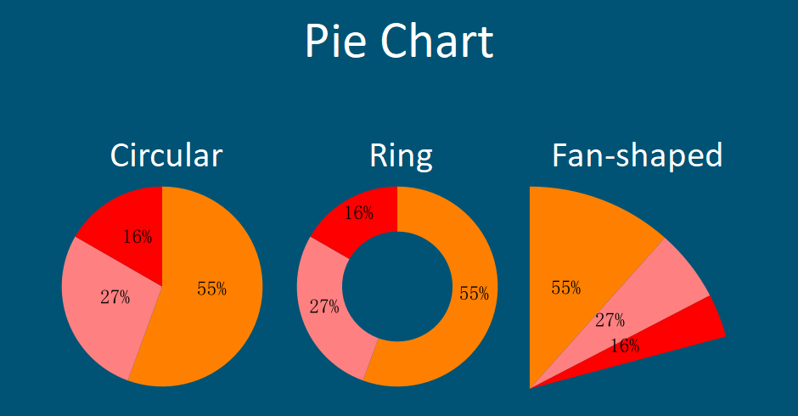
New Object
New
Pie Chart

Slide 19
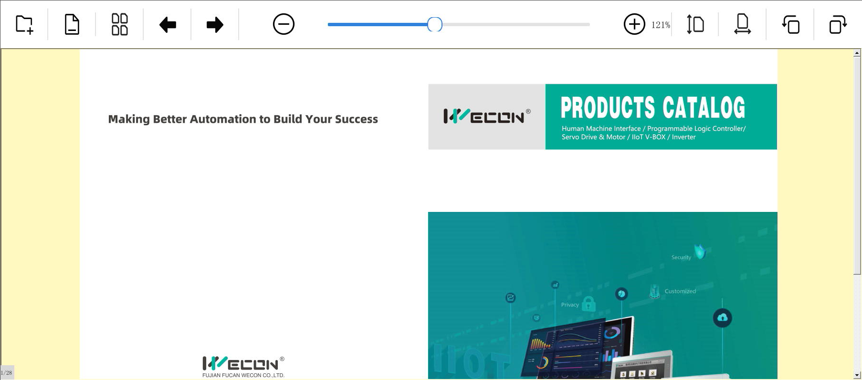
New Object
New
PDF Reader

Slide 20
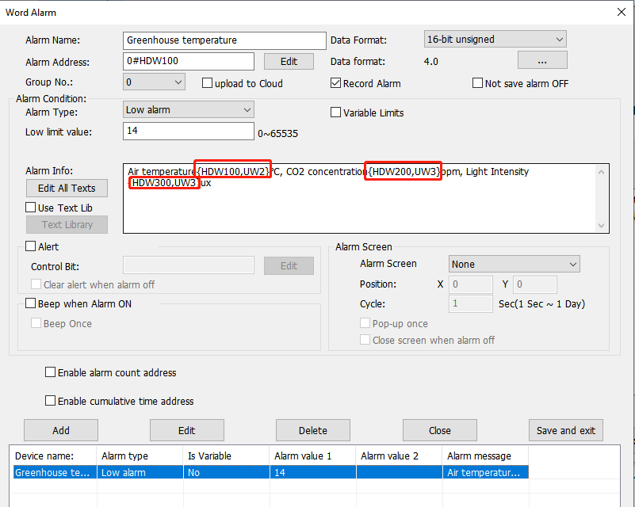
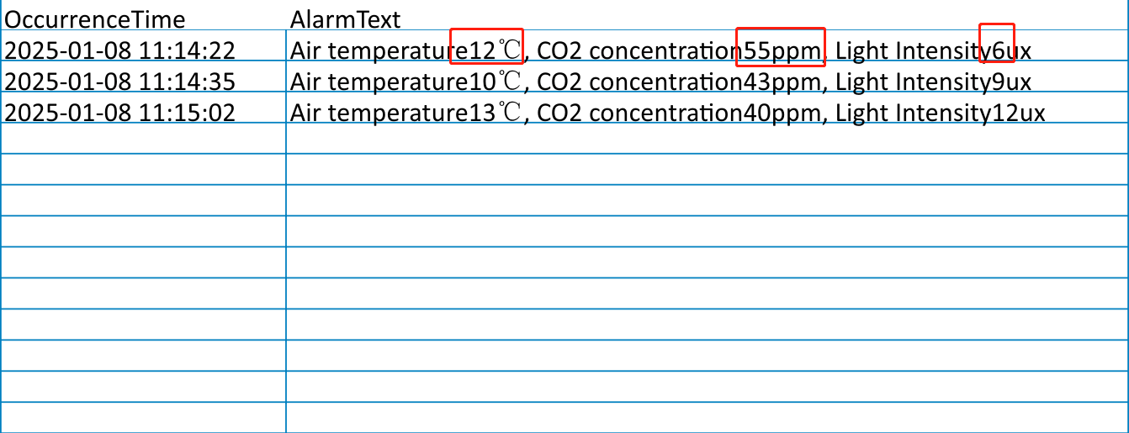
New Function
Alarm content support variables display

Slide 21
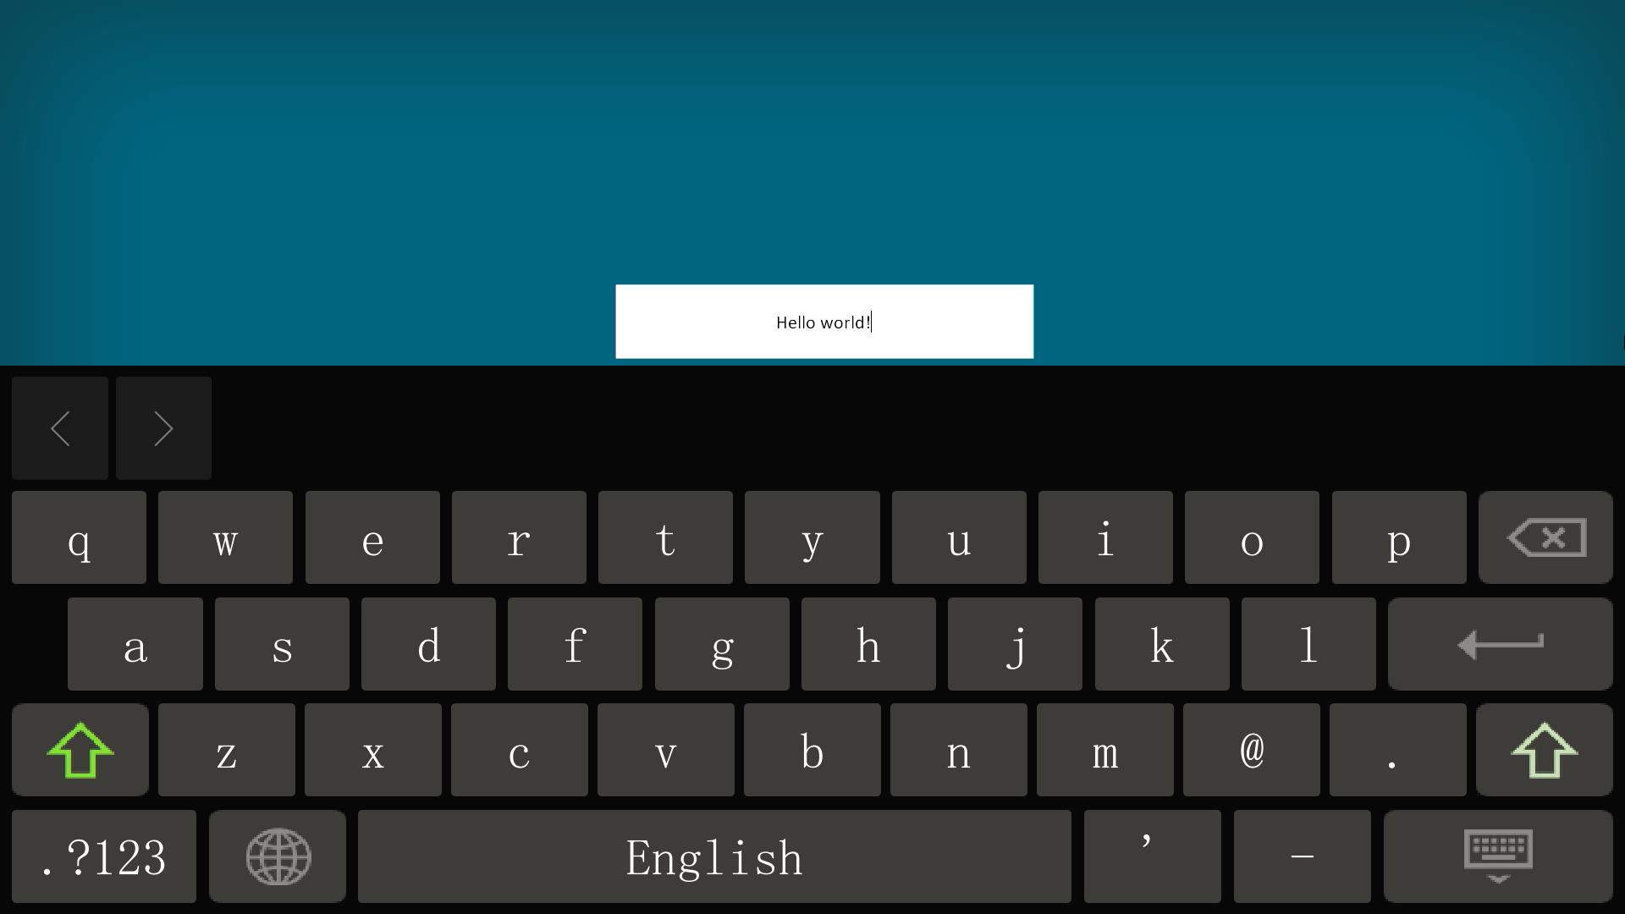
New Function
System keyboard

Slide 22
New Function
System keyboard

Slide 23
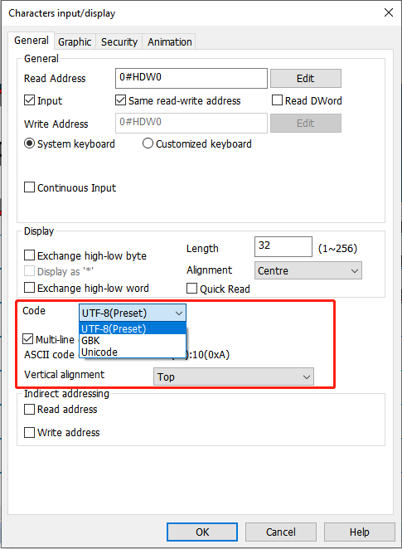
New Function
Multi-line display&Optional character encoding

Slide 24
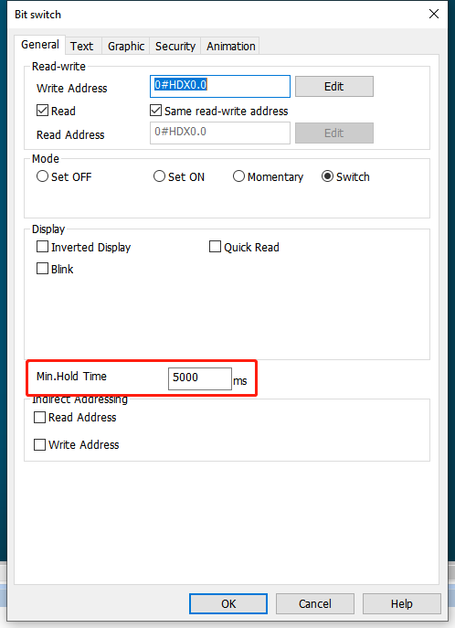
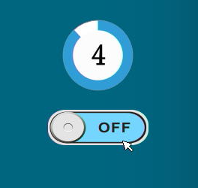
New Function
Countdown reminder

Slide 25
New Function
New Version Multi-link
Multi-link uses Ethernet cables to connect multiple HMIs through Master-Slave mode, allowing a single HMI project to be displayed across multiple screens.
In Multi-link connection, one HMI is Master, and all the others are Slave. Only Master HMI communicate with the PLC, the data received from the PLC is transmitted from the Master to each Slave.
PLC
Master
https://youtu.be/L42FruDtpSU
Slave1
Slave2
Slave3

Slide 26
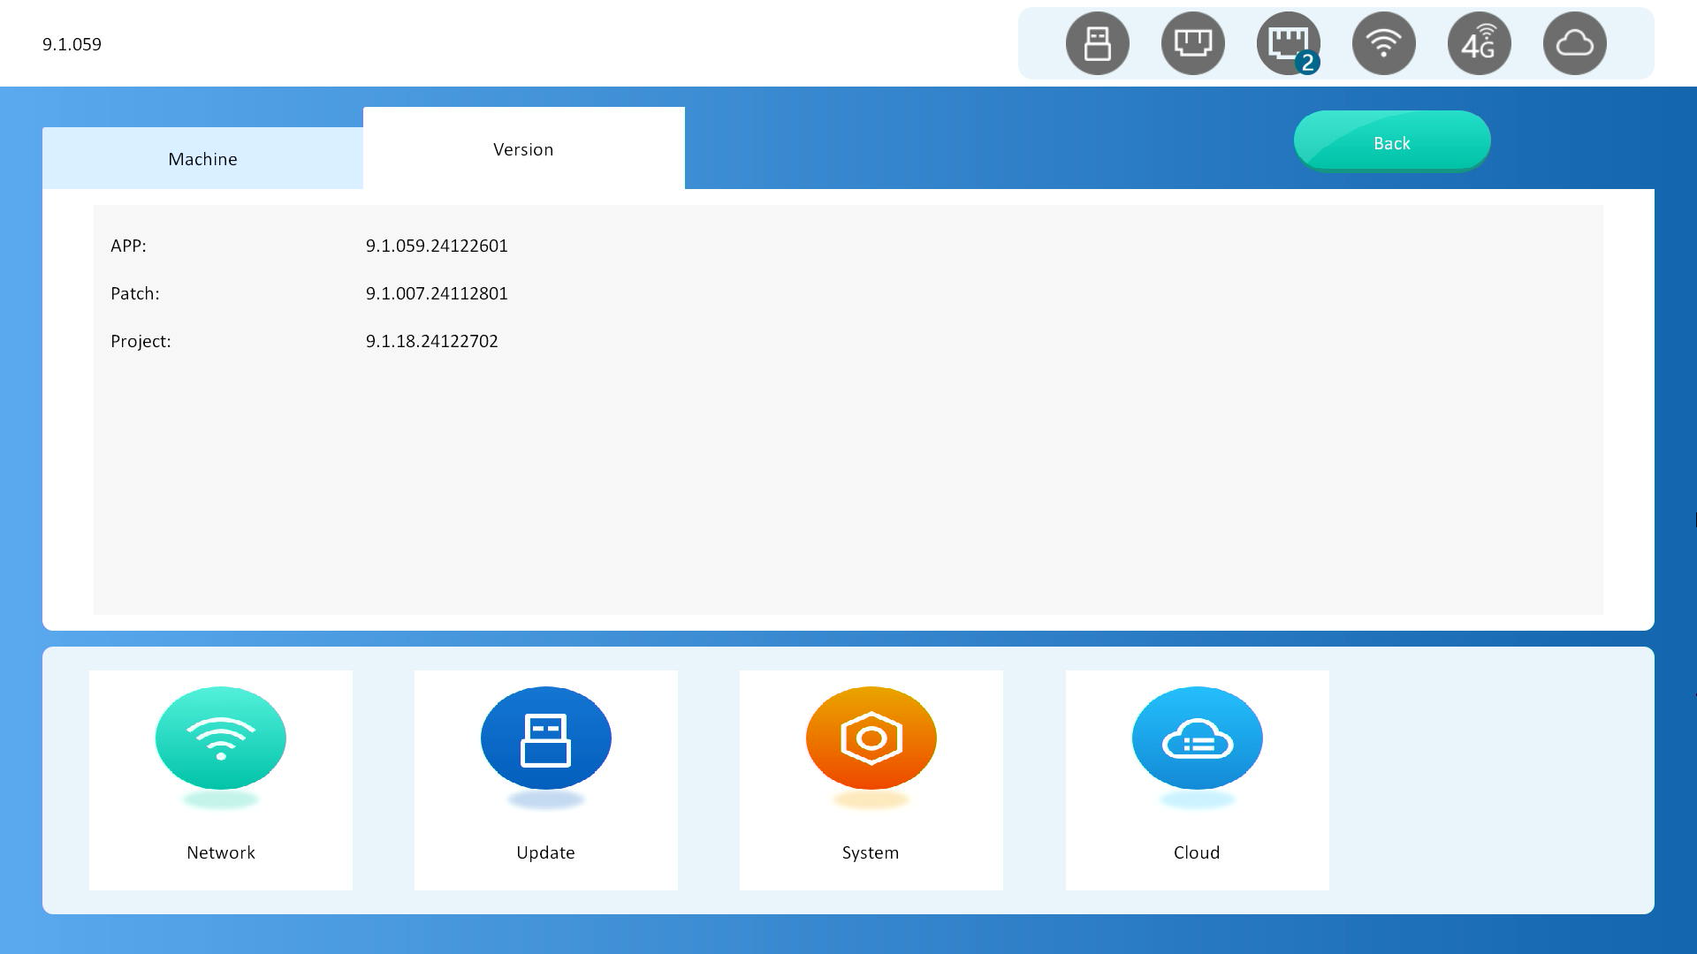
New Backend
Fully upgraded
Multiple methods to enter the backend: Long press the upper right corner, floating ball, special register, remote backend;
Isolate the project and backend, exit the backend without restart HMI;
Brand new UI;

Slide 27
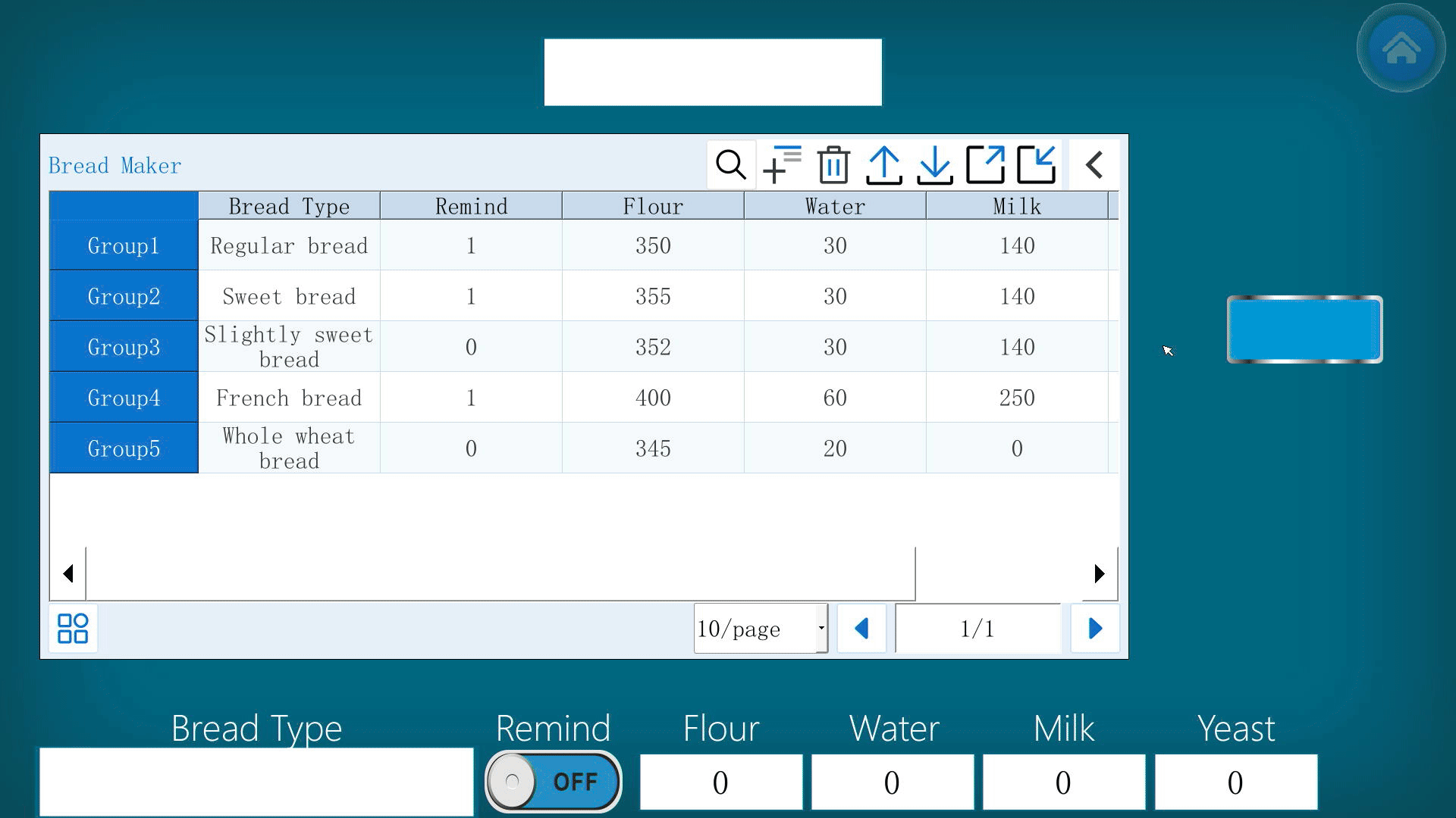
New Backend
3 methods to enter the backend
Long press the upper right corner;
Click the floating ball;
Trigger the special register (HSW884=1 or HSW1857=3);

Slide 28
Remote Backend
If the mobile or PC is same LAN with the HMI, we can acccess the backend interface remotely
The URL format: <HMI IP>:<port>, e.g.: 192.168.51.105:9091;
Default username: admin
Default password: 888888

Slide 29
Summary
Recipe Record
Display variables in Alarm records
System keyboard
Character encoding
Multi line display
Countdown reminder
One-click to enter the backend
Backend UI upgrade
Multi-link
More function
Remote background

Slide 30
Protocol Driver
OPC UA
Siemens FreeTag
BECKHOFF TwinCAT

Slide 31
New Driver
OPC UA Server&Client
Siemens S7-1200/1500 Ethernet FreeTag
BECKHOFF TwinCAT PLC Ethernet
YASKAWA MEMOBUS
MEGMEET MU ModBus TCP Series
MEGMEET MU ModBus RTU Series
MEGMEET MC ModBus TCP Series
MEGMEET MC ModBus RTU Series
Delta DVPES3 ModbusTCP
Delta DVPES3 ModbusRTU
DELTA_DVP_50MC_TCP
DELTA_DVP_50MC_RTU
HCFA_M_Series_TCP
HCFA_M_Series_RTU
MITSUBISHI Q00U CPU Port
MITSUBISHI FX5U Ethernet DB(Data register bit)
INOVANCE Easy series PLC Ethernet DB(Data register bit)
KEYENCE KV-5000(Ethernet) bit address type of word registers
CODESYS V3 continuous read, array continuous write
8

Slide 32
New Models
ig Series: PI3101ig, PI8101ig, PI8121ig
RH Series: RH-WIFI
RE Series: RE-00, RE-00-LA, RE-4G, RE-4G-LA

Slide 33
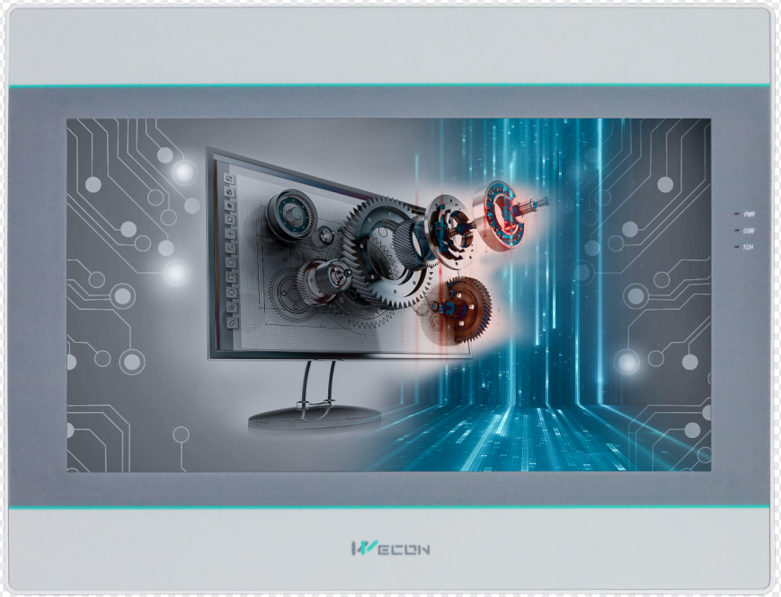
New Models
PI3101ig
The primary difference between PI3101ig and PI3102ig is the mounting size. PI3101ig uses a 259*202 mounting size, compatible with the competitors' 10.1" 260*202 standard.
Dual Ethernet model PI3101ig(N)

Slide 34
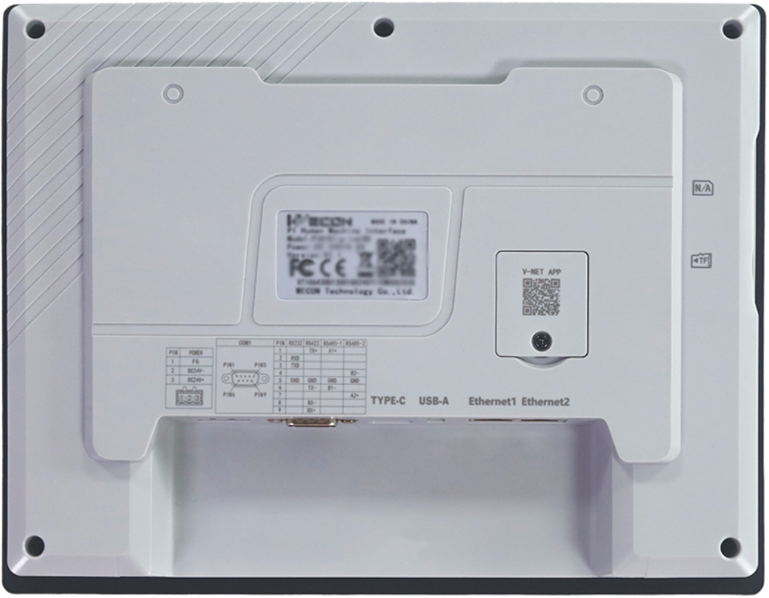
New Models
PI8101ig
The PI8101ig builds upon the PI3101ig by expanding its memory and storage, adopting a 512M+4G configuration to meet the needs of users with more complex applications and higher requirements.
Dual Ethernet model PI8101ig(N), comes standard with IoT functionality.

Slide 35
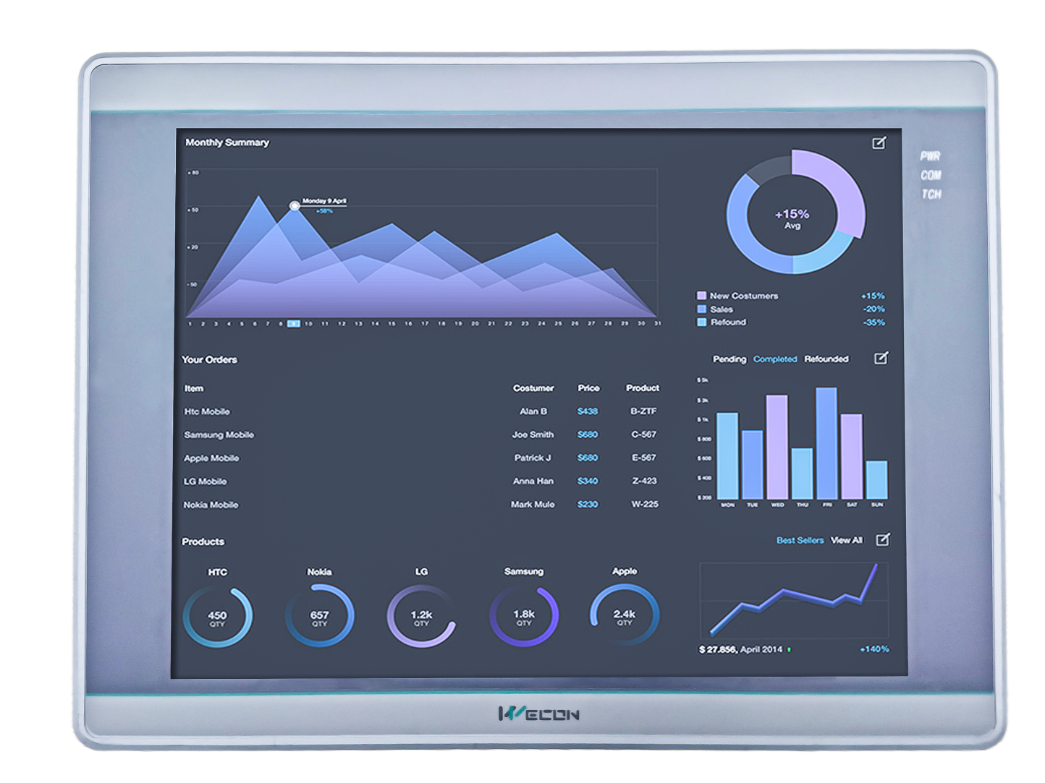
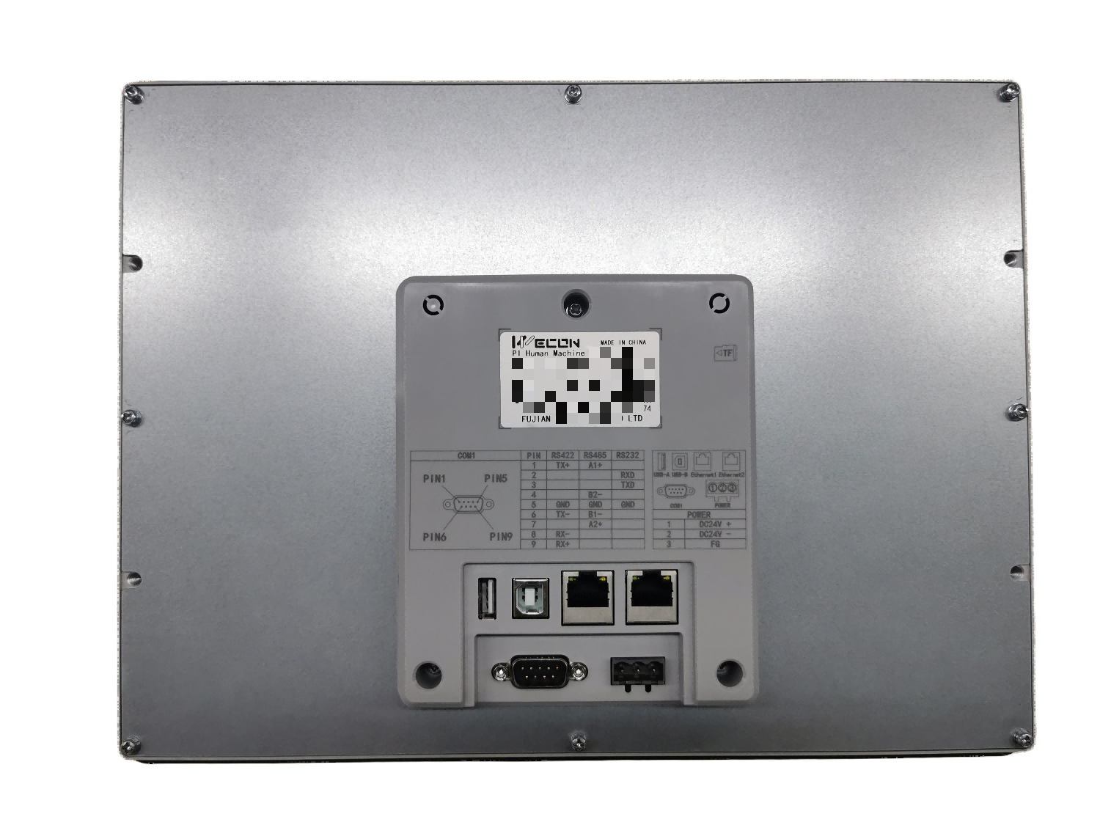
New Models
PI8121ig
Brand new 12" screen.
Dual Ethernet model PI8121ig(N), comes standard with IoT functionality.

Slide 36
New Models
V-BOX RH-WF
Programming by PIStudio
Display on large monitor via HDMI output, and display on webpage via LAN or V-NET.

Slide 37
New Models
V-BOX RE Series
Programming by PIStudio
Communicate with PLC by Ethernet or serial port.
Android/IOS APP access, desktop browse
Support remote screen monitoring, serial port pass-through, remote download, cloud SCADA, upload to cloud

Slide 38
THANK YOU!

