Slide 1
PIStudio New Version Released Functions
Presented by Hunter
福州富昌维控电子科技有限公司
FUZHOU FU CHANG WECON ELECTRONICS TECHNOLOGY CO.,LTD

Slide 2
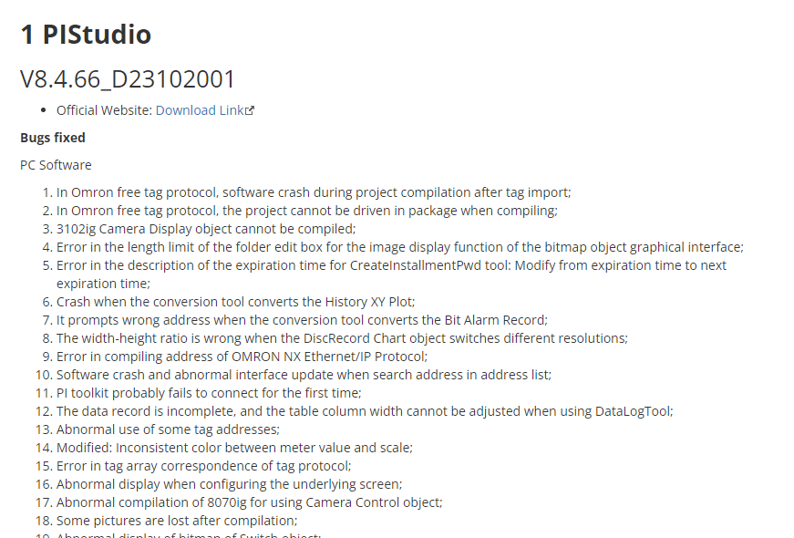
Link
New version update log
https://docs.we-con.com.cn/bin/view/PIStudio/Download/3%20Software/#HV8.4.66_D23102001

Slide 3
Catalog
1
LAN security monitoring
2
String table
3
Configurable type MQTT

Slide 4
LAN security monitoring

Slide 5
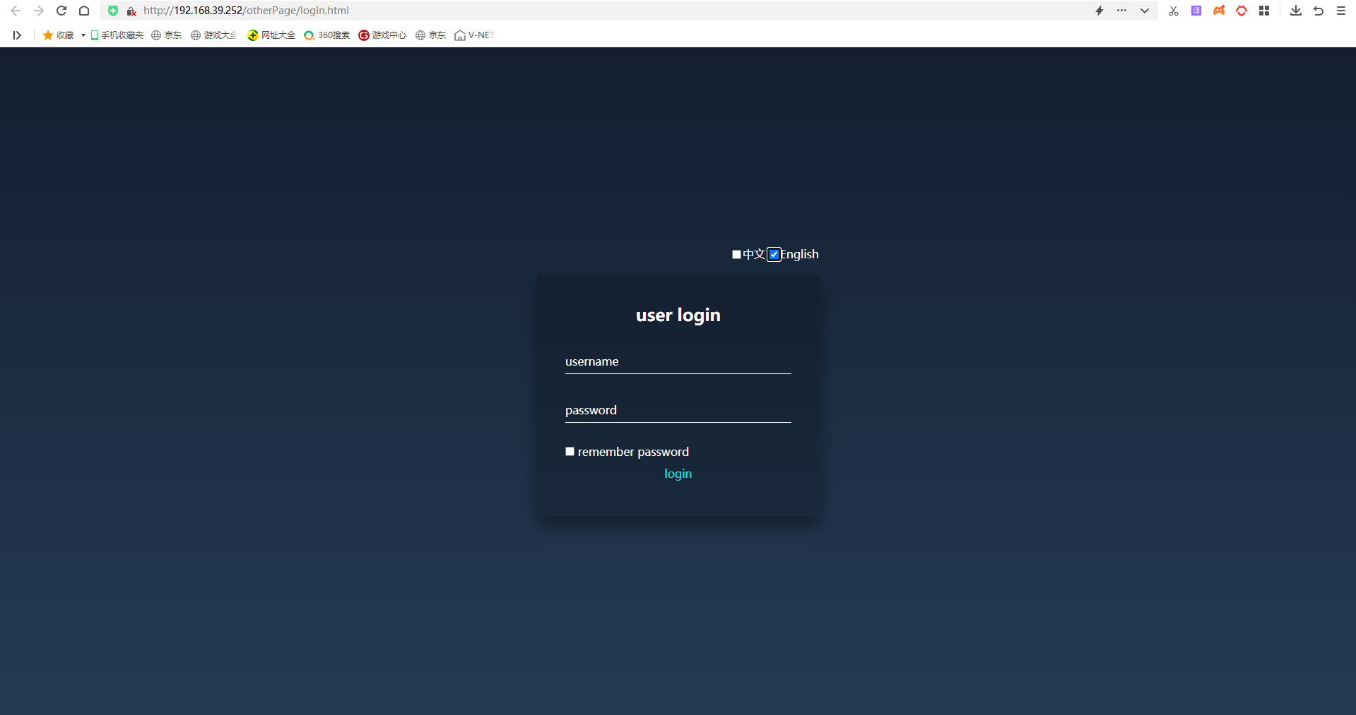
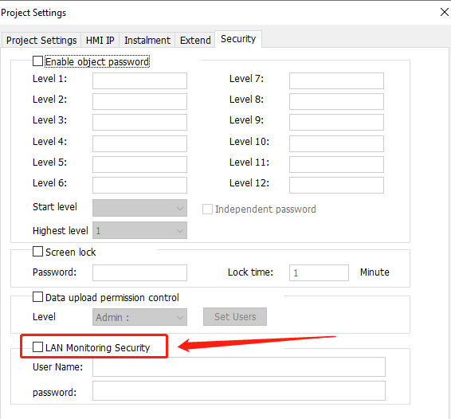
LAN security monitoring
Relevant Data From
https://docs.we-con.com.cn/bin/view/PIStudio/05.Project%20Settings/#HLANMonitoringSecurity

Slide 6
String table

Slide 7
String table
Purpose:
Originally, Text object only be able to show static text content, but after we developed the new String table, now the Text object could show dynamic text content;

Slide 8
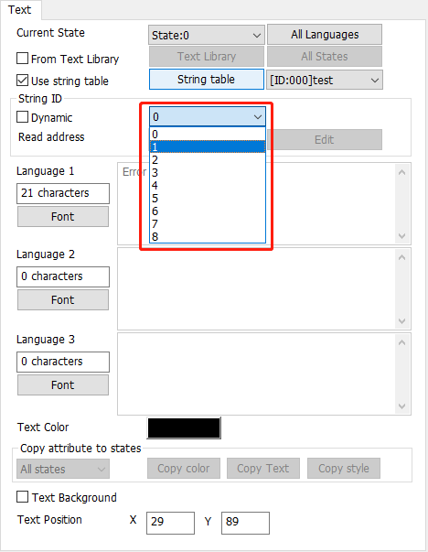
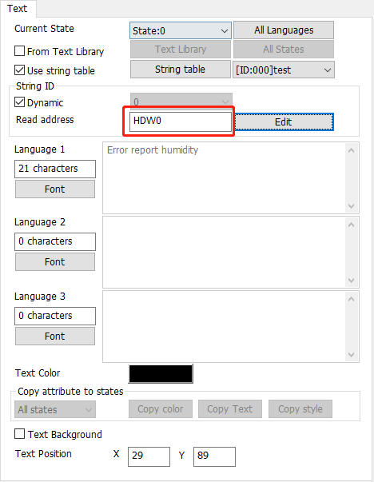
String table
There are two modes for String table:
Select the corresponding ID of String table
from the dropbox;
Enable the Dynamic option, using the address
to read the ID number;

Slide 9
Configurable type MQTT

Slide 10
MQTT
In the past, we only to connect the 3rd party MQTT server via programming Lua script, but now we have a designated configuration tab of MQTT in PIStudio, which could simplify our operation procedures;

Slide 11
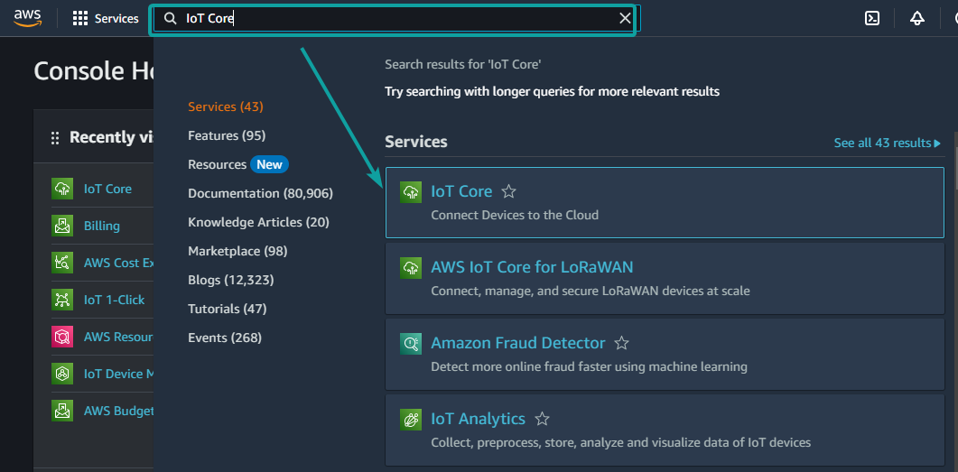
AWS IoT Core
After we login into AWS Console, type "IoT Core" in the search bar, and click the IoT Core services;

Slide 12
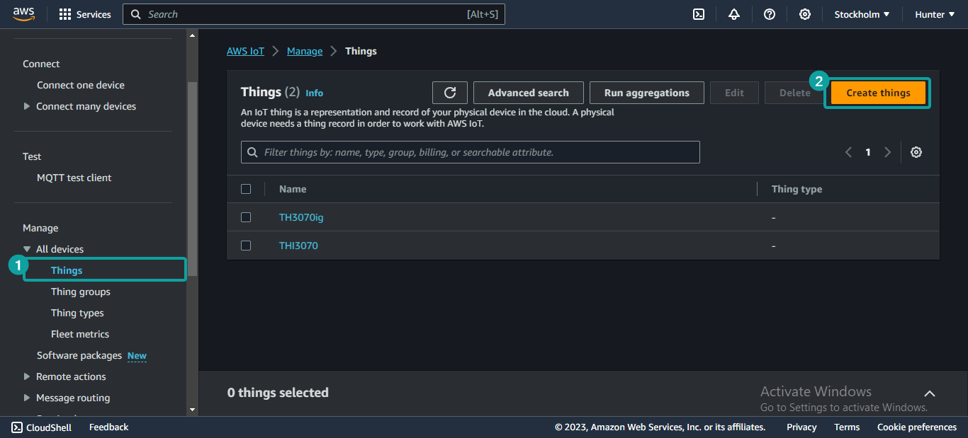
AWS IoT Core
On the left side bar, click [All device]-[Things] for create new thing;

Slide 13
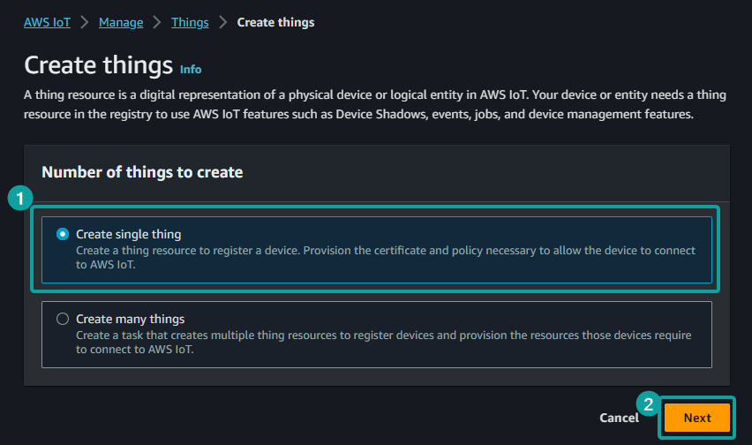
AWS IoT Core
Click [Create single thing]-[Next];

Slide 14
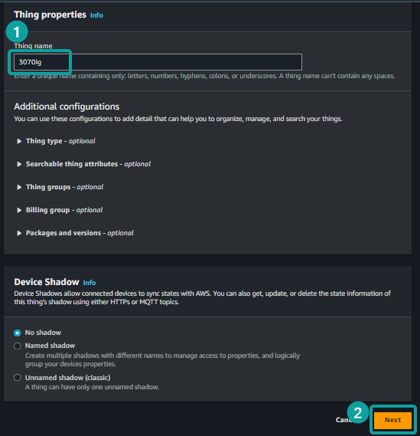
AWS IoT Core
Name the thing, and then click [Next];

Slide 15
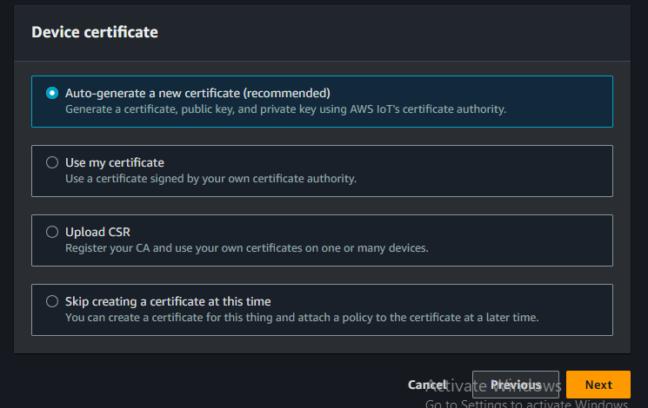
AWS IoT Core
Using the recommended option, then click [Next];

Slide 16
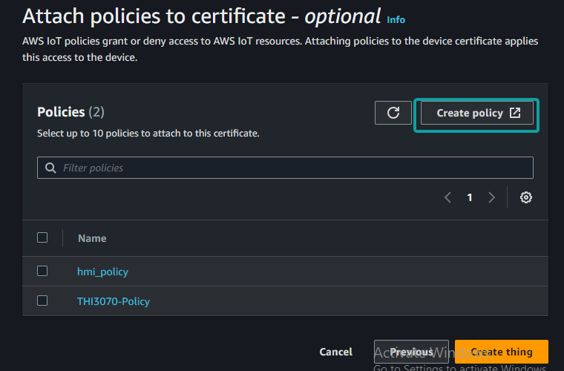
AWS IoT Core
Click [Create policy];

Slide 17
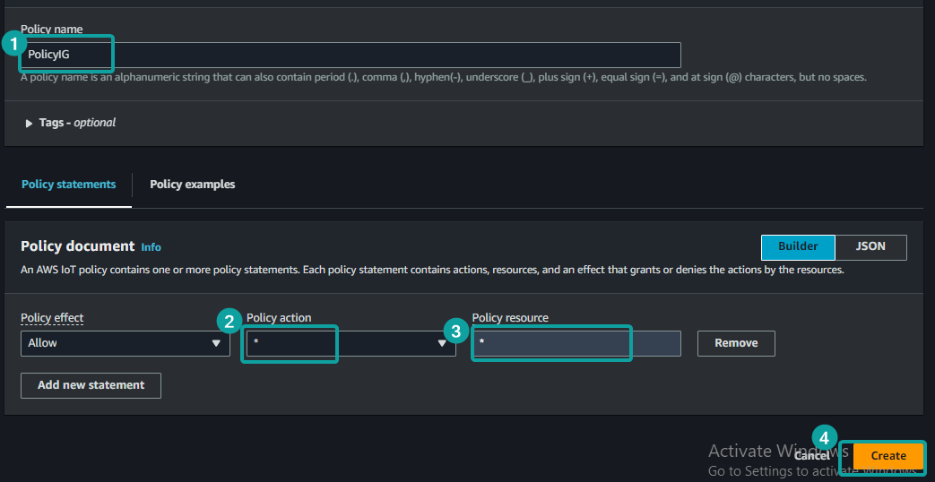
AWS IoT Core
Name the Policy, select the Policy action as *, also input the Policy resource as *, then [Create];

Slide 18
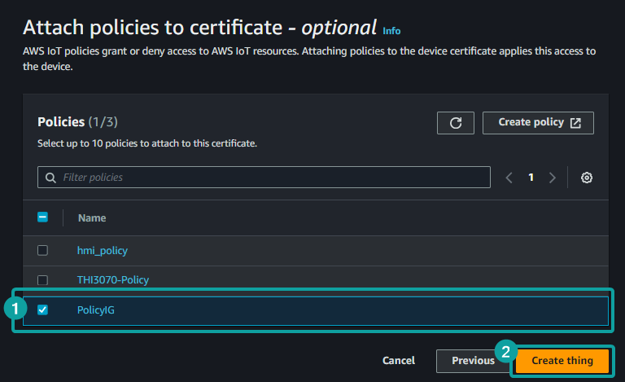
AWS IoT Core
Back to the original tab, and select the Policy we just created, then [Create thing];

Slide 19
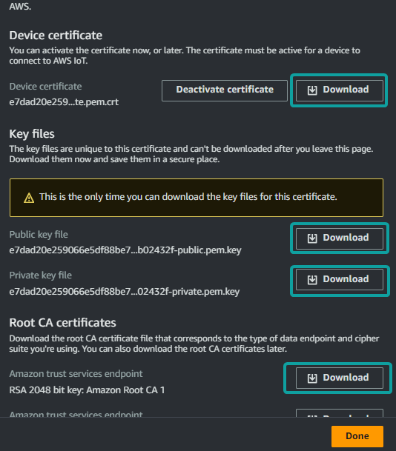
AWS IoT Core
Download the Device certificate,
Public key file, Private key file, and Root CA 1;

Slide 20
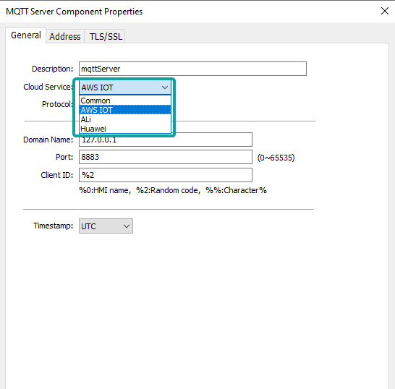
Report to AWS
Click [MQTT]-[Enable], it will open a new tab,
select the Cloud services as "AWS IOT" ;

Slide 21
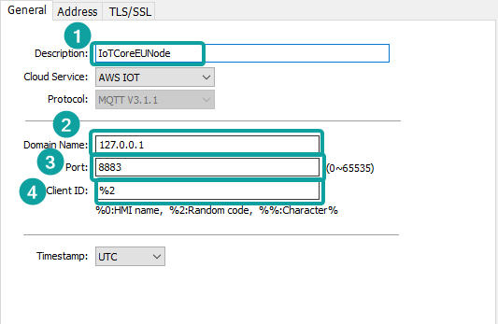
Report to AWS
Fill in all the parameters of AWS server: Domain name, Port, Client ID, and server description;

Slide 22
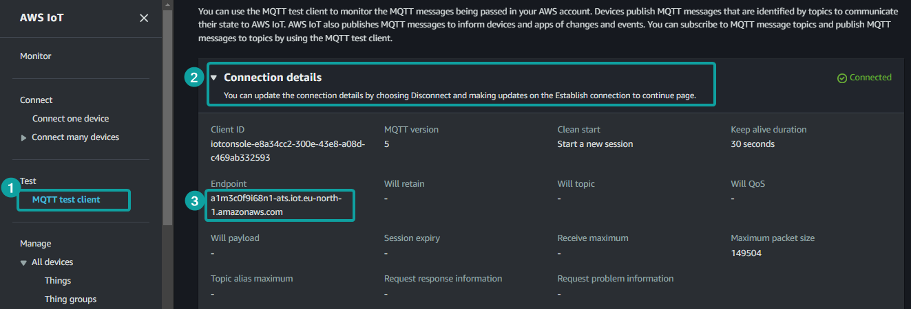
Report to AWS
Please notice that this Domain Name is obatin from AWS Endpoint, click [MQTT test client], and unfold the [Connection details] node, or check it from [Settings];

Slide 23
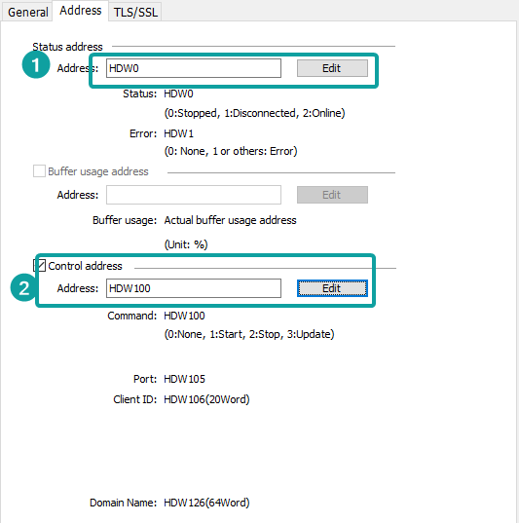
Report to AWS
In the Address tab, then assign address
for Status address and Control address;

Slide 24
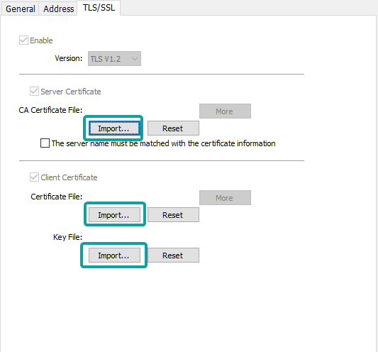
Report to AWS
In the TLS/SSL tab, upload the certificates we
just downloaded;
-RootCA1 is for CA Certificate File in Server
Certificate;
-Device certificate is for Certificate File in Client Certificate;
-Private Key file is for Key File;

Slide 25
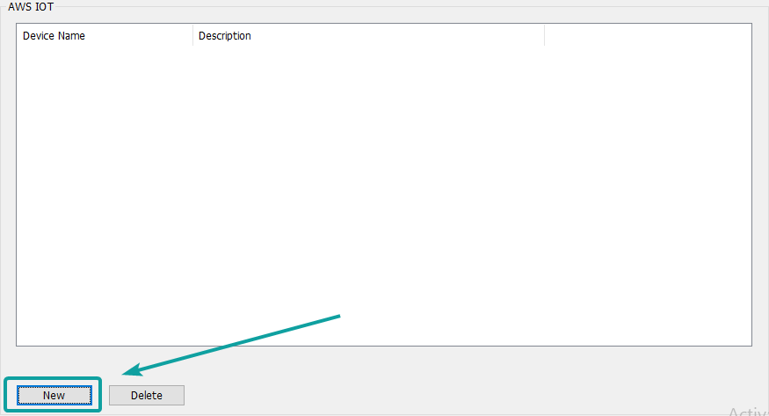
Report to AWS
New a device for configure the address value as required upload into server;

Slide 26
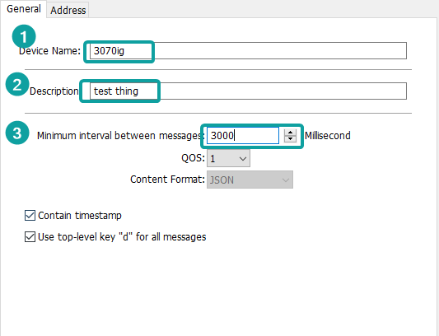
Report to AWS
Set the Device Name, Description, and minimum interval(Update frequency);

Slide 27
Report to AWS
Add new address for construct the publish data ;

Slide 28
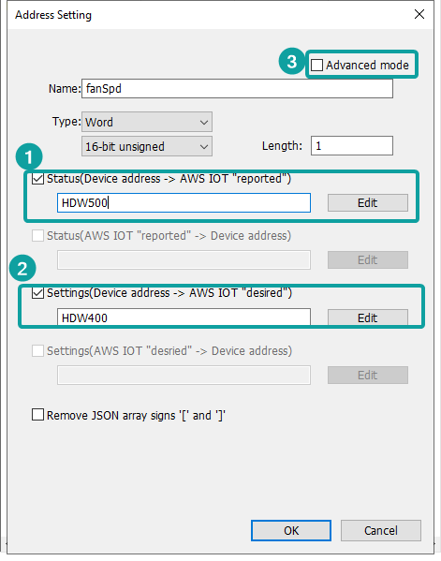
Report to AWS
Assign the corresponding address into [Settings] and [Status];
(Optional) If want to subscribe the Settings and Status from the AWS IoT, we can enable the [Advance mode];

Slide 29
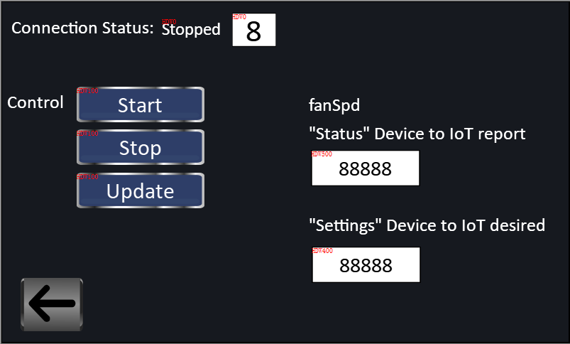
Report to AWS
Add the corresponding control address, status address and value on the screen in the project;

Slide 30
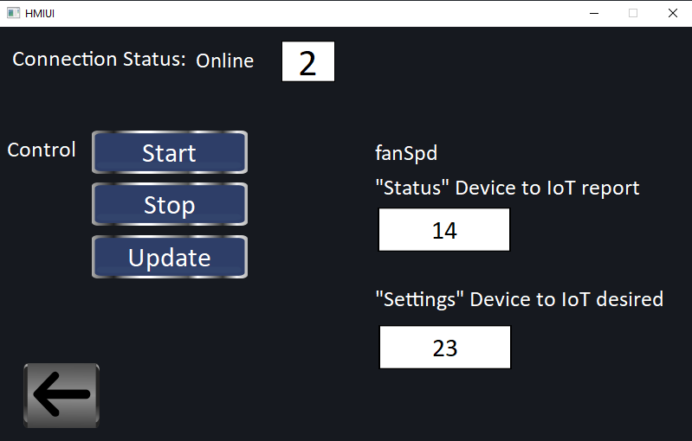
Report to AWS
Start up the MQTT connection , and write value into "Status" and "Settings";

Slide 31
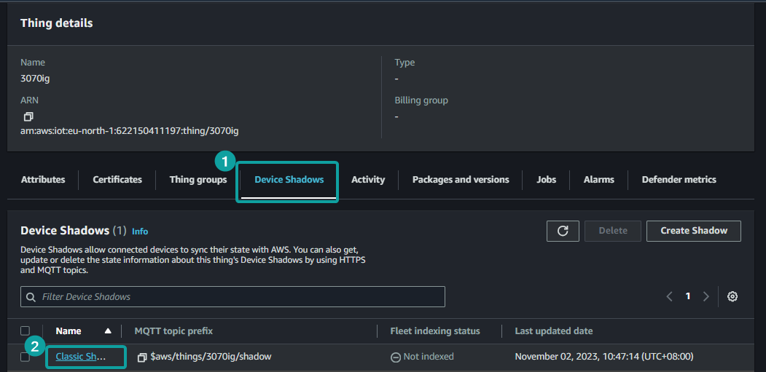
Report to AWS
Go into the [Device Shadow] of [3070ig(Created Thing)] to check the publish result;

Slide 32
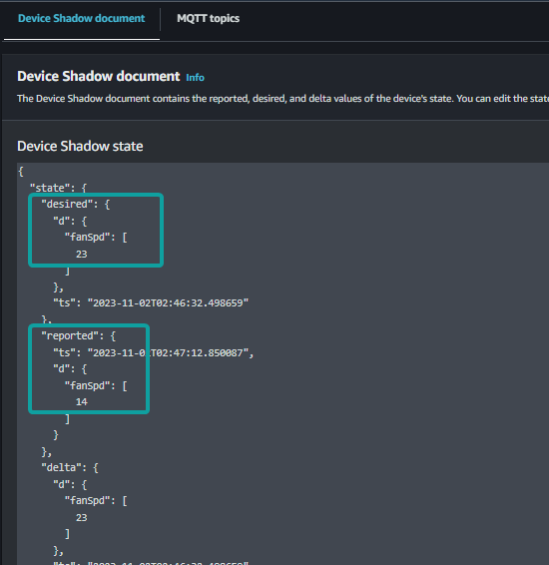
Report to AWS
In the [Device Shadow document], we could
see the result if successfully published;

Slide 33
THANK YOU!

