Slide 1
The ig HMI Introduction
Presented by Hunter
福州富昌维控电子科技有限公司
FUZHOU FU CHANG WECON ELECTRONICS TECHNOLOGY CO.,LTD

Slide 2
Catalog
1
The Differences Between IoT HMI and Common HMI
2
How to Add ig HMI to V-NET
3
Monitoring Tags & Upload to Cloud(-C Model Required)
4
Cloud SCADA(-C Model Required)
5
WVPN Passthrough
6
Remote Download
7
Lua Script
8
Email Configuration of V-NET (-C Model Required)

Slide 3
The Differences Between IoT HMI and Common HMI

Slide 4
Differences
IoT HMI | Common HMI
Remote Access Support | Not support Remote function
Viewed or managed from APP and PC Client | None
Data Logging can upload to Cloud Server | Data Logging only exist in the HMI
Alarm Email Notification | None
Allow multi users access the screen at the same time | None
Can be embedded into 3rd party platforms | Hard to embed 3rd party platforms
4G/Wi-Fi Module Support | None

Slide 5
How to Bind ig HMI

Slide 6
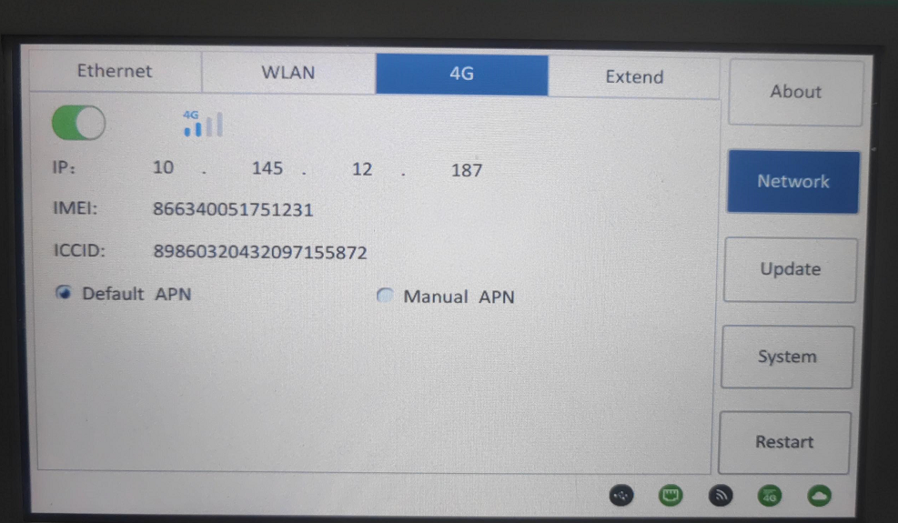
PIStudio Configuration
Create new project with ig model;
Enable the Cloud function;
Select the server;
Download project into HMI;
Make sure the HMI can access the Internet;
Video Link: No.06 https://docs.we-con.com.cn/bin/view/PIStudio/3%20Video/1.Get%20Started/

Slide 7
Monitoring Tags & Upload to Cloud

Slide 8
Monitoring Tags & Upload to Cloud
Add new tag in Tags;
Set up the Data records and Alarm records, enable the option of upload to Cloud;
Redownload the project into HMI;
On the Data view tab from V-NET, user can see the configuration which is uploaded to Cloud;
Video link: No.21 https://docs.we-con.com.cn/bin/view/PIStudio/3%20Video/2.Basic%20Object%20%26%20Settings/

Slide 9
Cloud SCADA

Slide 10
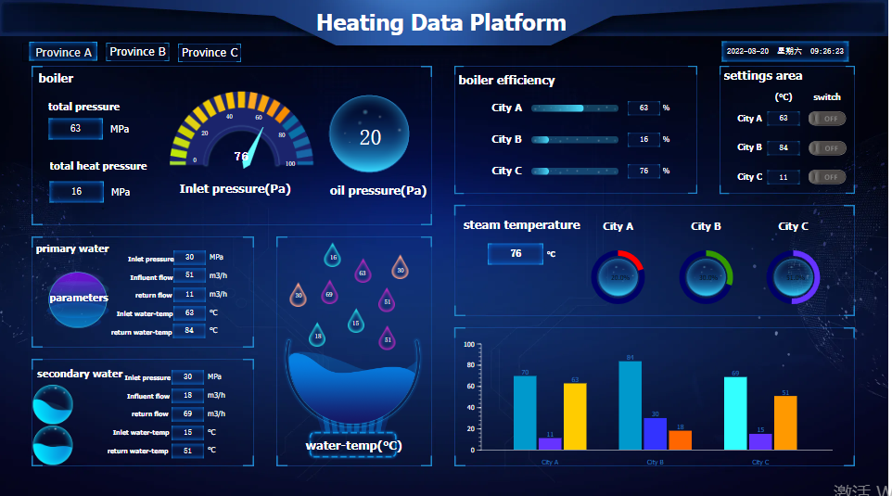
Cloud SCADA
Make sure the HMI already configured the tags;
Jump to SCADA editor interface;
Add the tag addresses into SCADA project;
Save project and view;

Slide 11
WVPN Passthrough

Slide 12
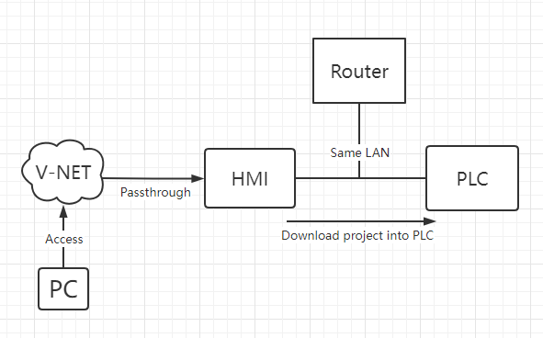
WVPN Passthrough Download
Make sure HMI and PLC at the same LAN;
Login into the WVPN Client tool;
Connected VPN;
Open the PLC software to search IP in LAN;
Download the program into PLC;
Disconnected VPN;

Slide 13
Remote Download

Slide 14
Remote Download
Click the gear icon on the upper right of PC Client to open the settings;
Enable the Download tool of PIStudio;
Select the PIStudio installation path;
Go to the Passthrough tab to open the Remote;
Download the project and HMI will self-restart;
Video link: No.19 https://docs.we-con.com.cn/bin/view/PIStudio/3%20Video/2.Basic%20Object%20%26%20Settings/

Slide 15
Lua Script

Slide 16
Lua Script Programming
Enable the Lua from project tree node;
Create a new Lua file;
Program the function you want to realize;
Call the function;
Download into HMI;
Video link: No.02 https://docs.we-con.com.cn/bin/view/PIStudio/3%20Video/Script/
Lua Demo link: https://docs.we-con.com.cn/bin/view/PIStudio/2%20Demo/Lua%20Script/

Slide 17
Email Configuration

Slide 18
Email Configuration
Make sure the HMI already configured the tags;
Jump to the Email page of V-NET;
Create a new configuration of Alarm or notification;
Save settings;
Video link: No.20 https://docs.we-con.com.cn/bin/view/PIStudio/3%20Video/2.Basic%20Object%20%26%20Settings/

Slide 19
THANK YOU!

