Slide 1
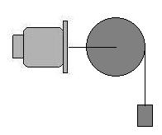
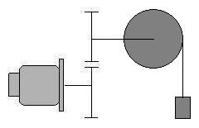
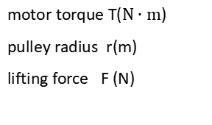
Torque Calculation
motor torque T($N∙m$)
pulley radius r(m)
lifting force F (N)
$$F=\frac{T}{r}$$
r
T
F
r
T
$$F=\frac{T}{r}∙R$$
1/R
F
lifting force after reducer

Slide 2
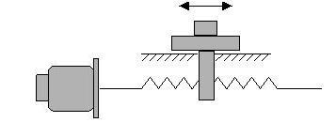
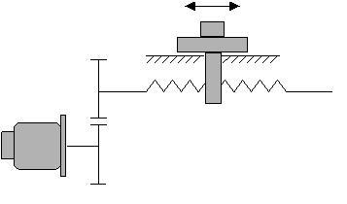
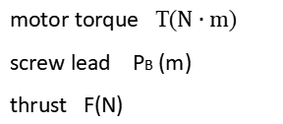
Torque Calculation
F
motor torque T($N∙m$)
screw lead PB (m)
thrust F(N)
$$F=T∙\frac{2π}{P_{B}}$$
T
PB
F
T
$$F=T∙\frac{2π}{P_{B}}∙R$$
1/R
thrust after reducer
PB

Slide 3
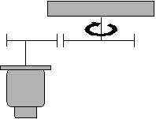
Inertia Calculation
1. Inertia calculation when the load rotates $J_{L}$(㎏ • ㎡)
(Based on the motor shaft)
1/R
L（m）
solid
cylinder
$$J_{K}=\frac{1}{8}∙M_{K}∙D^{2}$$
D（m）
L（m）
D0
（m）
D1
（m）
hollow
cylinder
$J_{K}=\frac{1}{8}∙M_{K}∙({D_{0}}^{2}$－ ${D_{1}}^{2})$
moment of inertia after the reducer
$$J_{L}=\frac{J_{K}}{R^{2}}$$

Slide 4
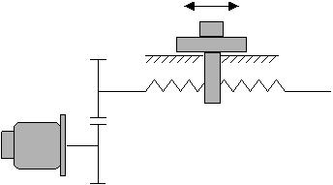
Inertia Calculation
2. Inertia calculation when load moves linearly $J_{L}$(㎏ • ㎡)
(Based on the motor shaft)
M
1/R
$$J_{K}=M∙{(\frac{P_{B}}{2π})}^{2}$$
PB
Linear motion part
moment of inertia after the reducer
$$J_{L}=\frac{J_{K}}{R^{2}}$$

Slide 5
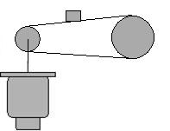
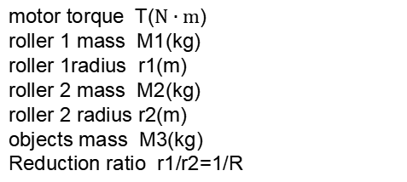
Inertia Calculation
M3
3. Inertia calculation for belt drive $J_{L}$(㎏ • ㎡)
(Based on the motor shaft)
M1
r1
r2
M2
motor torque T($N∙m$)
roller 1 mass M1(kg)
roller 1radius r1(m)
roller 2 mass M2(kg)
roller 2 radius r2(m)
objects mass M3(kg)
Reduction ratio r1/r2=1/R
$$J_{L}=\frac{1}{2}∙M_{1}∙{r_{1}}^{2}+\frac{1}{2}∙M_{2}∙{r_{1}}^{2}+M_{3}∙{r_{1}}^{2}$$

Slide 6
Servo Selection Principle
continuous working torque < servo motor rated torque
instantaneous maximum torque < servo motor maximum torque (at acceleration)
load inertia < 3 times motor rotor inertia
continuous working speed < motor rated speed

Slide 7
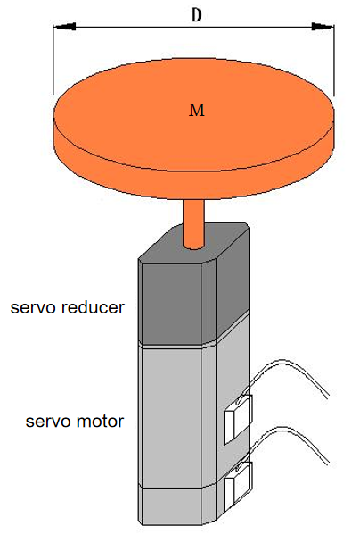
Example calculation 1
Known: disc mass M=50kg, disc diameter D=500mm, disc maximum speed 60rpm, please select servo motor and reducer.

Slide 8
Example calculation 1
Calculate the moment of inertia of the disc
Assuming the reduction gear ratio = 1:R
Then converted to the load inertia on the servo motor shaft as 15625 / R²
because load inertia < 3 times motor rotor inertia
If you choose a 400W motor, JM = 0.277kg.cm²
15625 / R² < 3*0.277，R² > 18803，R > 137
output speed=3000/137=22 rpm, can not meet the requirements。
If you choose a 500W motor，JM = 8.17kg.cm²，15625 / R² < 3*8.17，R² > 637，R > 25
output speed=2000/25=80 rpm, meet the requirements
This transmission method has little resistance and ignores torque calculation.
$$J_{K}=\frac{M∙D^{2}}{8}=15625 kg∙cm^{2}$$

Slide 9
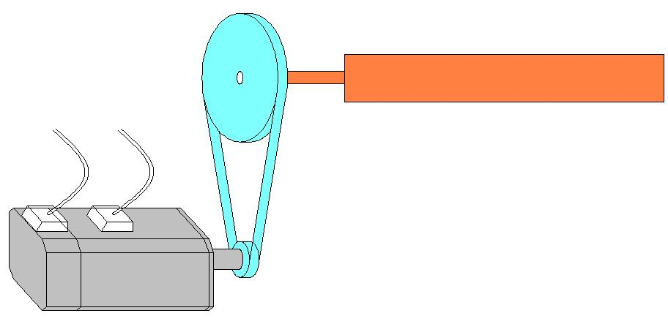
Example calculation 2
This transmission mode is the same as the example calculation 1. The calculation of the load inertia is mainly considered when selecting the model, and the calculation formula is also the same as the example calculation 1.
Summary: Rotating loads mainly consider inertia calculation

Slide 10
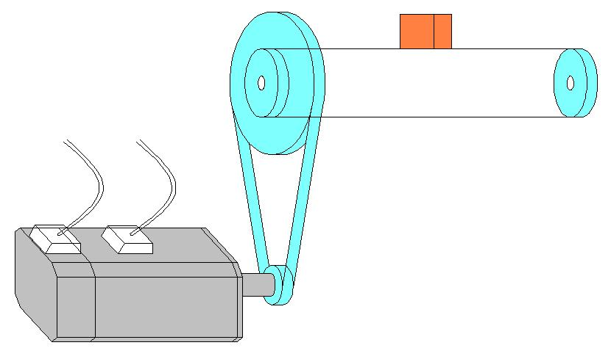
Example calculation 3
M
1:R2
D
1:R1
Known: the load weight M=50kg, the synchronous pulley diameter D=120mm, the reduction ratio R1=10, R2=2, the friction coefficient between the load and the machine µ=0.6, the maximum movement speed of the load is 30m/min, the load accelerates from static to The maximum speed time is 200ms, ignoring the weight of each conveyor pulley, what is the minimum power motor required to drive such a load?

Slide 11
Example calculation 3
1. Calculate the load inertia converted to the motor shaft
because load inertia < 3 times motor rotor inertia
$$J_{L}=\frac{M∙D^{2}}{4∙{R_{1}}^{2}}=18 kg∙cm^{2}$$
$$J_{M}>6 kg∙cm^{2}$$
2. Calculate the torque required by the motor to drive the load
Torque required to overcome friction
Torque required for acceleration
Servo motor rated torque > $T_{f}$ ，max torque > $T_{f}$ + $T_{a}$
$$T_{f}=M∙g∙μ∙\frac{D}{2∙R_{1}∙R_{2}}=0.882 N∙m$$
$$T_{a}=M∙a∙\frac{D}{2∙R_{1}∙R_{2}}=0.375 N∙m$$

Slide 12
Example calculation 3
3. Calculate the speed required by the motor
According to the above data analysis, The smallest optional motor is ECMA-G31306ES.
$$N=\frac{v∙R_{1}}{π∙D}=796 rpm$$

Slide 13
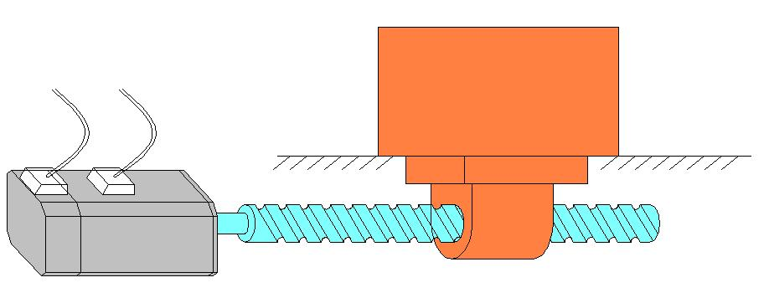
Example calculation 4
M
Known: load weight M=200kg, screw pitch PB=20mm, screw diameter DB=50mm, screw weight MB=40kg, friction coefficient µ=0.2, mechanical efficiency η=0.9, load moving speed V=30m/min, full movement Time t=1.4s, acceleration and deceleration time t1=t3=0.2s, static time t4=0.3s. Please select the smallest power servo motor that meets the load requirements.

Slide 14
Example calculation 4
1. Calculate the load inertia converted to the motor shaft
The moment of inertia converted from the weight to the motor shaft
Screw moment of inertia
total load inertia
$$J_{W}=M∙({\frac{P_{B}}{2∙π})}^{2}=20.29 kg∙cm^{2}$$
$$J_{B}=\frac{M_{B}∙{D_{B}}^{2}}{8}=125 kg∙cm^{2}$$
$$J_{L}=J_{W}+J_{B}=145.29kg∙cm^{2}$$
2. Calculate the motor speed
Motor required speed
$$N=\frac{V}{P_{B}}=1500 rpm$$

Slide 15
Example calculation 4
3. Calculate the torque required by the motor to drive the load
Torque required to overcome friction
Torque required for load acceleration
Torque required for screw acceleration
Total torque required for acceleration
$$T_{f}=\frac{M∙g∙μ∙P_{B}}{2∙π∙η}=1.387 N∙m$$
$$T_{a1}=\frac{M∙a∙P_{B}}{2∙π∙η}=1.769 N∙m$$
$$T_{a2}=\frac{J_{B}∙α}{η}=\frac{J_{B}}{η}∙\frac{N}{2∙π∙60∙t_{1}}=10.903 N∙m$$
$$T_{a}=T_{a1}+T_{a2}=12.672 N∙m$$
Another way to calculate the required acceleration torque
$$T_{a}=\frac{2∙π∙N∙(J_{W}+J_{B})}{60∙t_{1}∙η}=12.672N∙m$$

Slide 16
Example calculation 4
Calculate the instantaneous maximum torque：
acceleration torque
uniform torque
deceleration torque
effective torque
$$T_{A}=T_{a}+T_{f}=14.059 N∙m$$
$$T_{b}=T_{f}=1.387 N∙m$$
$$T_{c}=T_{a}−T_{f}=11.285 N∙m$$
$$T_{rms}=\sqrt{\frac{{{(T}_{A}}^{2}∙t_{1}+{T_{b}}^{2}∙t_{2}+{T_{c}}^{2}∙t_{3})}{(t_{1}+t_{2}+t_{3})}}=6.914 N∙m$$

Slide 17
Example calculation 4
4. Select the servo motor
servo motor rated torque T > $T_{f}$ and T > $T_{rms}$
servo motor maximum torque $T_{max}$ > $T_{f}$ + $T_{a}$
Therefore, the ECMA-E31820ES motor was selected.

Slide 18
Factors that Determine the Servo Motor
transfer method
load weight
weight of transmission parts such as pulley/ball screw
reduction ratio
pulley Diameter / Ball Screw Pitch
acceleration and deceleration characteristics
running speed
friction coefficient
mechanical efficiency

