Slide 1
VD2 Series V1.20 Version Update

Slide 2
1
V1.20 New Function
CONTENTS
2
V1.20 Function changes
3
V1.20 Bug Fixed
3
4
V1.20 Optimization
4

Slide 3
V1.20 New Function
New function code [P10-11] :
Motor stall over-temperature protection
New function code [P0-30]:
Shield encoder over-temperature fault
New monitoring value [U0-49]:
Overload internal count

Slide 4
[P10-11]
Set P10-11 as 0
When the motor stalls, the actual motor speed is less than 10 rpm, the torque command exceeds the motor rated torque, and the duration reaches the motor overheating protection time under the corresponding torque, an ER.45 fault will be reported and the machine will stop immediately.
Set P10-11 as 1
When the motor stalls , the torque will be changed to 70% rated torque.

Slide 5
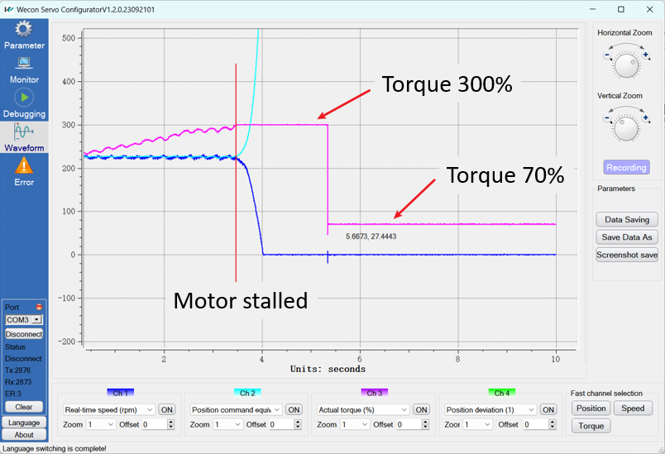
[P10-11]
P10-11=1: shield overtemperature detection of motor blocked rotation

Slide 6
[P0-30]
V1.20 add shielding the problem of encoder over-temperature fault

Slide 7
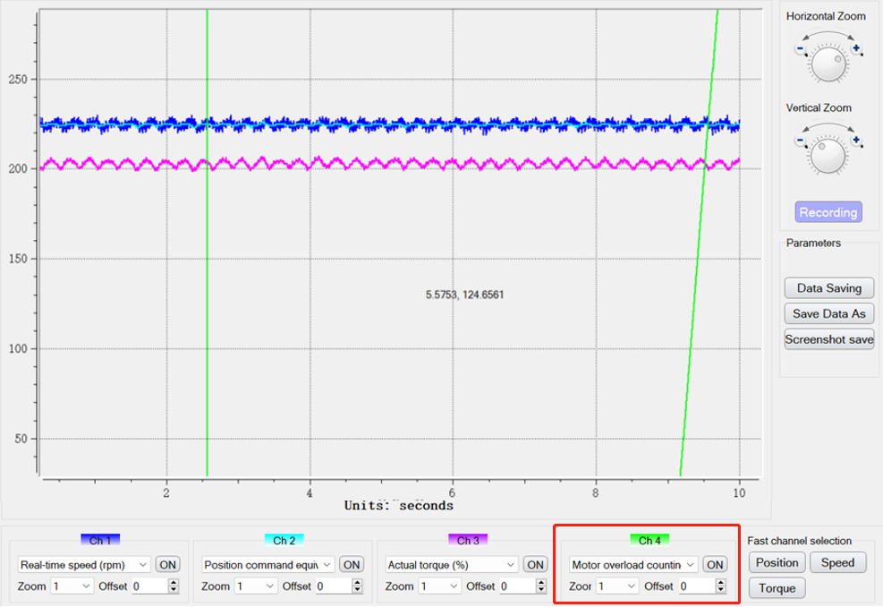
[U0-49]
When the motor is overloaded, motor overload counting will be performed. The greater the overload of the motor, the faster the count will increase.

Slide 8
V1.20 Function Changes
Parameter group P15 and P16 no longer support Modbus communication modification.
Modified the voltage point of under-voltage fault of VD2-TA1G model.
Modified the default value of [P1-19] :
torque saturation timeout time
P10-4 Motor overload protection time coefficient range modification

Slide 9
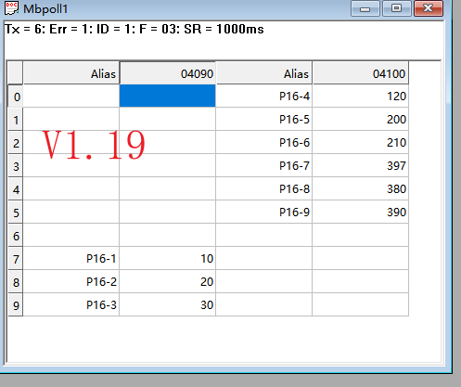
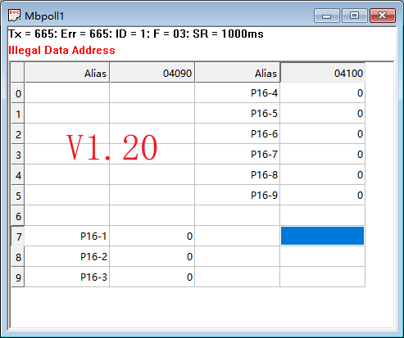
P15 group and P16 group
In the V1.20 version, group P15 and group P16 are set as internal parameters, and Modbus cannot be used for read and write operations.

Slide 10
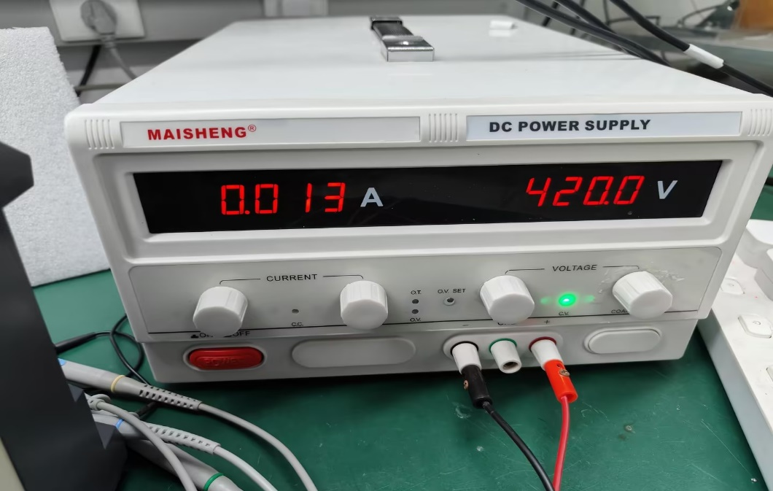
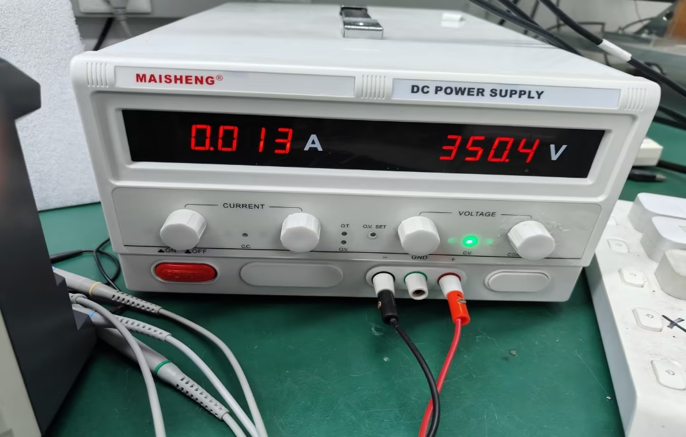
VD2-TA1G undervoltage point modification
V1.19
V1.20
Change the DC undervoltage protection point of VD2-021TA1G from 420V to 350V.

Slide 11
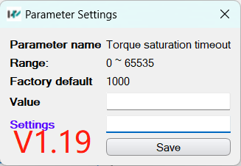
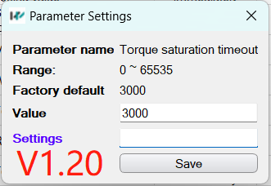
[P1-19]
In version V1.20, the default value of torque saturation timeout is adjusted from 1000 to 3000.

Slide 12
[P10-04]
Modified the range of motor overload protection time coefficient and deleted the function of shielding overload protection fault detection.

Slide 13
V1.20 Bug Fixed
Fixed the bug of U1-05 shrinking 10 times
Fixed the problem of U0-56 mutation in multi-turn absolute motors with a small probability.
Fixed the acceleration and deceleration problem when internal multi-segment positions are stopped when set a small ppr.

Slide 14
[U1-05]
Fixed a bug that caused the bus voltage in the fault record to be reduced by 10 times when a fault with excessive position deviation occurred.

Slide 15
[U0-56]
When the number of turns of U0-55 changes from 65535 to 0, U0-56 has a small probability of data sudden increase of 65535*number of pulses in one turn.

Slide 16
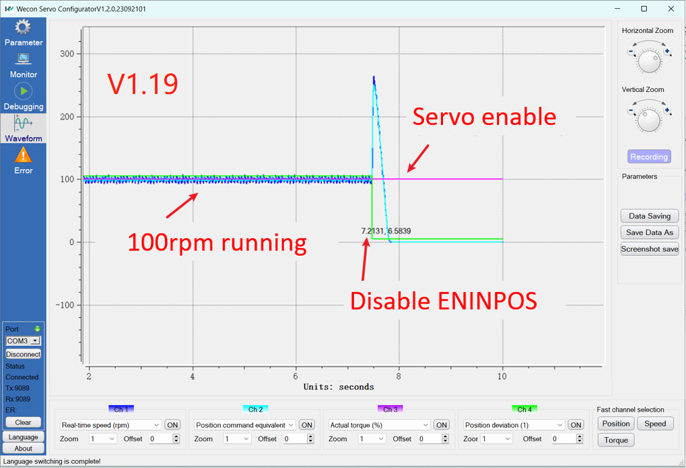
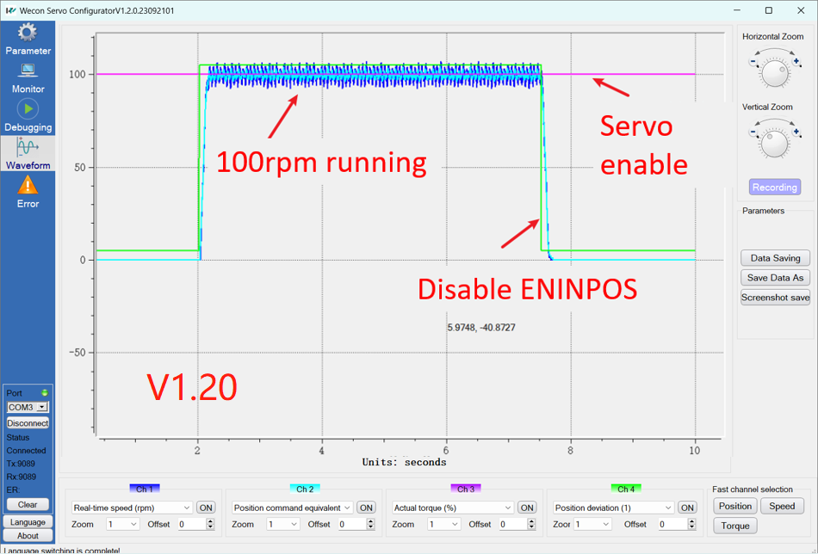
Internal muti-segment acce/dece problem
Fixed the issue of acceleration and deceleration errors when the internal multi-segment position enable is turned off when the number of pulses in one revolution is small and running at low speed.

Slide 17
4
V1.20 Optimization
Modify the detection time of ER.21 undervoltage fault to 1000ms
During the process of powering on and off the servo, the control signal glitches of the relay are eliminated.
Eliminates the motor current sound when the driver is in ready state
Improved bus voltage utilization
Notes:
首先是新功能介绍

Slide 18
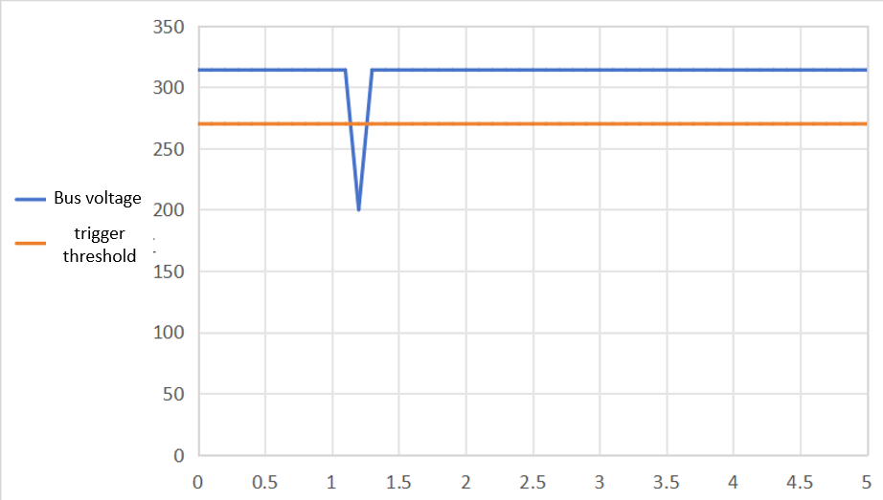
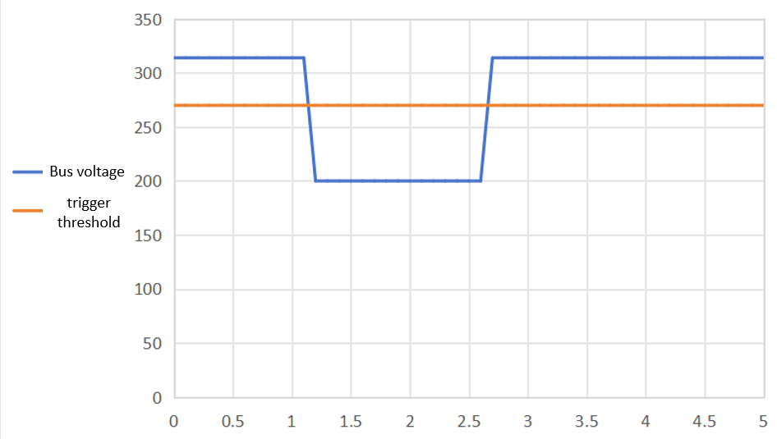
ER.21
The undervoltage fault detection time of V1.19 is only a few milliseconds, so it will also report an ER.21 fault in the situation shown on the left. V1.20 needs to be below the trigger threshold for 1000ms before it will issue an ER.21 fault warning. .

Slide 19
Eliminates relay control signal glitches
There will be glitches in the control signal of the relay during the power on and off process. The V1.20 version has fixed this problem. (Internal discovery, does not affect use)

Slide 20
V1.20 eliminates high-frequency current noise in the driver’s ready state.

Slide 21
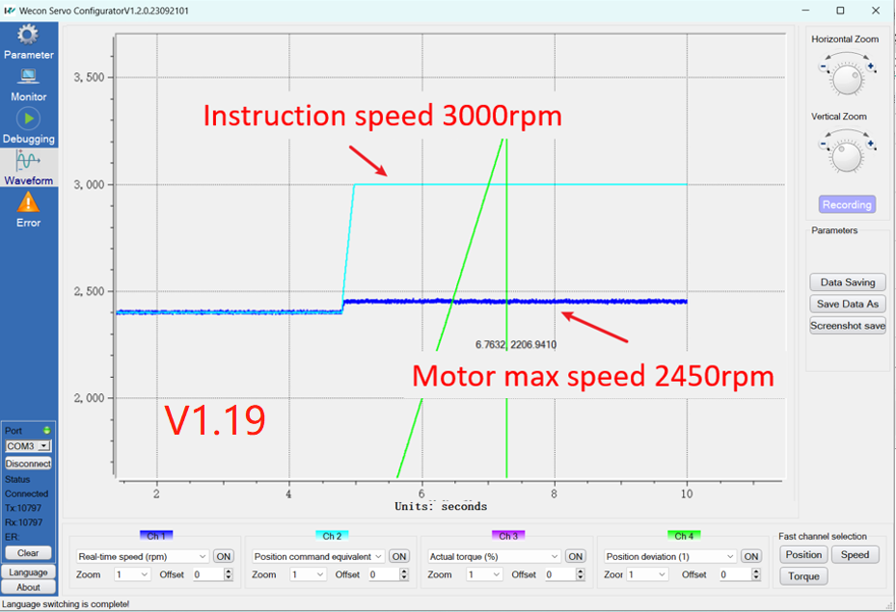
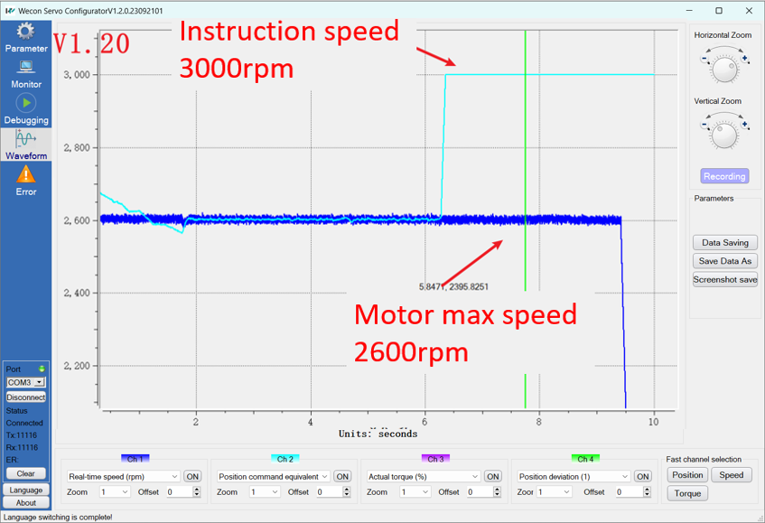
Improved bus voltage utilization
The above two pictures are the speed curves when the same motor is used and the pulse signal sent by the PLC to the driver is 3000 rpm. The speed of V1.19 can only reach about 2450 rpm, while the speed of V1.20 can reach 2600 rpm.

Slide 22
THANK YOU

