Slide 1
Servo Gain Parameter Introduction
By Jim

Slide 2
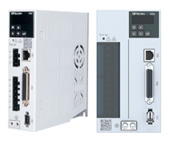
1
Self-adjusting
CONTENTS
2
Manual Adjusting Parameter
3
General Commissioning Steps

Slide 3
01
SECTION
Self-adjusting Parameter

Slide 4
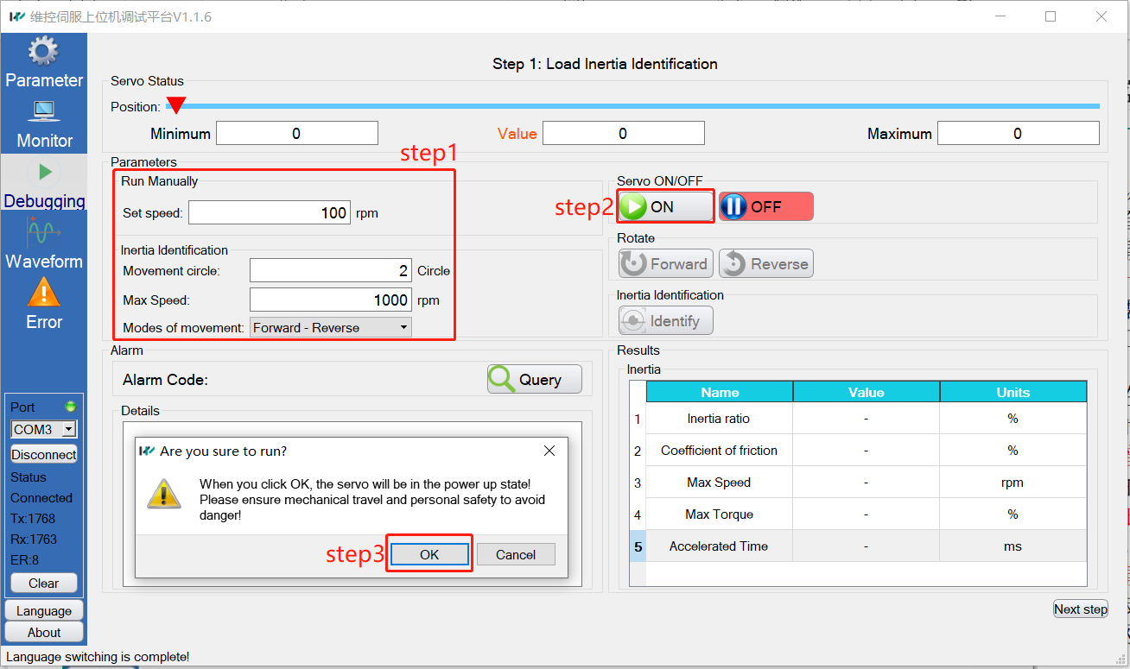
Self-adjusting
——Load inertia recognition
NOTE: Set servo in position mode(P0-01)

Slide 5
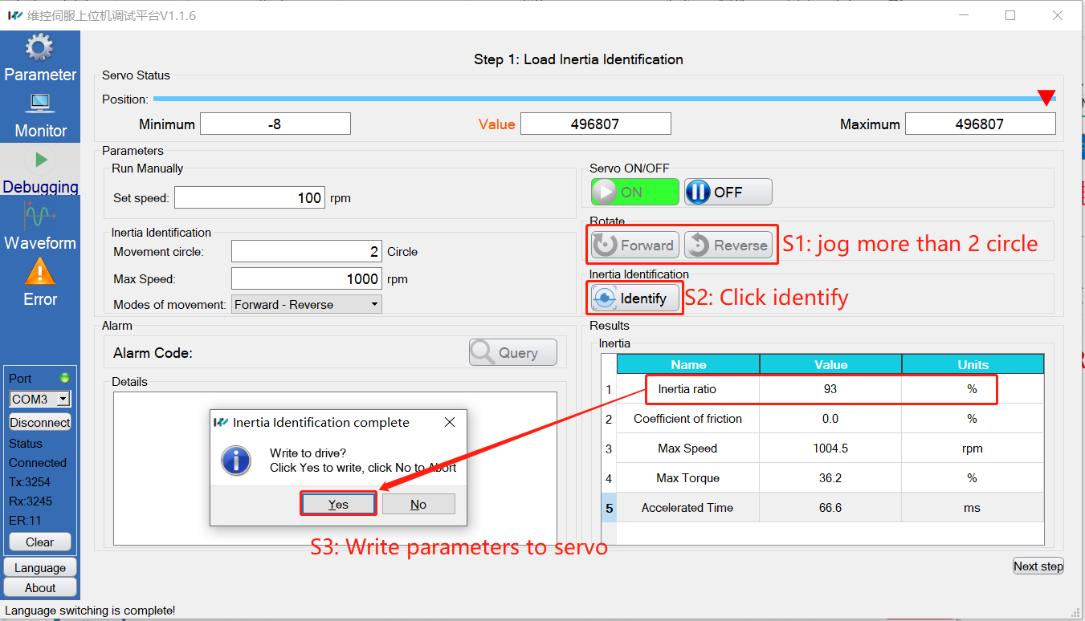
Self-adjusting
——Load inertia recognition
If there are loud sound and strong vibration during inertia recognition, please reduce the rigidity(P3-02) and then try again.

Slide 6
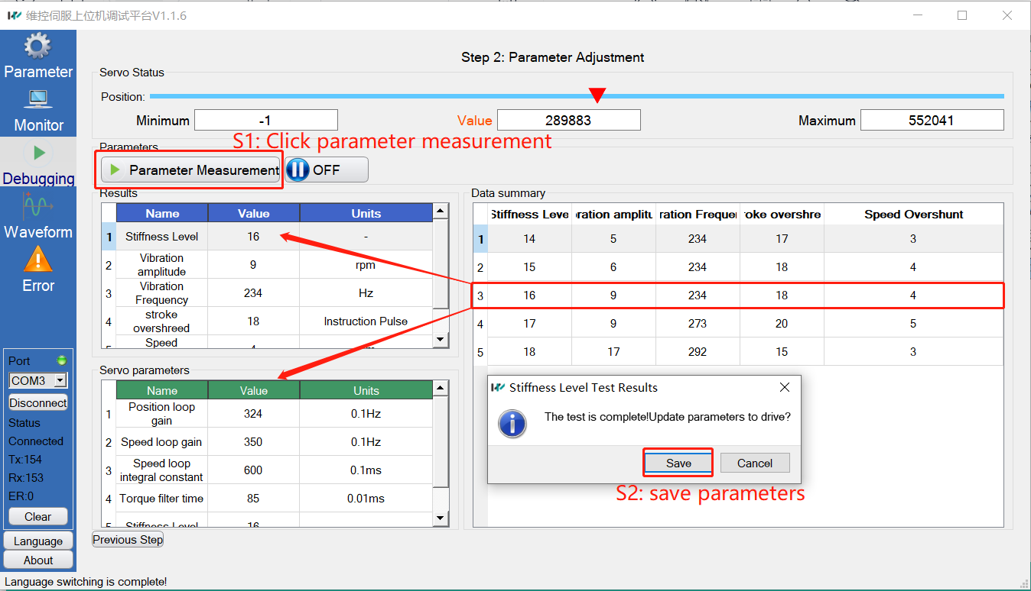
Self-adjusting
——Parameter adjustment
Measure the parameters and save the gain result to servo

Slide 7
02
SECTION
Manual Adjusting Parameter

Slide 8
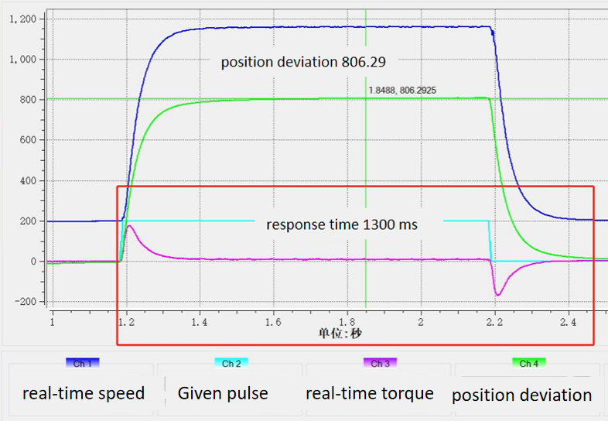
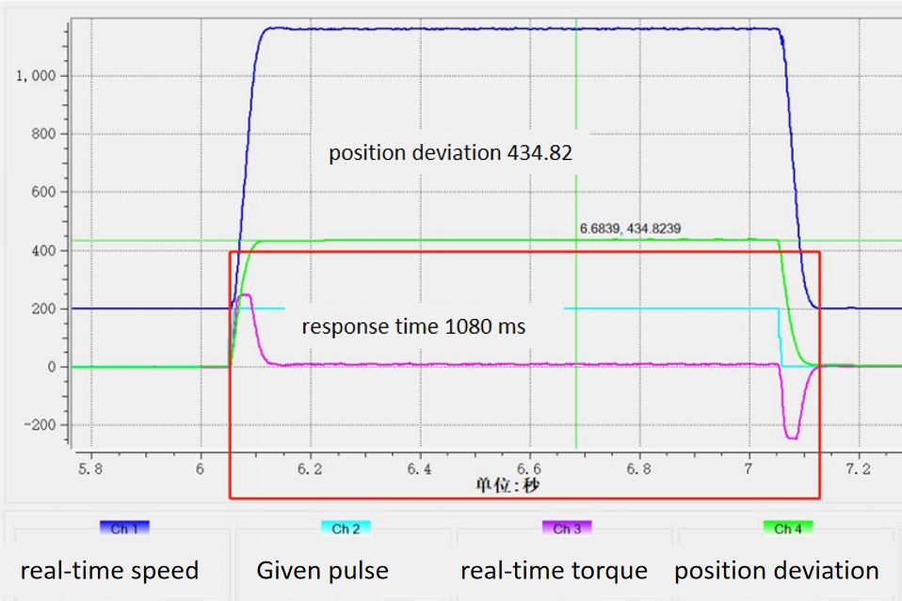
Manual Adjusting Parameter
——Position loop gain(P2-01)
Increasing the position loop gain can speed up the positioning time and reduce position deviation. However, too high a setting may lead to system instability and oscillation.

Slide 9
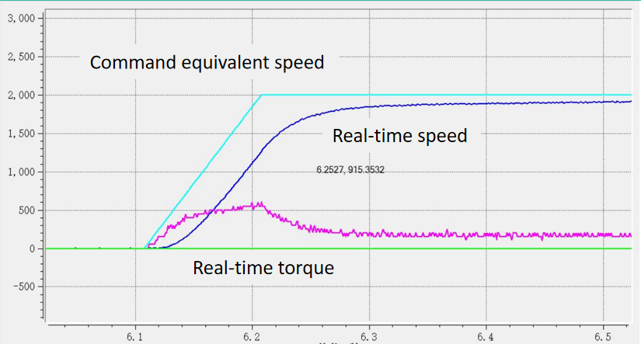
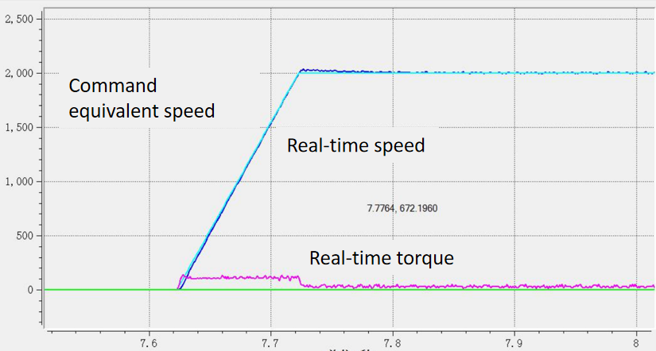
Manual Adjusting Parameter
——Speed loop gain(P2-02)
With no vibration in the mechanical system, the larger the speed loop gain setting, the better the responsiveness of the servo system and the better the speed following.

Slide 10
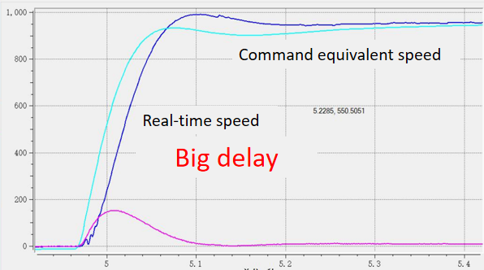
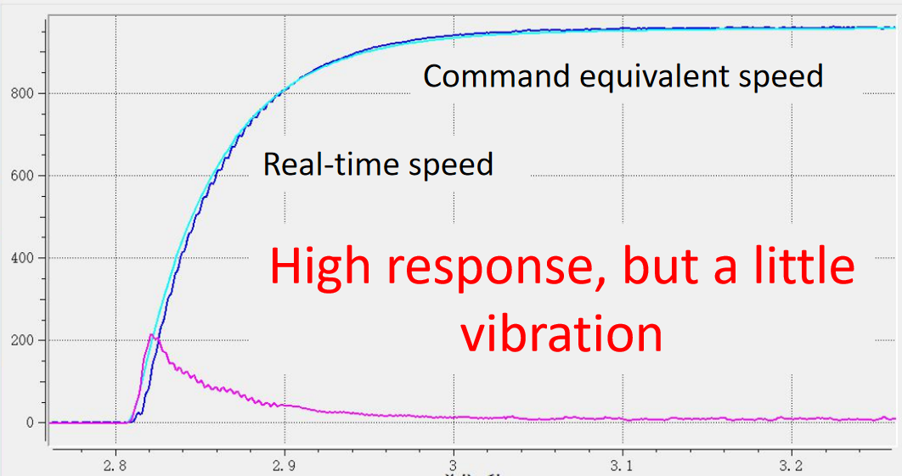
Manual Adjusting Parameter
——Speed loop gain(P2-02)
Small speed loop gain: Have a delayed start and slow stabilization.
Large speed loop gain: Starts quickly and stabilizes quickly, but too large causes system vibration.

Slide 11
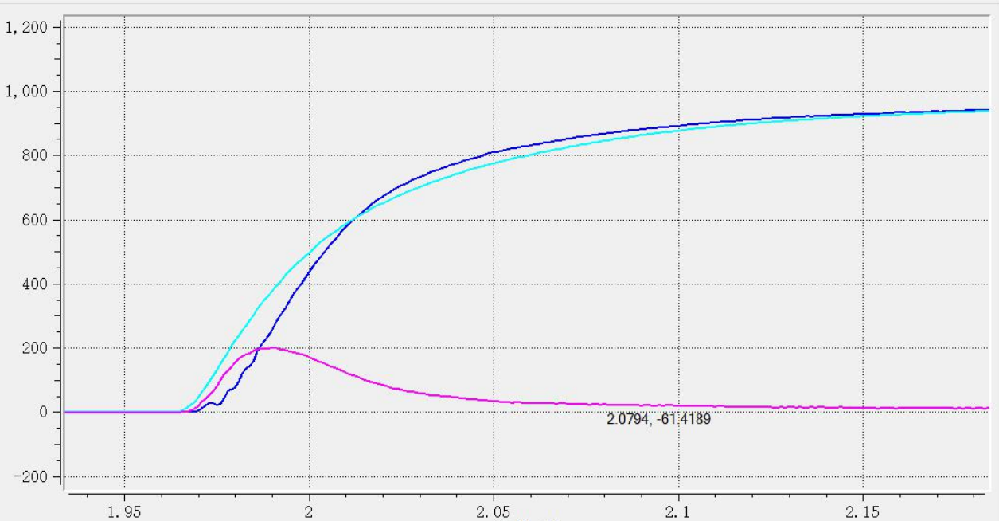
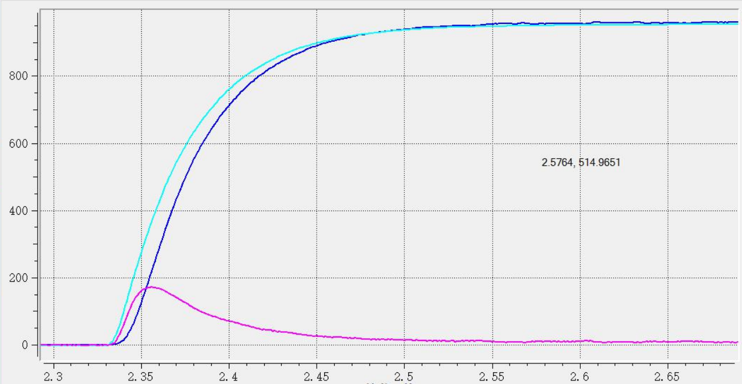
Manual Adjusting Parameter
——Speed loop integral time constant(P2-03)
Used to eliminate velocity loop deviations.
Small gain: improves speed response, too small will cause speed overshoot or vibration;
Large gain: resulting in speed loop bias.

Slide 12
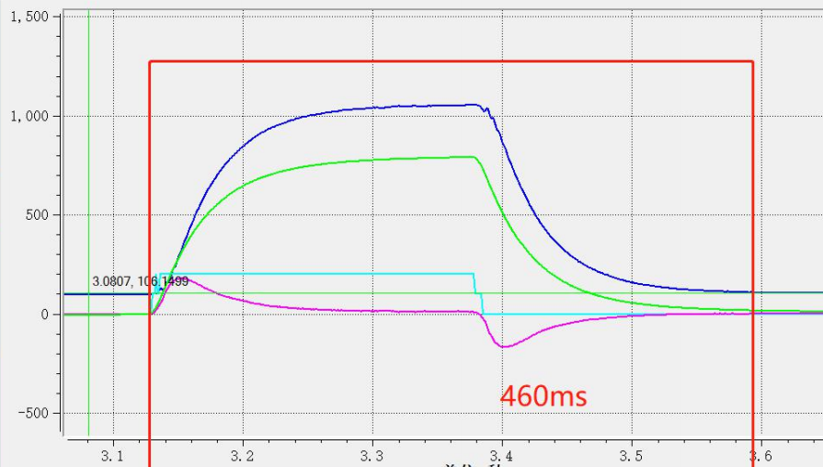
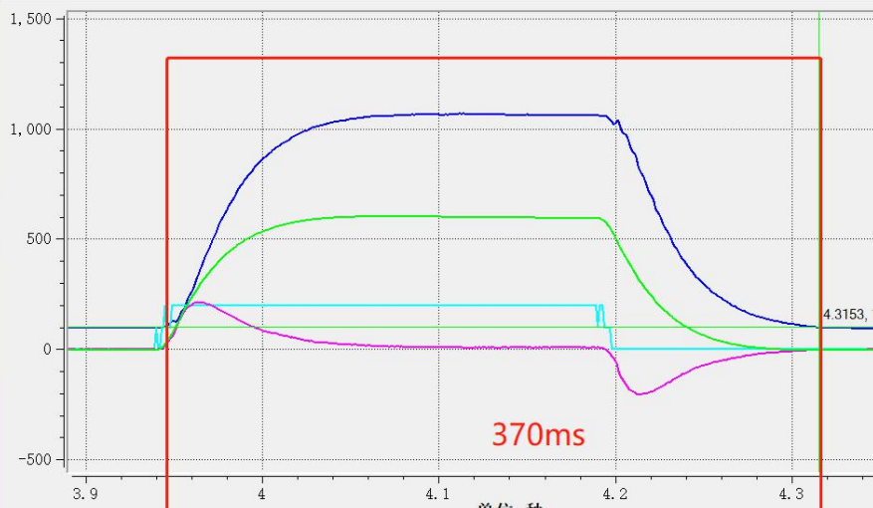
Manual Adjusting Parameter
——Speed feedforward gain(P2-09)
P2-09=0
P2-09=240
Used to eliminate errors.
Increase P2-09: further reduce position deviation and improve responsiveness.
Increase too much: lead to overshoot and vibration.

Slide 13
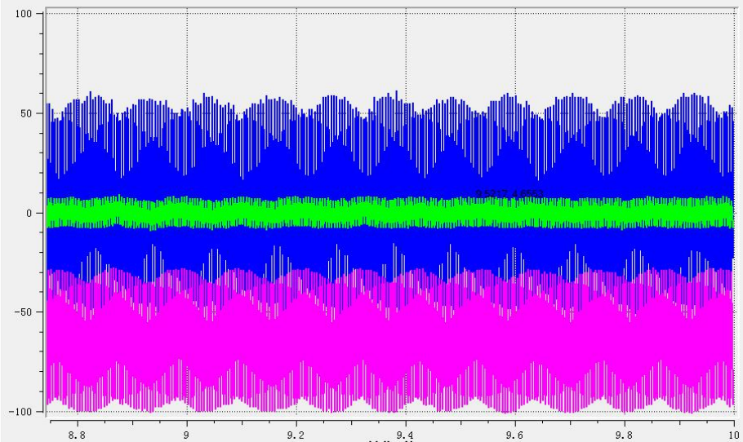
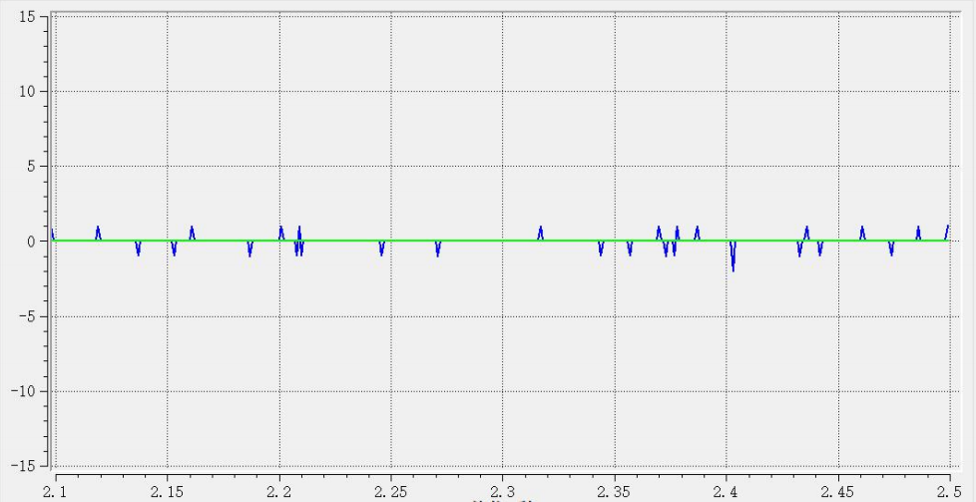
Manual Adjusting Parameter
——Torque filter time constant(P4-04)
Mechanical Resonancce
Normal
Used to suppress mechanical resonance.
The higher the value of this parameter, the stronger the suppression, but setting too large will cause vibration.

Slide 14
03
SECTION
General Commissioning Steps

Slide 15
General Commissioning Steps
——Vibration solution
S1: Confirm the source of vibration: whether it is generated by the motor itself or by external interference. (Off enable judgment)
S2: Set the appropriate load inertia ratio(p3-01).
S3: Reduce rigidity level (P03-02).
S4: Adjust torque filtering time constant(P04-04), from the minimum to large.
S5: Adjust the trap, set the trap frequency(P04-05), reduce the trap depth(P04-06) (100: no inhibition. 0: the strongest suppression)
S6: Reduce the input command frequency.
S7: Reduce speed feedforward gain value(P02-09).

Slide 16
General Commissioning Steps
——Position commissioning steps
S1: Set the appropriate load inertia ratio(P3-01)
S2: Set the speed loop integral time constant(P2-03) as a big value.
S3: Increase speed loop gain(P2-02) until mechanical vibration, take 80% current value.
S4: Reduce speed loop integral time constant(P2-03) until system begin to vibrate.
S5: Increase position loop gain(P2-01) until system begin to vibrate.
S6: If you need shorter positioning time and smaller position devition, you can increase the speed forward gain(P2-09), but should not exceed 80%

Slide 17
General Commissioning Steps
——Speed commissioning steps
S1: Set the appropriate load inertia ratio(P3-01)
S2: Set the speed loop integral time constant(P2-03) as a big value.
S3: Increase speed loop gain(P2-02) until mechanical vibration, take 80% current value.
S4: Reduce speed loop integral time constant(P2-03) until system begin to vibrate.

Slide 18
Thank You
www.we-con.com.cn
400 799 8189

