Slide 1
Servo Internal Multi-speed Command
By Jim

Slide 2
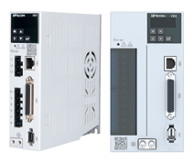
1
Multi-speed Command Introduction
2
DI Terminal Configuration
CONTENTS
3
Function Code Configuration
4
Application

Slide 3
01
SECTION
Multi-speed Command Introduction

Slide 4
Multi-segment Postion Mode Introduction
——Application
In this mixer, by adjusting the motor speed, the two materials can be evenly mixed according to the set ratio. Users can set different speed ratios first, and then switch in real time through the DI terminal to suitable the current material ratio.

Slide 5
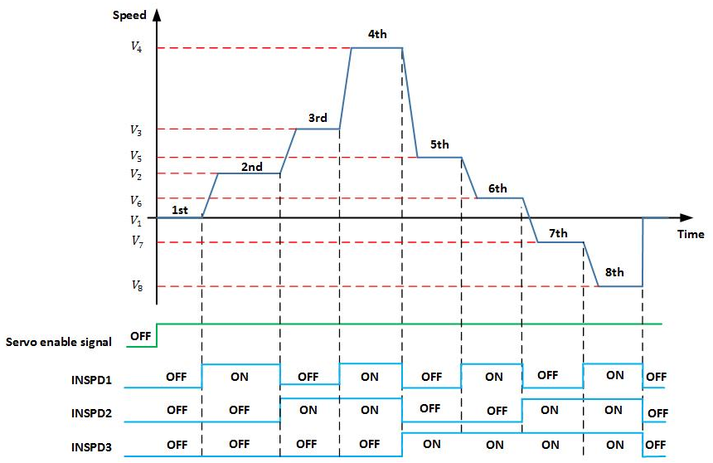
Multi-segment Postion Mode Introduction
——Principle
The corresponding speed can be selected through the DI port, max to 8 segments.

Slide 6
02
SECTION
DI Terminal Configuration

Slide 7
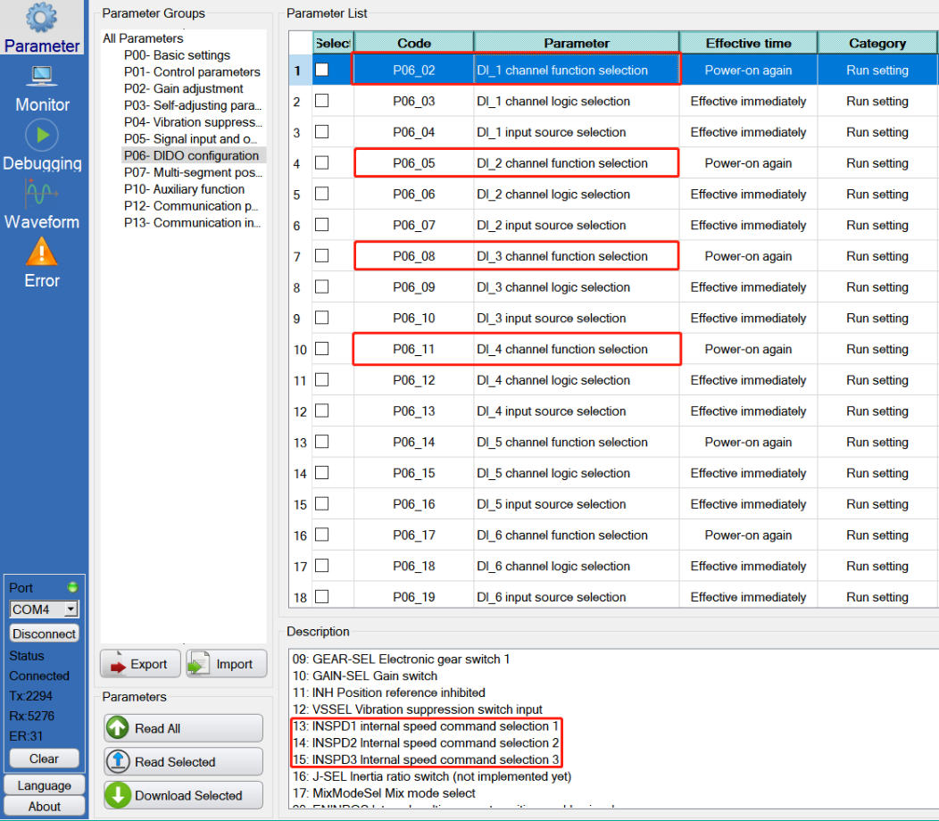
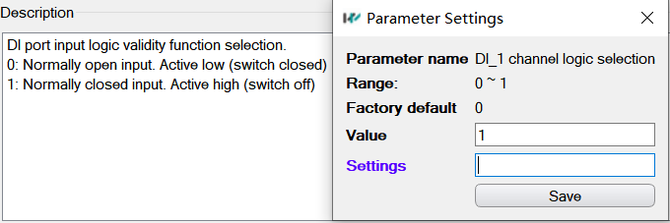
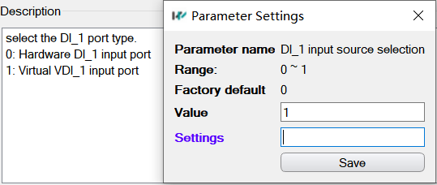
DI Terminal Configuration
1 DI to enable servo
3 DI to select speed
DI logic&input source selection

Slide 8
DI Terminal Configuration
Speed Table
15-INSPD3 | 14-INSPD2 | 13-INSPD1 | Speed Command
0 | 0 | 0 | P1-02
0 | 0 | 1 | P1-23
0 | 1 | 0 | P1-24
0 | 1 | 1 | P1-25
1 | 0 | 0 | P1-26
1 | 0 | 1 | P1-27
1 | 1 | 0 | P1-28
1 | 1 | 1 | P1-29

Slide 9
03
SECTION
Function Code Configuration

Slide 10
Function Code Configuration
Step 1: Set the running mode
P00-01=2 ——> Speed Control
Step 2: Select the speed command source
P01-01=0 ——> Internal speed command
Step 3: Set the speed command
P01-02=100 P01-23=-100
P01-24=200 P01-25=-200
P01-26=300 P01-27=-300
P01-28=400 P01-29=-400
Step 4: Set the DI terminal
P06-02=1 P06-03=1 P06-04=1
P06-05=13 P06-06=1 P06-07=1
P06-08=14 P06-09=1 P06-10=1
P07-03=15 P06-12=1 P06-13=1
Step 5: Change the DI input
P13-01=1(enable servo) P13-02=xx
P13-03=xx P13-04=xx
Speed Table
15-INSPD3 | 14-INSPD2 | 13-INSPD1 | Speed Command
0 | 0 | 0 | P1-02
0 | 0 | 1 | P1-23
0 | 1 | 0 | P1-24
0 | 1 | 1 | P1-25
1 | 0 | 0 | P1-26
1 | 0 | 1 | P1-27
1 | 1 | 0 | P1-28
1 | 1 | 1 | P1-29

Slide 11
04
SECTION
Application

Slide 12
Applition
Step 1: Set the running mode
P00-01=2 ——> Speed Control
Step 2: Select the speed command source
P01-01=0 ——> Internal speed command
Step 3: Set the speed command
P01-02=100 P01-23=-100
P01-24=200 P01-25=-200
P01-26=300 P01-27=-300
P01-28=400 P01-29=-400
Step 4: Set the DI terminal
P06-02=1 P06-03=1 P06-04=1
P06-05=13 P06-06=1 P06-07=1
P06-08=14 P06-09=1 P06-10=1
P07-03=15 P06-12=1 P06-13=1
Step 5: Change the DI input
P13-01=1(enable servo) P13-02=xx
P13-03=xx P13-04=xx
Speed Table
15-INSPD3 | 14-INSPD2 | 13-INSPD1 | Speed Command
0 | 0 | 0 | P1-02
0 | 0 | 1 | P1-23
0 | 1 | 0 | P1-24
0 | 1 | 1 | P1-25
1 | 0 | 0 | P1-26
1 | 0 | 1 | P1-27
1 | 1 | 0 | P1-28
1 | 1 | 1 | P1-29

Slide 13
Thank You
Form link: https://forms.gle/KrCTWwRXySUuBo4V8
www.we-con.com.cn
400 799 8189

