Slide 1
Servo Multi-segment Postion Mode
By Jim

Slide 2
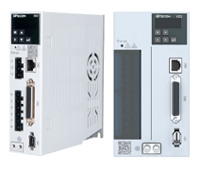
1
Multi-segment Postion Mode Introduction
2
Single Operation
CONTENTS
3
Cyclic Operation
4
DI Switching Operation
Form link: https://forms.gle/KrCTWwRXySUuBo4V8

Slide 3
01
SECTION
Multi-segment Postion Mode Introduction

Slide 4
Multi-segment Postion Mode Introduction
——Application
In this case, the product needs to be soaked in 4 different liquids，and each soaking time is different. One cycle needs to run 12 displacements. So we can use our multi-segment position mode to realize.

Slide 5
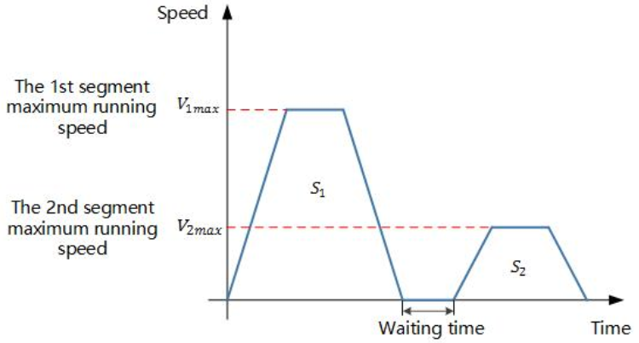
Multi-segment Postion Mode Introduction
——Principle
• Multi-segment position commands support 16-segment commands
• 3 operation modes: single operation, cyclic operation,
DI switching operation.
• Each segment consists of four parameter: displacement length, steady-state running speed, acceleration/deceleration time, and waiting time.
• Sequential execution(single operation and cyclic operation) can set the start segment number and end segment number.
• DI switching operation determines the number of running segments through 4 DI terminals.
1. VD2-xxxSA1G firmware: V1.10 and above
2. VD2F firmware: V1.00 and above
3. VD2 B-type incremental drive does not support

Slide 6
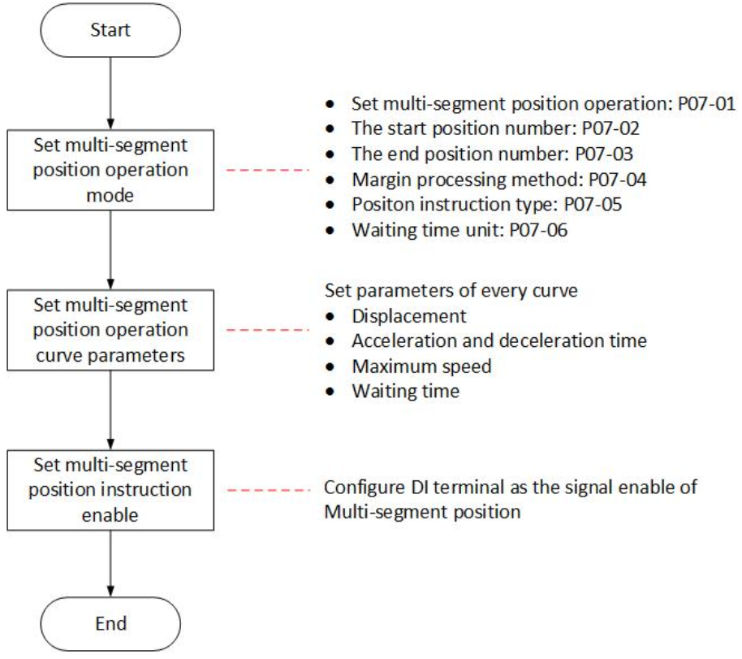
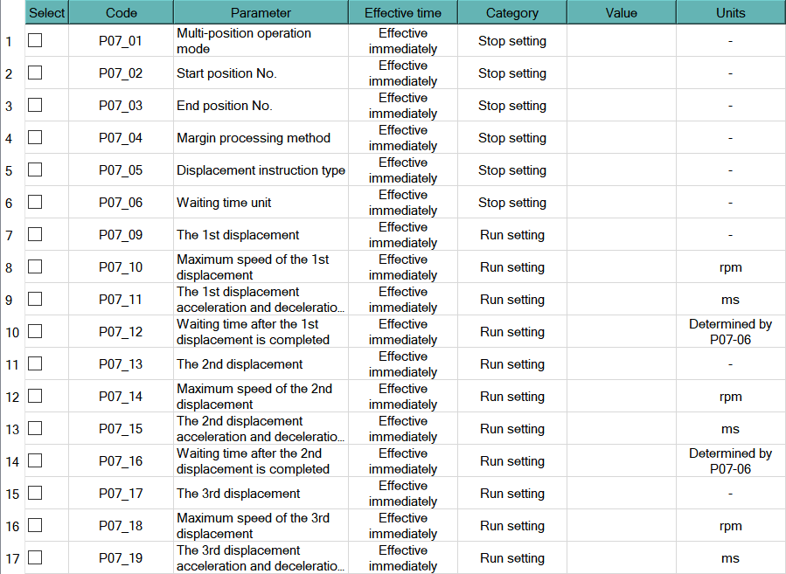
Multi-segment Postion Mode Introduction
——Parameter introduction
1.Main parameters are in group7
2.Need to select a DI terminal set to 20

Slide 7
02
SECTION
Single Operation

Slide 8
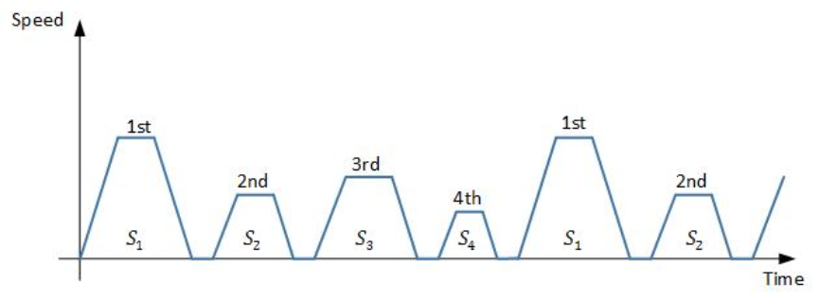
Single Operation
——Operation introduction
In this operation mode, the segment number is automatically increased and switched, and the servo drive only runs one round (from P07_02 to P07_03) and then stop.

Slide 9
Single Operation
——Parameter setting
Step 1: Set the running mode and the number of pulses per revolution:
P00-01=1, P00-16=10000
Step 2: Select the position command source:
P01-06=1
Step 3: Set the servo enable DI terminal and the internal multi-segment position enable DI terminal:
P06-02=1, P06-03=1, P06-04=1, P06-05=20, P06-06=1, P06-07=1
Step 4: Set multi-segment position operation mode:
P07-01=0, P07-02=1, P07-03=2 P07-04=0, P07-05=0, P07-06=0
Step 5: Set the parameters of 2 segments:
P07-09=50000, P07-10=60, P07-11=100, P07-12=2000, P07-13=-50000, P07-14=60, P07-15=100, P07-16=2000
Step 6: Turn on the servo enable and internal multi-segment position enable signals
P13-01=1、P13-02=1
Note: This example uses virtual VDI_1 to control the servo enable and virtual VDI_2 to control the internal multi-segment position enable signal.

Slide 10
03
SECTION
Cyclic Operation

Slide 11
Cyclic Operation
——Operation introduction
In this operation mode, the segment number is automatically increased and switched, and the servo drive will run continuously (from P07_02 to P07_03) until user disenable the servo.

Slide 12
Cyclic Operation
——Parameter setting
Step 1: Set the running mode and the number of pulses per revolution:
P00-01=1, P00-16=10000
Step 2: Select the position command source:
P01-06=1
Step 3: Set the servo enable DI terminal and the internal multi-segment position enable DI terminal:
P06-02=1, P06-03=1, P06-04=1, P06-05=20, P06-06=1, P06-07=1
Step 4: Set multi-segment position operation mode:
P07-01=1, P07-02=1, P07-03=2 P07-04=0, P07-05=0, P07-06=0
Step 5: Set the parameters of 2 segments:
P07-09=50000, P07-10=60, P07-11=100, P07-12=2000, P07-13=-50000, P07-14=60, P07-15=100, P07-16=2000
Step 6: Turn on the servo enable and internal multi-segment position enable signals
P13-01=1、P13-02=1
Note: The biggest difference from single operation is that user need to set P07-01 as 1

Slide 13
04
SECTION
DI Switching Operation

Slide 14
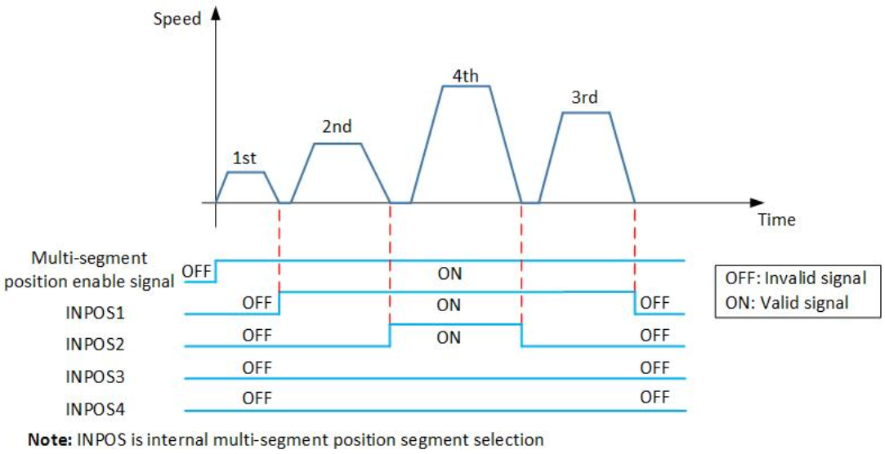
DI Switching Operation
——Operation introduction
In this operation mode, the segment number is determined by the DI terminal. If the current segment number does not change, the current segment will be run cyclically.
Note: If the segment number is changed during operation, the new segment number will be run after the current segment is completed.

Slide 15
DI Switching Operation
——Parameter setting
Step 1: Set the running mode and the number of pulses per revolution:
P00-01=1, P00-16=10000
Step 2: Select the position command source:
P01-06=1
Step 3: Set the servo enable DI terminal and the internal multi-segment position enable DI terminal:
P06-02=1, P06-03=1, P06-04=1, P06-05=20, P06-06=1, P06-07=1
Step 4: Set multi-segment position operation mode:
P07-01=1, P07-02=1, P07-03=2 P07-04=0, P07-05=0, P07-06=0
Step 5: Set the internal multi-segment position segment selection DI terminal:
P06-08=21, P06-09=1, P06-10=1, P06-11=22, P06-12=1, P06-13=1, P06-14=23, P06-15=1, P06-16=1, P06-17=24, P06-18=1, P06-19=1
Step 6: Set the parameters of 16 segments:
P07-09=50000, P07-10=60, P07-11=100, P07-12=2000, P07-13=-50000, P07-14=60, P07-15=100, P07-16=2000, other 14 segments use default setting.
Step 7: Turn on the servo enable and internal multi-segment position enable signals
P13-01=1、P13-02=1
Note: Set the DI terminals(21~24) according to the required number of segments

Slide 16
Thank You
Form link: https://forms.gle/KrCTWwRXySUuBo4V8
www.we-con.com.cn
400 799 8189

