Slide 1
Servo Torque Mode Training
By Jim

Slide 2
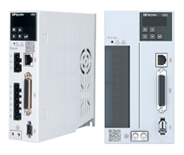
1
Introduction to Torque Mode
2
Internal Torque Command Input
CONTENTS
3
Analog Torque Command Input
4
Torque Control DI/DO Setting

Slide 3
01
SECTION
Introduction to Torque Mode

Slide 4
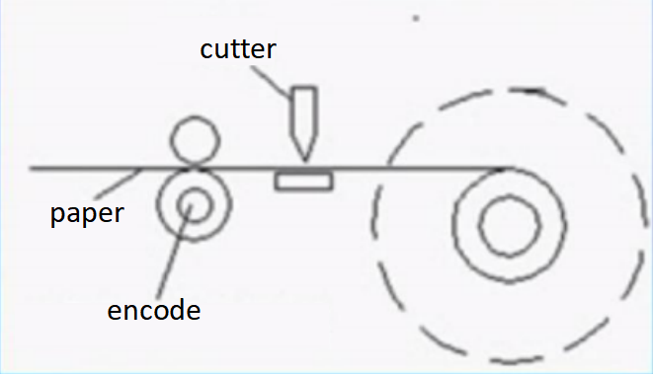
Introduction to Torque Mode
——Application
There is a rewinding system that requires the tension of the paper to remain unchanged during rewinding. When the rewinding reaches 100 meters, the motor stops and the cutter moves to cut the paper.

Slide 5
Introduction to Torque Mode
——Principle
Torque control mode is used in applications that require torque control, such as printing presses, winding machines, screw machines, and unwinding machines. The drive includes two command input modes: analog input and internal torque input.
The current of the servo motor has a linear relationship with the torque, so the control of the current can realize the control of the torque.

Slide 6
02
SECTION
Internal Torque Command Input

Slide 7
Internal Torque Command Input
——Parameters Setting

Slide 8
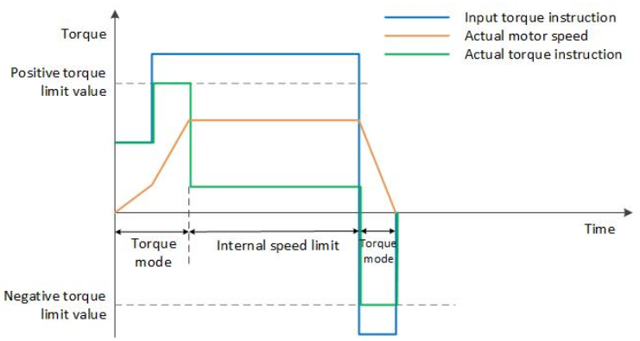
Internal Torque Command Input
——Parameters Setting
P1-09=0 ---> Source of speed limit in torque mode: internal forward and reverse rotation limit
P1-17=3000 ---> Forward rotation speed limit in torque mode
P1-18=3000 ---> Reverse speed limit in torque mode
P01-14=0 ---> Torque limit source: Internal value
P01-15=3000 ---> Forward torque limit
P01-16=3000 ---> Reverse torque limit
P01-19=1000 ---> Torque saturation timeout time (ms) ------- error37:Abnormal torque saturation
1. The larger the actual torque, the faster the acceleration and deceleration:
Servo set torque - motor feedback torque=ma
2. Torque limit and speed limit work at the same time.
3. Less torque while maintaining speed.

Slide 9
03
SECTION
Analog Torque Command Input

Slide 10
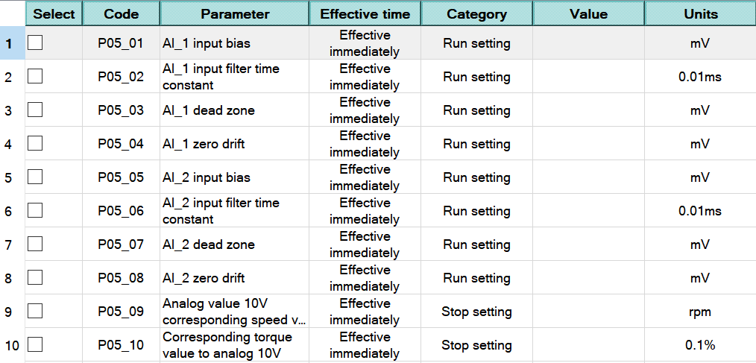
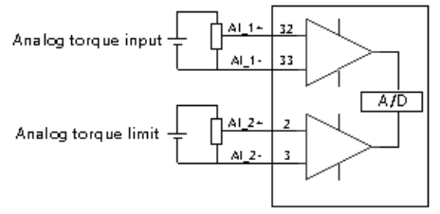
Analog Torque Command Input
——Parameters Setting
VD2A and VD2B series servo have 2 analog input channels:
AI_1 ---> analog torque input
AI_2 ---> analog torque limit.

Slide 11
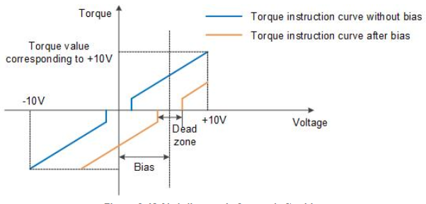
Analog Torque Command Input
——Parameters Setting
Zero drift: When analog input voltage is 0, the servo drive sample voltage value relative to the value of GND.
Bias: After zero drift correction, the corresponding analog input voltage when the sample voltage is 0.
Dead zone: It is the corresponding analog input voltage interval when the sample voltage is 0

Slide 12
04
SECTION
Torque Control DI/DO Setting

Slide 13
Torque Control DI/DO Setting
——Related Parameters
Torque mode related DI functions
Torque mode related DO functions
01-SON Servo enable
02-A-CLR fault and alarm clear
03-POT Forward drive prohibited
04-NOT Reverse drive prohibited
07-C-SIGN instruction inversion
08-E-STOP Emergency stop
129-RDY Servo ready
130-ALM fault signal
131-WARM warning signal
132-TGON Rotation Detection
138-T-COIN Torque reached
139-T-LIMIT Torque limiting

Slide 14
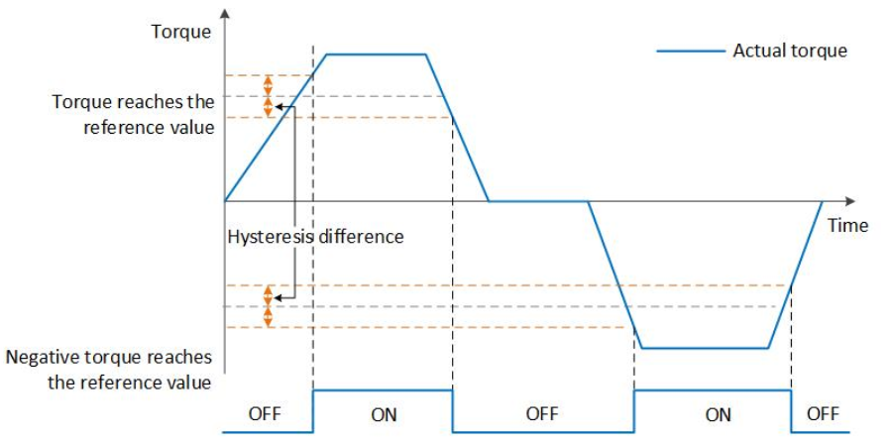
Torque Control DI/DO Setting
——T-COIN Torque Reached
If set P5-20 as 100%, set P5-21 as 10%, then:
1. When the actual torque > 100+10=110%, the torque arrival signal is output.
2. When the actual torque < 100-10=90%, the torque arrival signal is not output.
3. When the actual torque between 90% and 110%, the torque arrival signal does not change.

Slide 15
Thank You
Training material: https://forms.gle/5B3eLzyozYnUdtMW8
www.we-con.com.cn
400 799 8189

