Slide 1
V1.11 Version VD3E Series Upgrade
By Jim

Slide 2
V1.11 New Function
1. Add CST&PT
2. Torque speed limit & torque limit
3. DI display [60FD]
4. Position deviation alarm Er36 [6065]
5. P10-6 clear U0-56&6064 value
6. Communication tolerance [P0-32]
7. Waveform fault record
8. Quick stop 605A and pause stop 605D

Slide 3
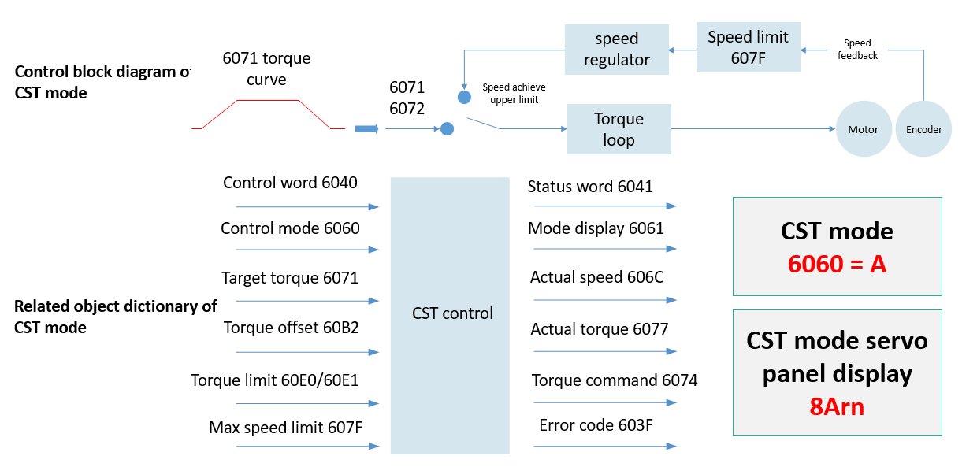
Add CST

Slide 4
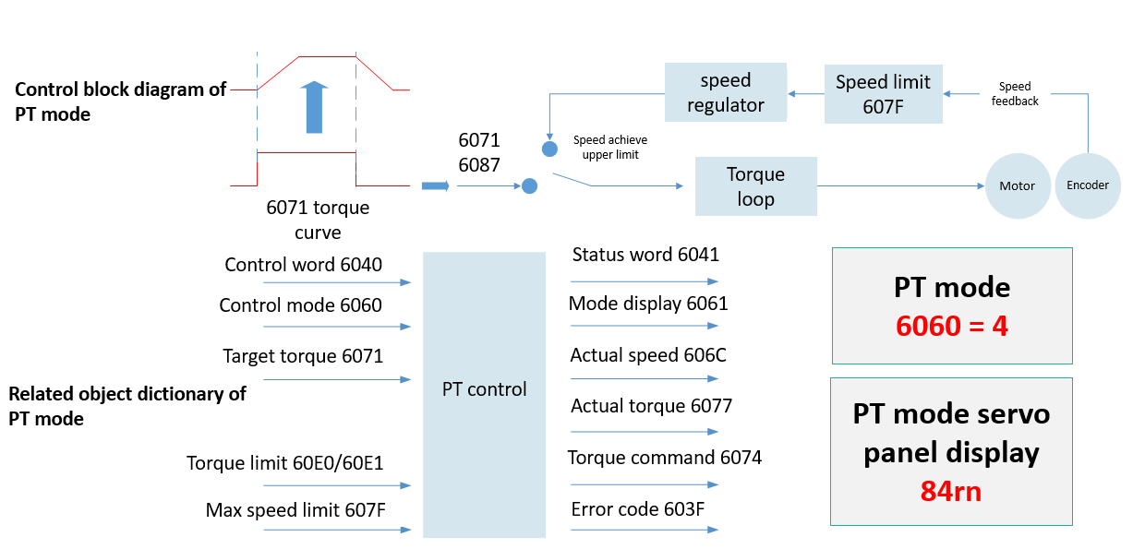
Add PT

Slide 5
Torque speed limit & torque limit
P1-9 Speed limit source in torque mode:
0: Internal forward and reverse limit (P1-17 and P1-18)
1: invalid
2: EtherCAT communication
Forward speed limit: 607F
Reverse speed limit: 607F
Note: Used in torque mode
P1-14 Torque limit source:
0: Internal value (P1-15 and P1-16)
1: invalid
2: EtherCAT communication designation.
Forward torque limit: minimum value between 6072 and 60E0
Reverse torque limit: minimum of 6072 and 60E1
607F
Maximum speed limit
Unit: unit/s
6072
Maximum torque
Unit: 0.1% rated torque
60E0/60E1
Forward/reverse torque limit
Unit: 0.1% rated torque

Slide 6
DI Display [60FD]
60FD
bit | Signal | illustrate
0 | NOT | 0: invalid 1: valid
1 | POT | 0: invalid 1: valid
2 | HOME_ORG | 0: invalid 1: valid
3 | reserve
4 | reserve
5 | reserve
6 | reserve
7 | reserve
8 | reserve
9 | reserve
10 | reserve
11 | reserve
12 | reserve
13 | reserve
14 | reserve
15 | reserve
16 | DI_1 | 0：DI_1 invalid 1:DI_1 valid
17 | DI_2 | 0：DI_2 invalid 1:DI_2 valid
18 | DI_3 | 0：DI_3 invalid 1:DI_3 valid
19 | DI_4 | 0：DI_4 invalid 1:DI_4 valid
20 | DI_5 | 0：DI_5 invalid 1:DI_5 valid
21 | DI_6 | 0：DI_6 invalid 1:DI_6 valid
22 | reserve
23 | reserve
24 | reserve
25 | reserve
26 | reserve
27 | reserve
28 | reserve
29 | reserve
30 | reserve
31 | reserve
60FD : display the status of DI
Attributes: read-only RO, mappable RPDO
60FD refresh rate: 1ms (Monitoring value refresh rate: 100ms)

Slide 7
Position deviation alarm Er36 [6065]
6062
position command
(read only)
6064
position feedback
(read only)
60F4
position deviation
(read only)
6065
position deviation range
(read and write)
60F4 = 6062- 6064
(command unit)
Er36
Position deviation alarm
|60F4| > 6065

Slide 8
P10-6 clear U0-56&6064 value
P10-6 = 1
U0-56
Multi-turn absolute value position = 0
6064 (command unit)
Motor feedback position=0
6063 (encoder unit)
Motor feedback position=0

Slide 9
Communication tolerance [P0-32]
Application scenarios:
1. Poor network cable quality
2. Network cable is too long
3. Large network interference
When the master station communicates with the driver, this parameter can be used to set the tolerance of PDO receiving event loss. When the accumulated errors exceed the set threshold, ER.09 will be reported.

Slide 10
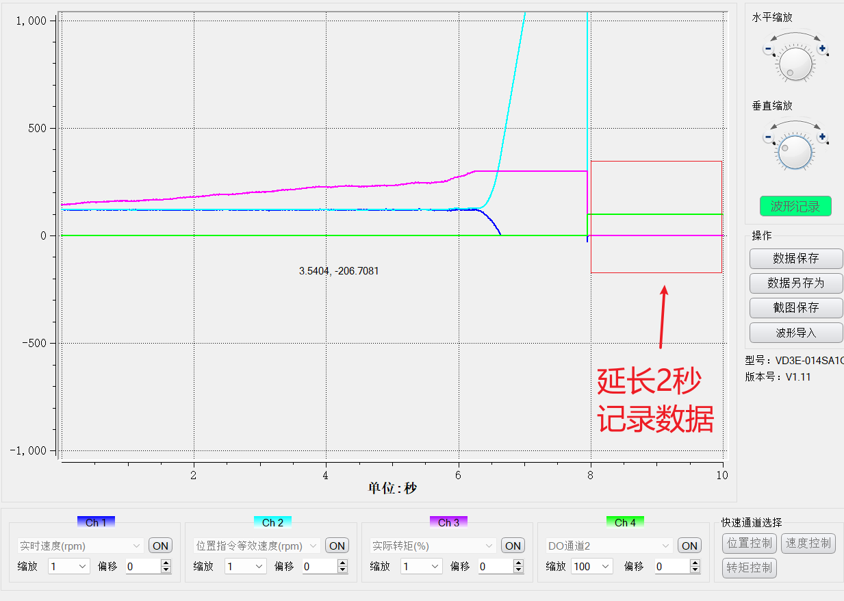
Waveform fault record
illustrate
When the old version drive have error, the waveform will stop recording immediately, while the new version can save an additional 2 seconds of data, used for troubleshooting.

Slide 11
Quick stop 605A and pause stop 605D
605A : Quick Stop Selection (Default 2)
0：free shutdown, change to nf status
1：Shut down at 6084 ramp (HM:609A), change to nf status
2：Shut down at 6085 ramp, change to nf status
3：Shut down at emergency torque, change to nf status
4：Not supported
5：Shutdown at 6084 ramp (HM:609A), change to qs status
6：Shut down at 6085 ramp, change to qs status
7: Stop with an emergency, change to qs status
605D : Pause Shutdown Selection (Default 1)
[CSP/PP/HM/CSV/PV mode:
0: Not held
1：Shutdown at 6084 ramp (HM:609A), change to rn status
2：Shut down at 6085 ramp, change to rn status
3：Shut down with emergency torque, change to rn status
[CST/PT Mode]
0: Not supported
1/2/3: Shutdown at 6087 ramp, change to rn status

Slide 12
THANK YOU

