Slide 1
Servo Software Training
By Jim

Slide 2
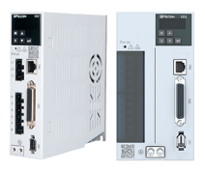
1
Servo communicate with PC
2
Software interface
3
Parameter setting
CONTENTS
Status monitoring and fault query
4
5
Inertia identification
6
Waveform window
Form link:https://forms.gle/6zuUynA9wgGLTfPs7

Slide 3
01
SECTION
Servo communicate with PC

Slide 4
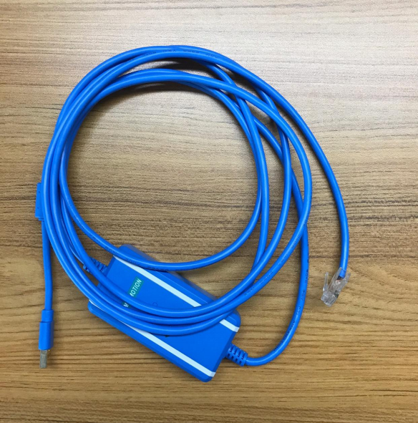
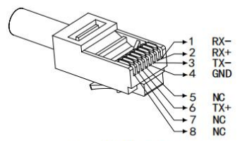
Servo communicate with PC
——How to make a communication line?
Wiring
RJ45
USB to RS422
The servo software communicates with the servo through modbus rs422. The user needs to buy the “usb to rs422” cable(Supports up to 115200 baud rate) and “RJ45”, to make the communication line . And pin wiring as shown, be careful not to get it wrong.

Slide 5
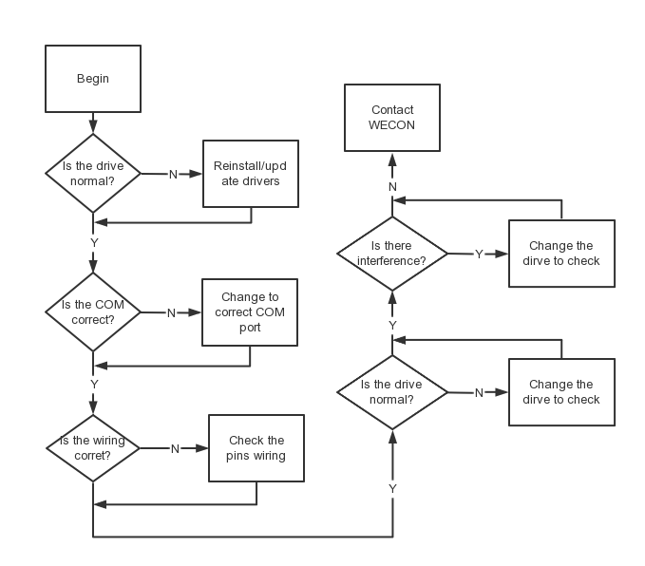
Servo communicate with PC
——How to troubleshoot communication problems?
Note: If the software displays an “unknown model” after successful communication, please download the latest software to communicate.

Slide 6
02
SECTION
Software interface

Slide 7
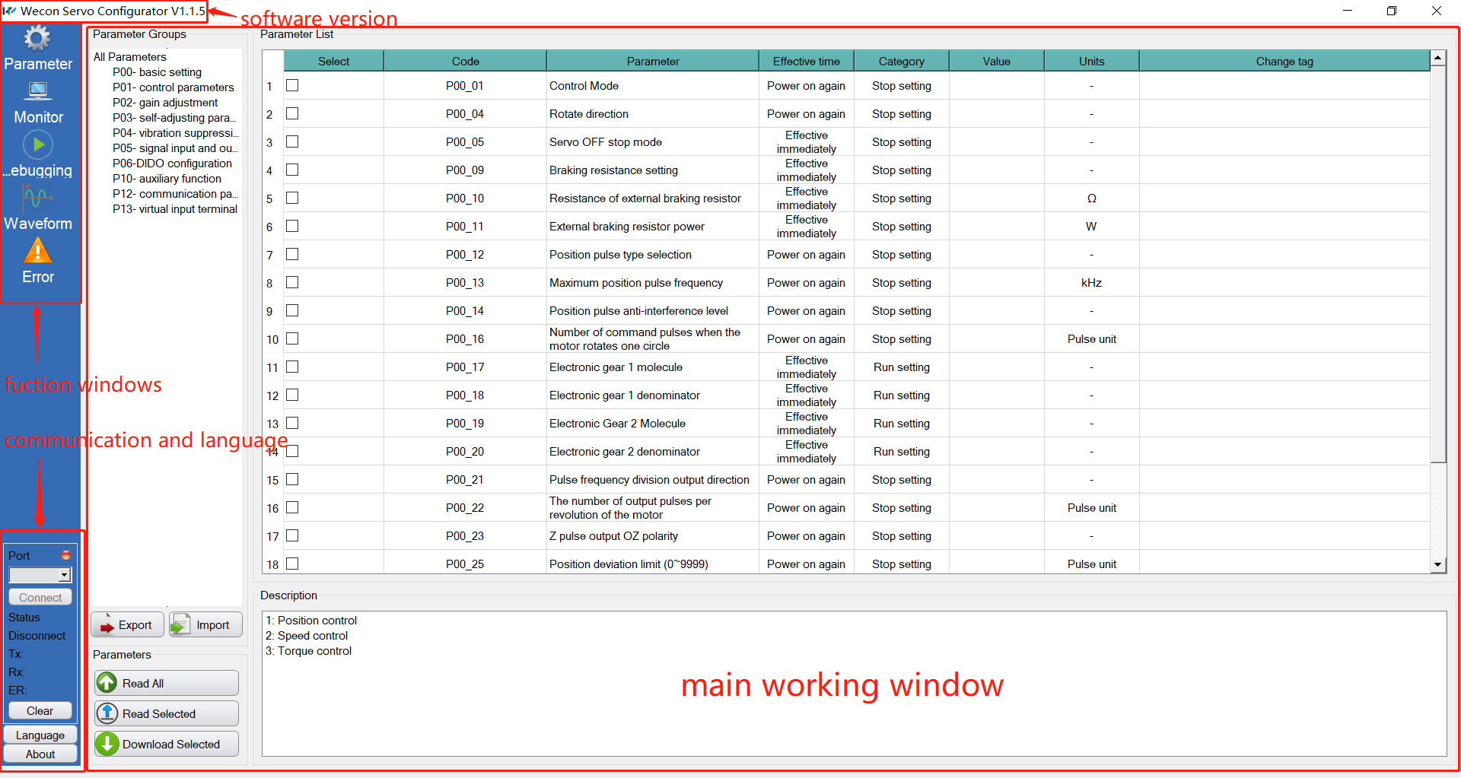
Software interface

Slide 8
03
SECTION
Parameter setting

Slide 9
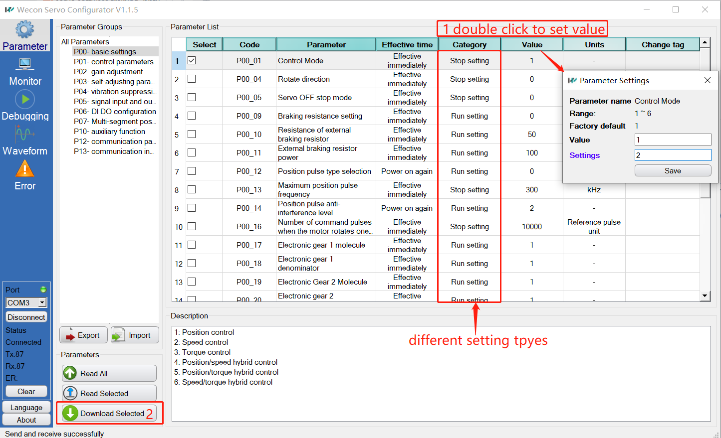
Parameter setting
——How to download the parameters?

Slide 10
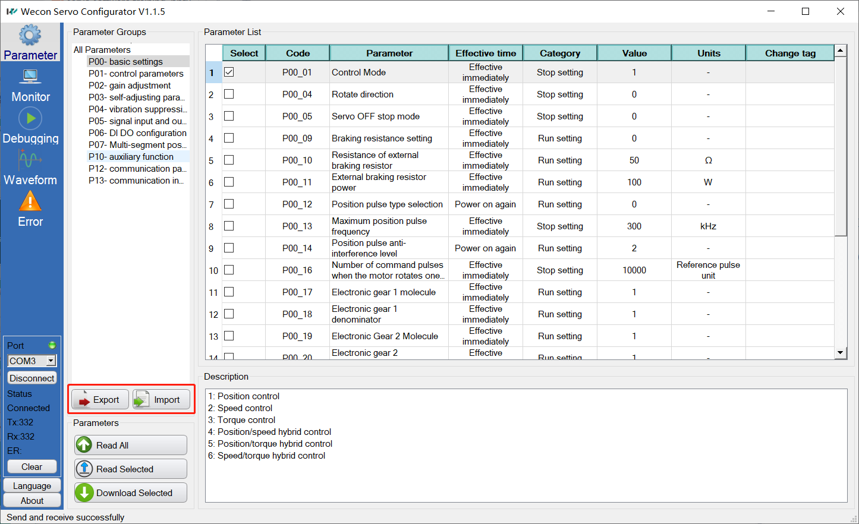
Parameter setting
——How to export/import parameters?
User can export parameters as backup before restoring to factory settings

Slide 11
04
SECTION
Status monitoring and fault query

Slide 12
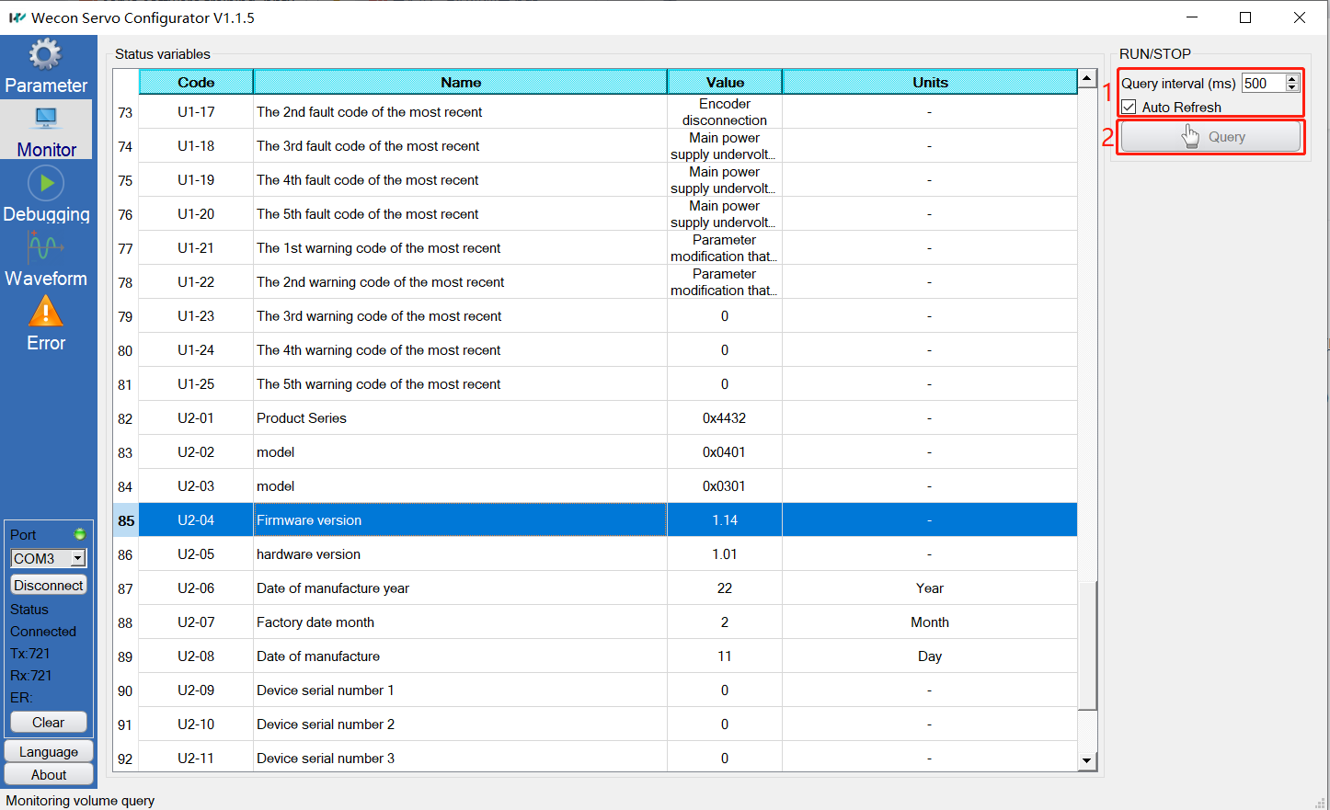
Status monitoring and fault query
——status monitoring
Parameter composition
1. operating status
2. historical fault
3. device version
Periodic automatic refresh or manual query

Slide 13
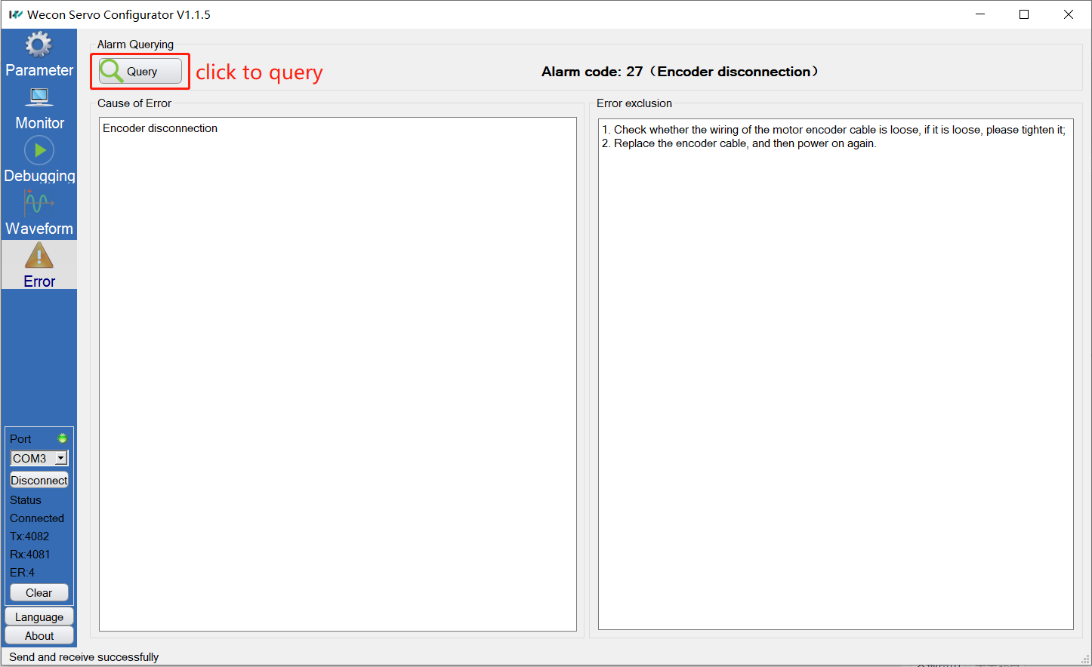
Status monitoring and fault query
——fault query
Parameter composition
1. alarm code
2. cause of error
3. error exclusion

Slide 14
05
SECTION
Inertia identification
The real-time and accuracy of inertia identification is one of the key factors for the servo control system to achieve high performance, which will affect the adjustment of gain parameters.

Slide 15
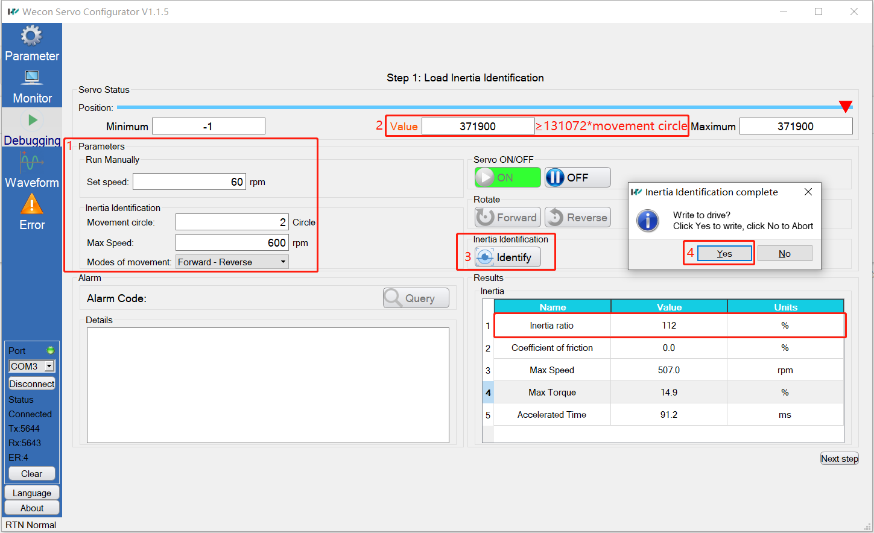
Inertia identification
——debug to indentificate

Slide 16
Inertia identification
——identification process
forward to forward

Slide 17
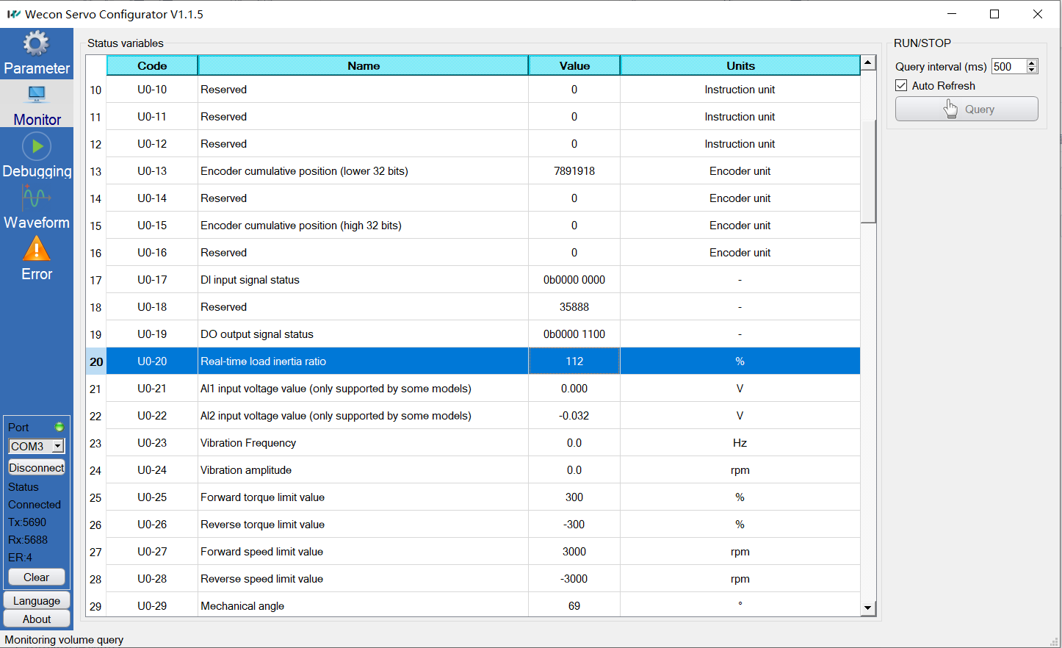
Inertia identification
——monitor to indentificate
Make the motor rotate a few turns at >300rpm

Slide 18
06
SECTION
Waveform window

Slide 19
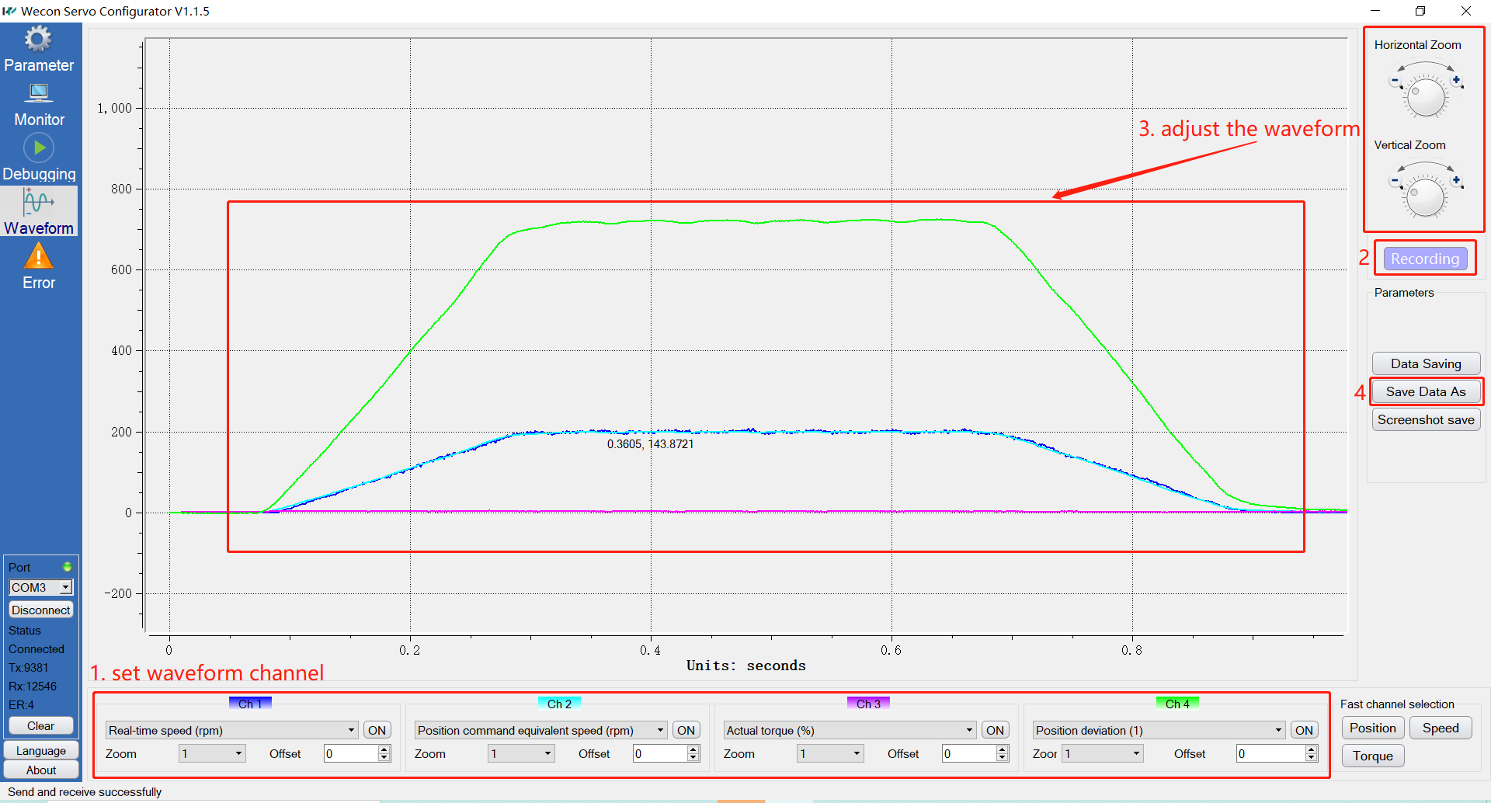
Waveform window
——get waveform

Slide 20
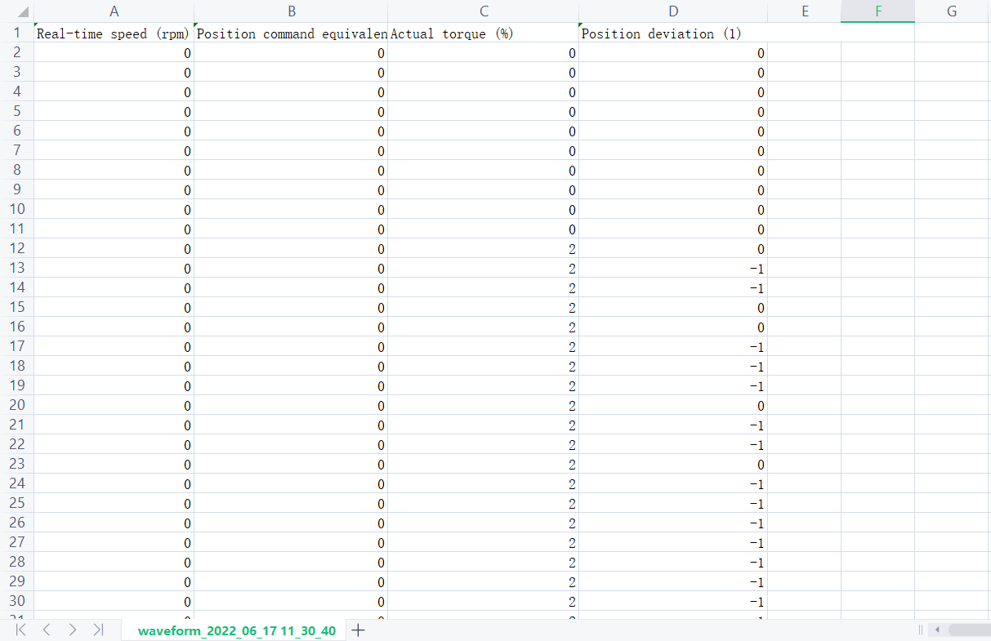
Waveform window
——waveform data

Slide 21
Thank You
www.we-con.com.cn
400 799 8189

